Slide 1
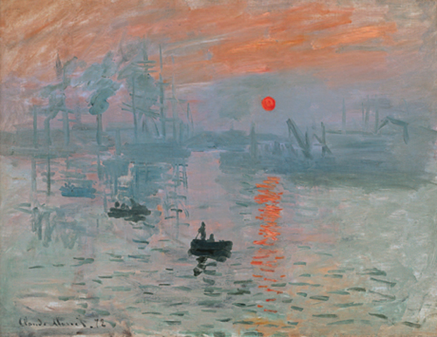
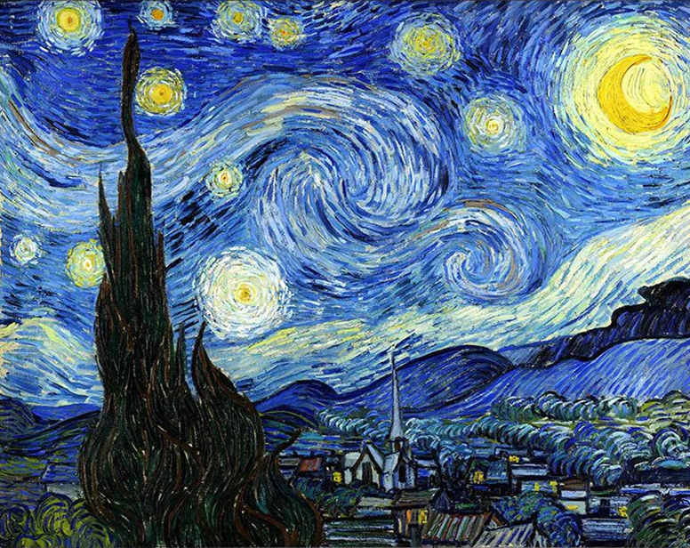
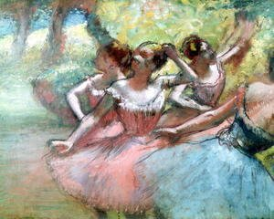
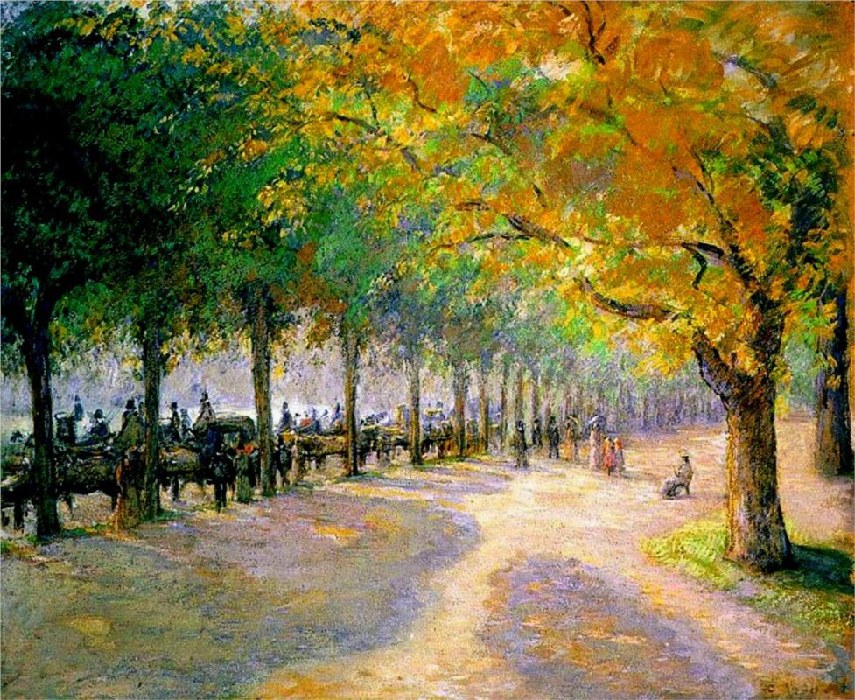
Impressionism
Claude Monet
Impressionism developed in France in the nineteenth century and is based on the practice of painting out of doors and spontaneously ‘on the spot’ rather than in a studio from sketches. Main impressionist paintings were landscapes and scenes of everyday life impressionist artists were not trying to paint a reflection of real life, but an ‘impression’ of what the person, light, atmosphere, object or landscape looked like to them. And that’s why they were called impressionists! They tried to capture the movement and life of what they saw and show it to us as if it were happening before our eyes.
Some of the main impressionist artists are Claude Monet, Berthe Morisot, Camille Pissarro, Alfred Sisley, Auguste Renoir, Mary Cassatt and Edgar Degas.
They often painted thickly and used quick (and quite messy) brush strokes.
Vincent Van Gogh
Edgar Degas
Camille Pissaro

Slide 2
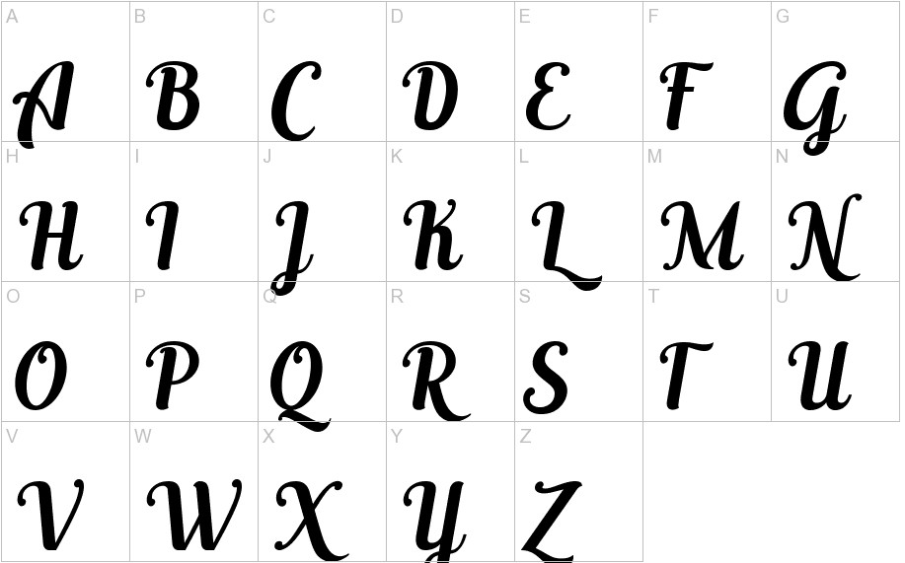
TASK- Create a page on Impressionism
Use the information and the imagery on the ‘Impressionism’ page to create a page in your sketchbook all about impressionism. You should make sure it is neat well presented, colourful and informative. Include;
A hand drawn title with a pencil then shaded with colour pencil saying ‘Impressionism’. Use a creative/ elegant font.
Written information (extract from the text) of what impressionism is and key facts about it.
Cut out and stick some of the images on to the page from the impressionism sheet
Sketch and colour some of the impressionism images.

