Slide 1
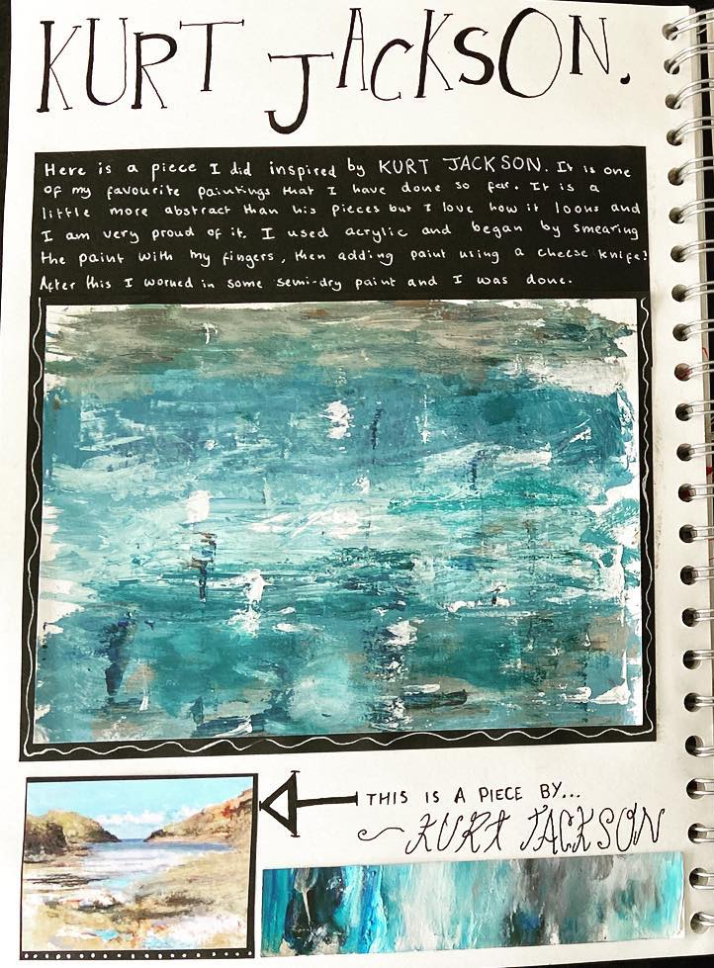
Kurt Jackson Artist research page and studies (AO1/AO2).
This is what you need to include on your Kurt Jackson artists pages...
Your artists pages should be at least a double page spread, if you're aiming for the higher grades then I would expect to see at least two double spread pages on the artist's pages ( 4 pages in total)!
A Title- ‘Kurt Jackson' in an interesting font
6-8 images of the artist’s work.
Annotation of images of his work- In your own words explain; what do you like/dislike about his paintings, colour pallet, form, composition etc.
Key information and facts about the artist. Talk about where he is from, what his art is about, how he creates it etc.
Presentation and layout is important! Reflect the artist and his style! Consider background and colour choices. (sponge painted background? Paint flicking? Textured surface with paint over the top?
1 small painted studies of Kurt Jackson’s work, using different textures.
1 Larger painted study . Annotation of your artists studies. Explaining if you are pleased with them and why/ why not? What have you learned?
Analysis of your favourite painting by Jackson

Slide 3
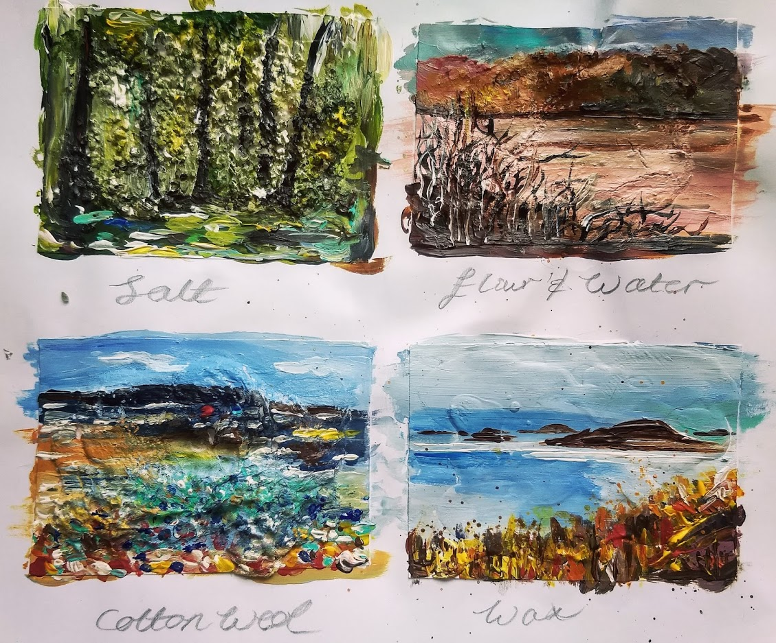
Creating an artist's page on Kurt Jackson and texture samples!
Begin your samples by putting down the texture that you want to explore first. Glue this down
Different textures are; cotton wool, salt, flour and water paste, cardboard, crushed leaves, tea bag paper, etc.
Once your texture is glued down start applying the colours with acrylic over the top. Do this with a range of different sized brushes/ sponges/ pallet knives
You can use different mark making techniques with your acrylics. You can scratch in to the paint with materials like cocktail sticks, splat the paint, flick it, stipple with it etc.

Slide 4
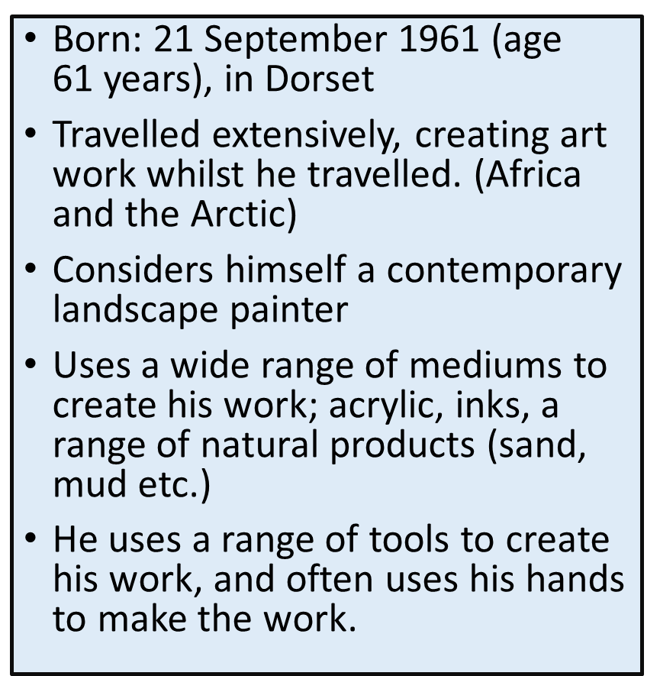
Annotations talking about Kurt Jackson and his work
Use the information to the left to form a paragraph explaining who Kurt Jackson is and what his work is about. Use full sentences to make the information flow.
Select a painting of Kurt Jackson’s to describe in detail using Art elements to help you.
Discuss what the painting is of
How it makes you feel
The atmosphere of the painting (cold, windy, loud, light etc. focus on the senses)
Describe the colours used in the painting
Describe the Texture, the detail and mark making in the painting
Describe the composition (the layout of where things are)

Slide 5
Annotating your work on Kurt Jackson. Model answer.
WHAT- This is my mixed media and acrylic artist’s study of Kurt Jacksons Seascape painting.
HOW-
To create this study I have used a range of different texture materials and different colours of acrylic paint. I started by selecting different Textures for each part of the painting such as bubble wrap for the top of the waves and flour and water for the sky. I had to mix the flour and water to form a paste first which I then applied to the areas where I wanted the Texture. Once I had put down all the Textures I started to mix the correct colours needed for the painting, I used different shades of blue with white, black and hints of purple to achieve different tones in the sea. I applied the paint with different tools like a thick brush and a pallet knife.
INSPIRATION-
I was inspired by Kurt Jackson’s seascapes because I feel they are very atmospheric, it’s as though you are in the landscape with the way he uses the paint and texture to capture the feeling of the surrounding elements. That is why I chose to select this painting to form a study of.
SUCCESS??-
I am very pleased with the final outcome of my painting as I think I selected good materials that work for the textures in the painting. Furthermore I feel I have developed my colour mixing skills and feel more confident acrylic painting now as a result.
WHAT WOULD YOU DO DIFFERENTLY?- If I were to create the piece again I think I could be more adventurous with the range of textures I am using, perhaps using more of them combined. I could have also used more mark making or paint splatting to get a greater range of detail in the work.

