Slide 1
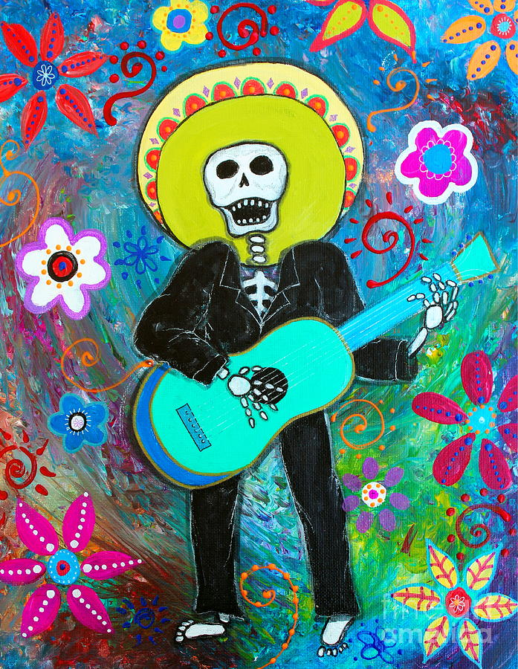
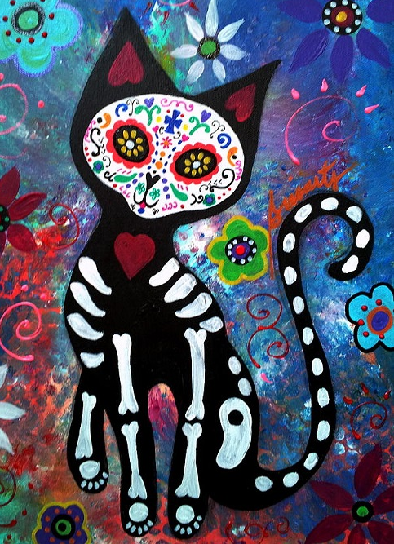
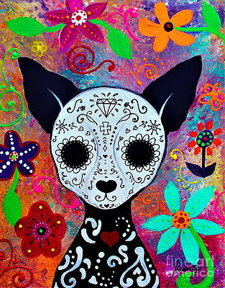
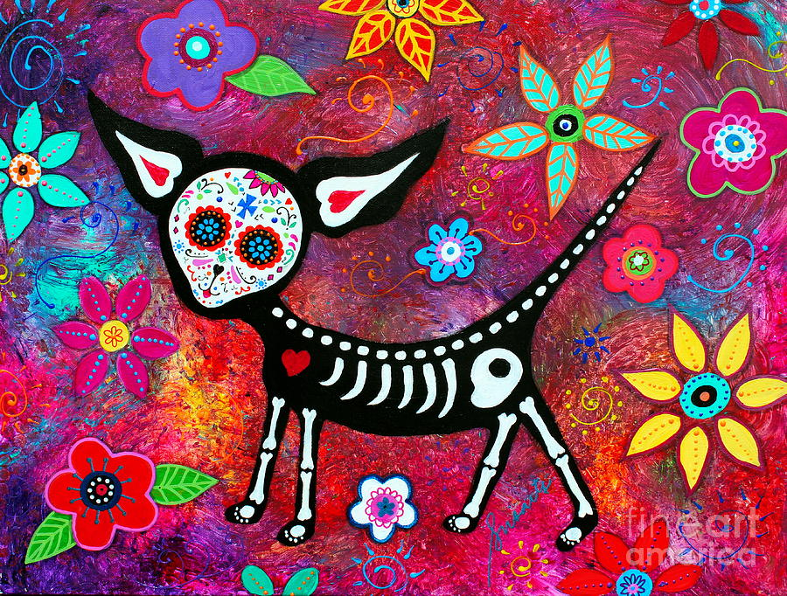
Pristine Cartera Turkus
An American artist
She has a degree in Fine Art.
Her Art work is bright and colourful, designed to make people smile!
“Painting is my life. It is a calling that is as strong and real as the beating of my heart. I have sold my art all over the world.”
Her work has Hispanic/ Mexican themes, especially with the use of vibrant colours.

Slide 2
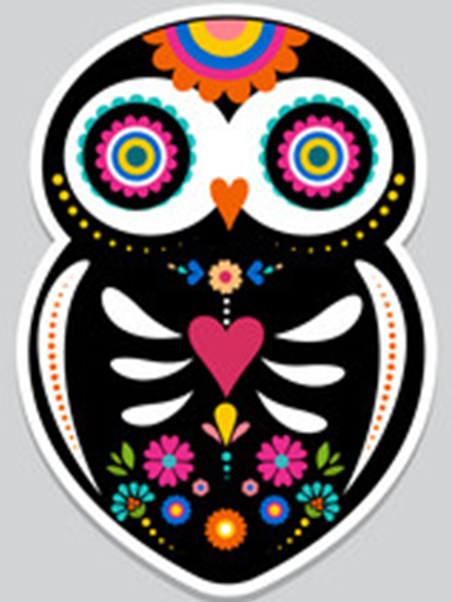
Your task… creating day of the dead creatures.
On A4 paper have a go at drawing some of these day of the dead creatures!
-begin by sketching the basic shapes with a pencil, then add the bones and the details like flowers and patterns inside the shapes.
Once you have sketched the basic outline you then need to add colour to the animals using colour pencils. Their should be black areas surrounding the bones and then bold colours for flowers and patterns!
Try and fill your A4 paper with as many different creatures as possible…

