Slide 1
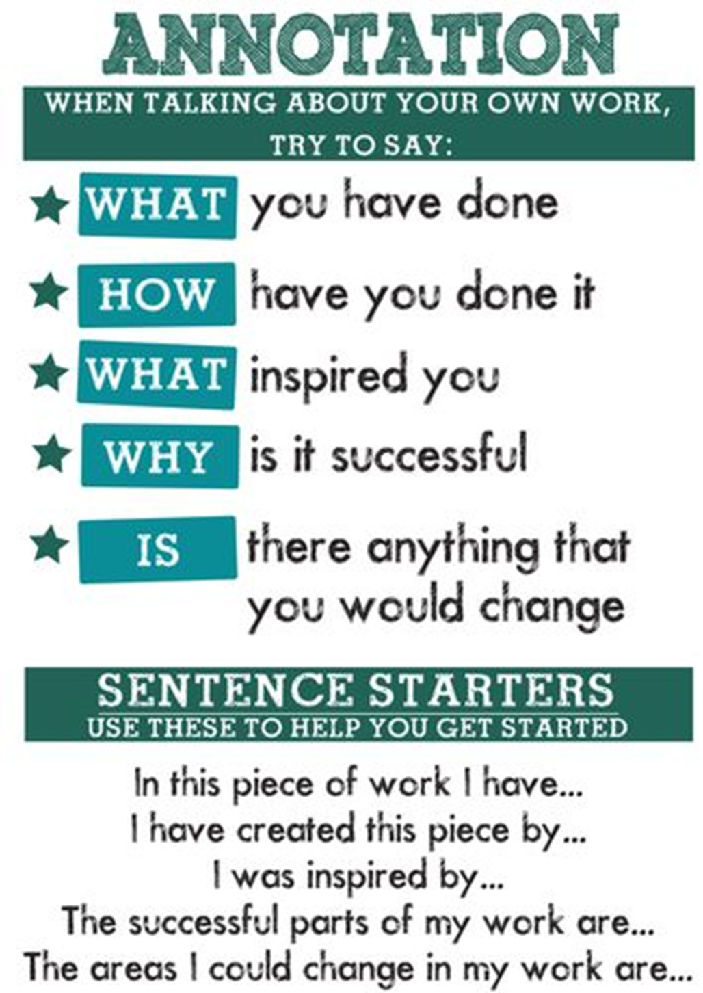
Coursework annotation task.
Spend an hour going through your sketchbook and completing any outstanding tasks that you need to complete, with a specific focus on any annotations that are incomplete.
When annotating sketchbook work you need to be evaluating any pieces of art you have made in your book. You need to explain what it is. (A painting, drawing, a print etc.?)
You then need to describe how you made it and talk about what material and process you used. For example; I used acrylic blending and I achieved this by pushing two wet colours together gently.
If the piece of artwork you are annotating was in the style of an artist then explain that you are using inspiration from that artist. Say what it is you have taken from them; colour pallet? texture? Marks? Etc.
Finally, you will need to say how successful you feel your piece of artwork is. Explain whether or not you are pleased and why or why not.
E.G: I am very pleased with my acrylic painting study of the garden because I feel I have blended the colours well and formed good texture.

