Slide 1
Design a package to hold a child’s toy
Look at the Resource sheet on the next slide for inspiration
Choose a child's toy that you may have at home or find one on the internet.
Think about the shape that the package needs to be to do the following:
Contain – Enclose the child's toy
Protect- Protect the toy so that it does not become damaged
Advertise- Sell the product so that if it was on a shelf in a shop a child or parent would want to buy it.
Inform- Tell the person who buys it how the toy works or tells them about materials it is made from.

Slide 2
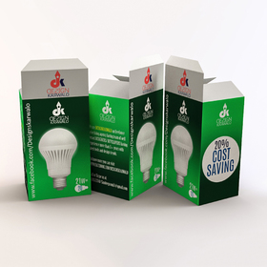
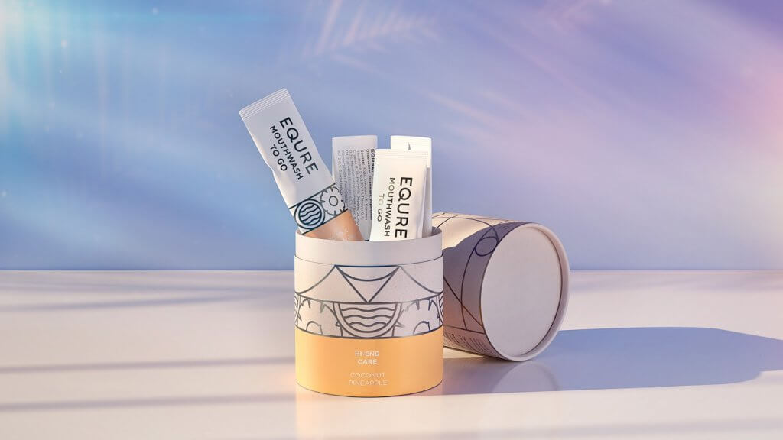
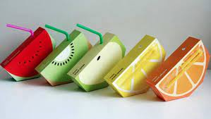

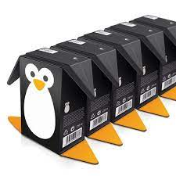

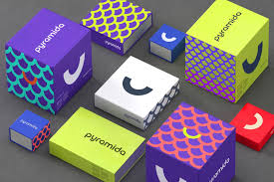
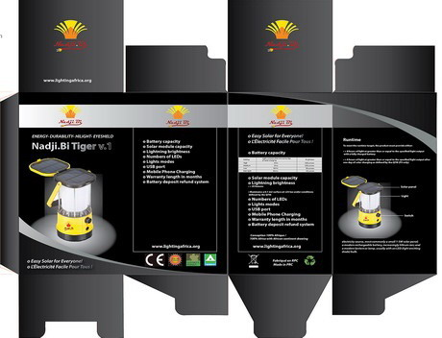
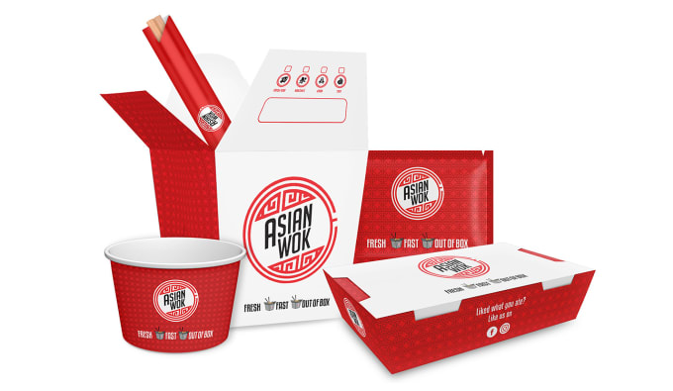
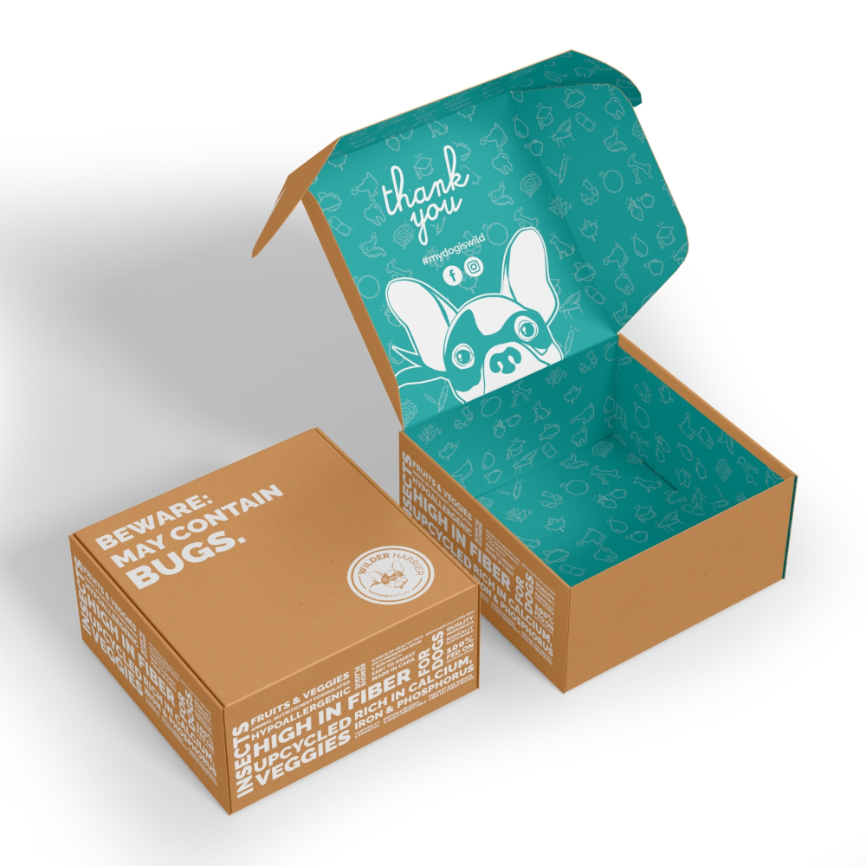
Packaging resource sheet

Slide 3
Mini Project Tasks
Draw out a design for your package (in 3D if possible). You can print off and use the isometric grid paper to help you.
Draw out the NET or DEVELOPMENT OF THE PACKAGE (the shape of all of the panels if they were laid out flat
Add images and text onto each of the panels of the NET. Draw and write them carefully and neatly
Add colour to your NET design
Cut out the NET and fold it up into the 3D shape of your package.
Photograph it and email me an image of the package.

Slide 4
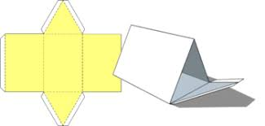
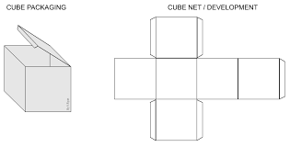
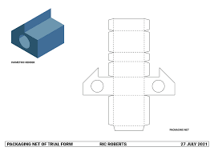
Example Package NETS

Slide 5
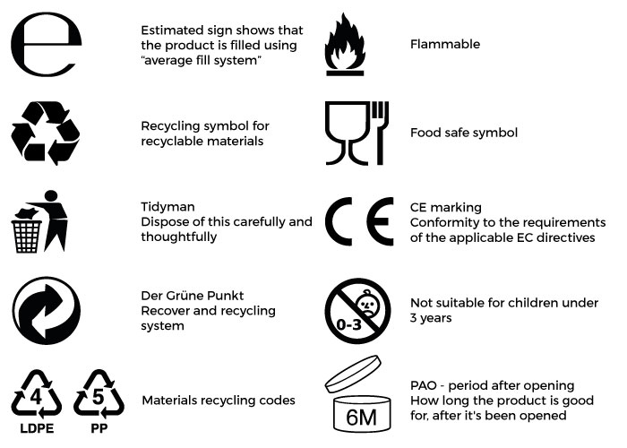
Before producing your package designs Think about what needs to be put on the outside of it.
A picture of what is inside
The brand name and name of the product
Information about what the product does
Information about key features of the design
Target market age group information
A barcode
A price

