Slide 1
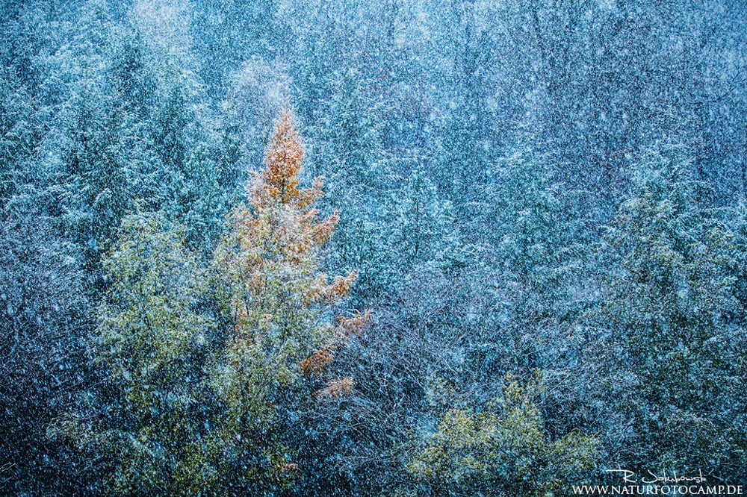
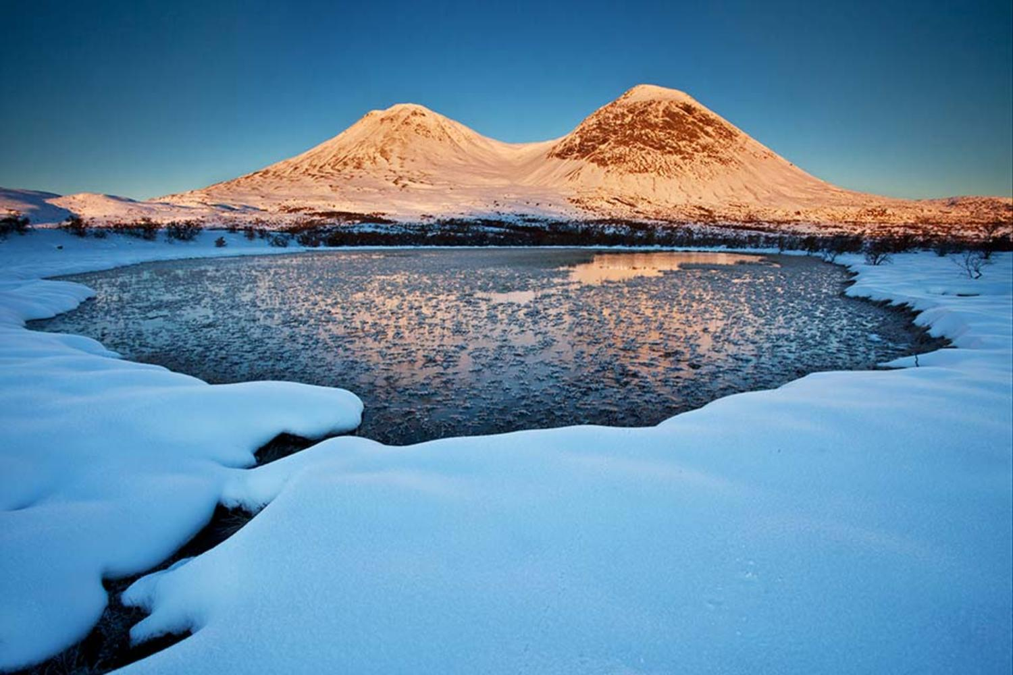
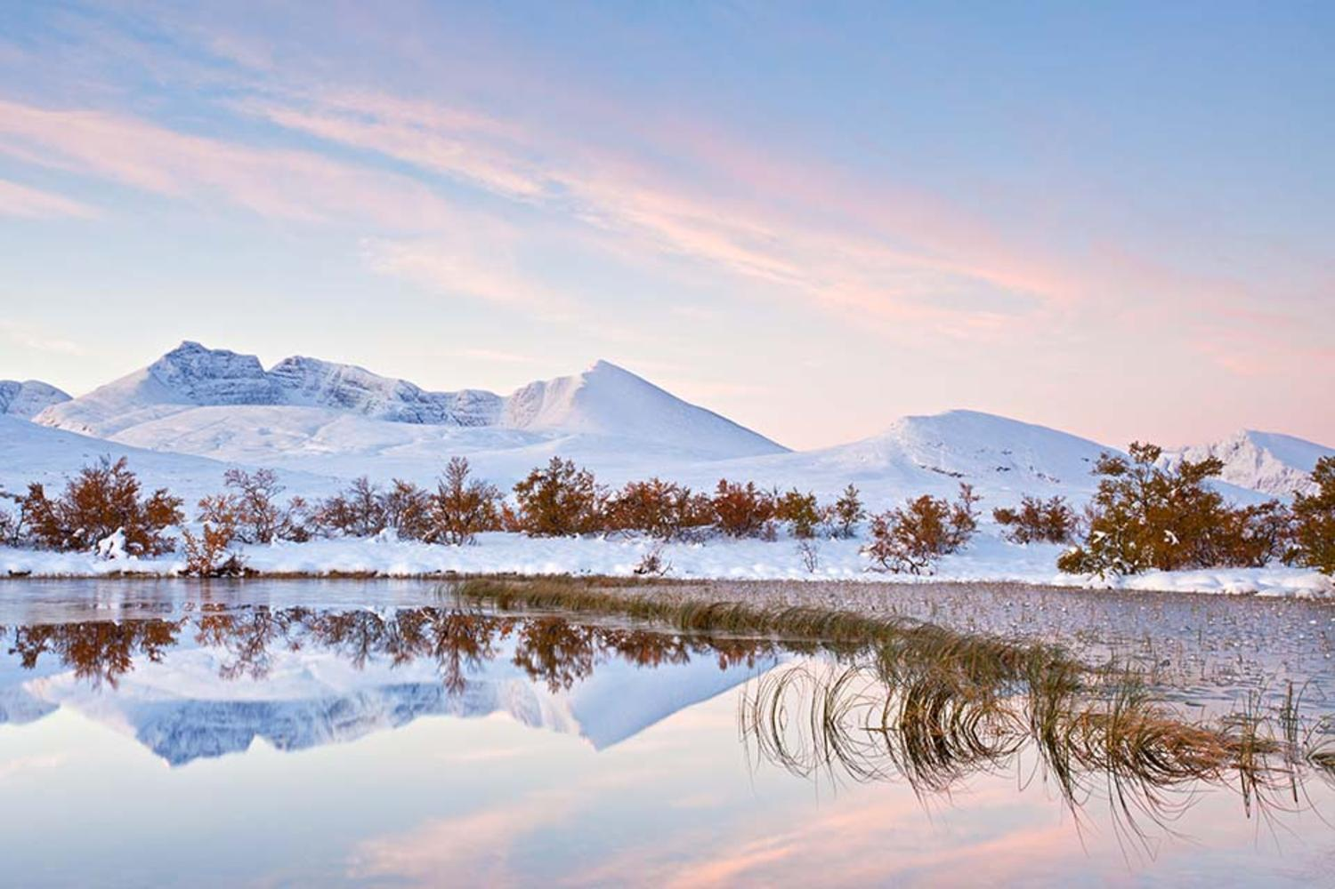
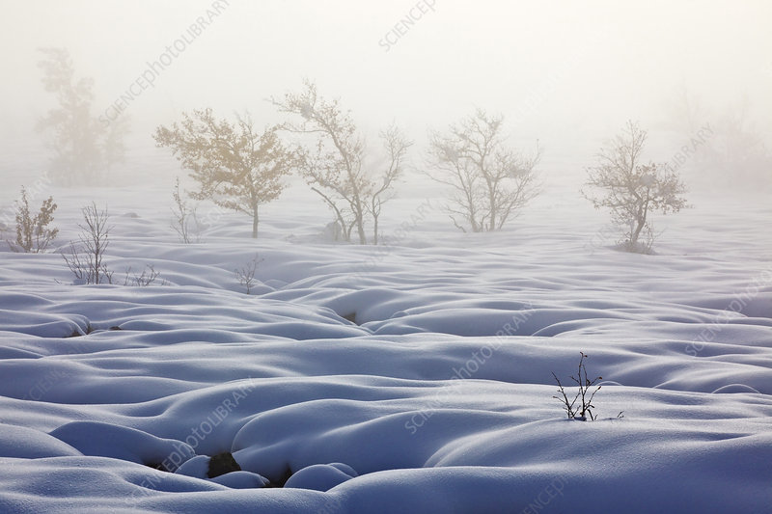
Radomir Jakubowski
Born in Germany in 1987
At 18, the self-taught shooter became one of the youngest members of Germany's association of nature photographers
has had his images published in magazines and books across the world.
Has won wildlife photographer of the year award multiple times!!

Slide 2
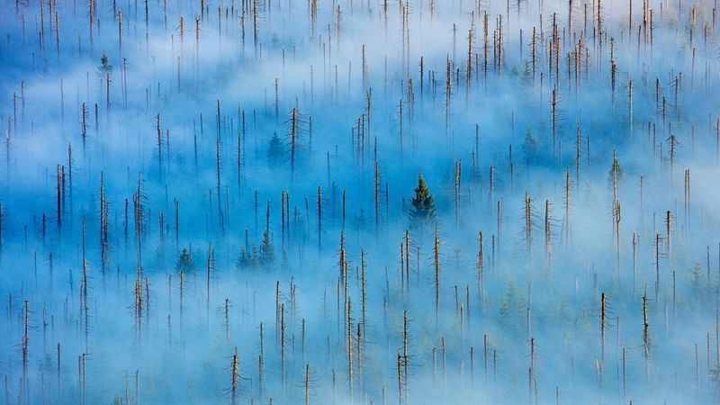
Radomir Jakubowski inspired photography task
Take inspiration from Jakubowki and use the cold winter weather to capture the beauty of the season.
When taking your photos try and link it to Jakubowski by doing some of the following;
-using a wide angle to capture a large part of a landscape
-having a focus point that the eye is drawn to instantly
-Focusing on a colour pallet of pink and blue hues (frosted colours)
-A picture that gives a feeling of calm and tranquillity.
Take at least ten different photographs and email them to me. My email: Edeegan@st-maryshigh.Hereford.sch.uk
Challenge; select your favourite photograph and produce an Art study of it at least A5 in size in a material of your choice.

