Slide 1
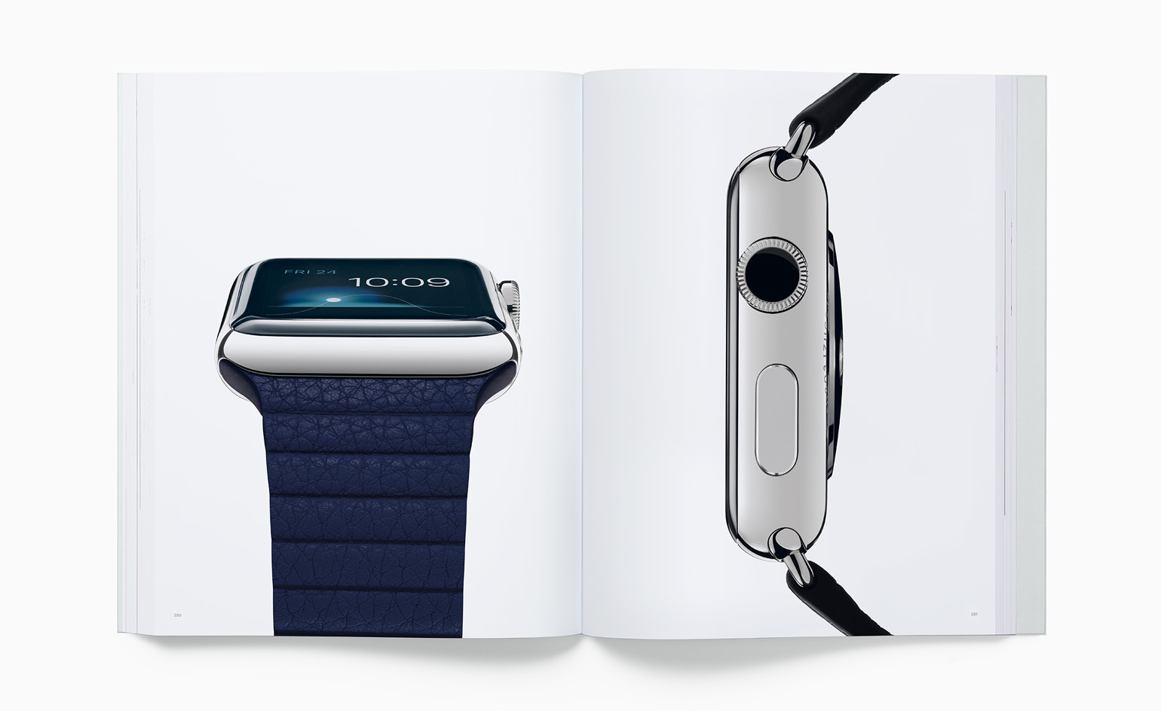
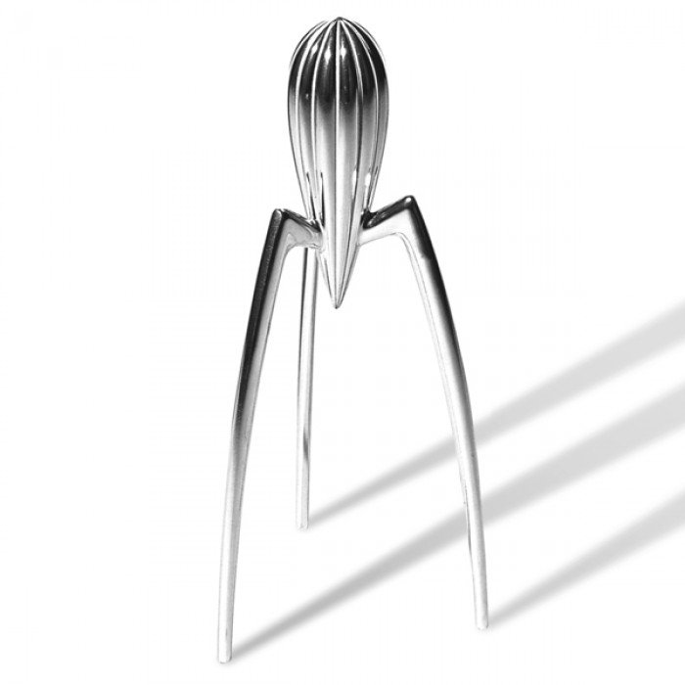
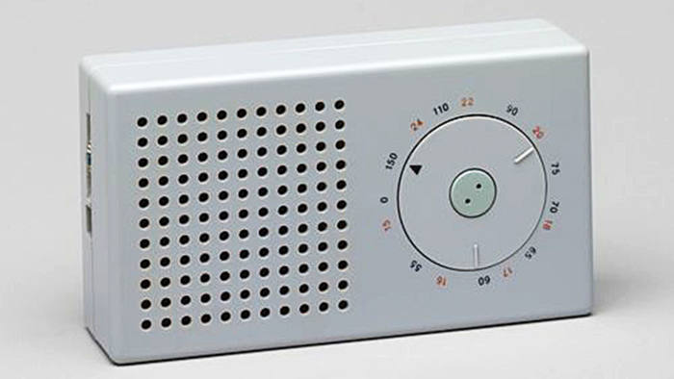
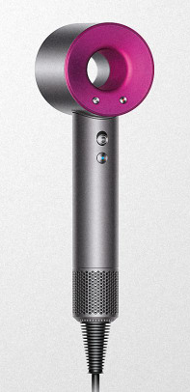
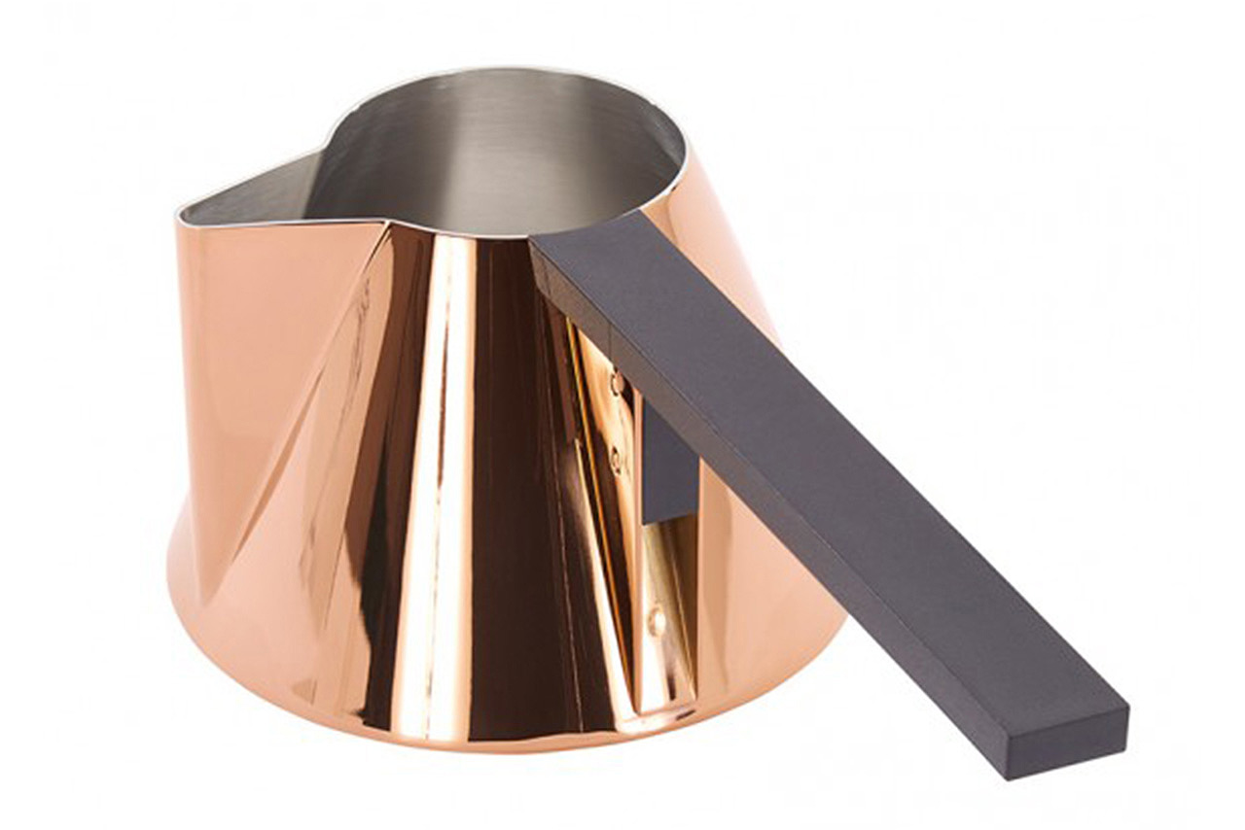
Design like a Famous Designer
Learn about a famous designer and their work
Investigate and research their design style
Design a product of your choice
in the style of a famous designer.
Make sure that you have got the ‘Notes’ / ‘Comments’ switched on on PowerPoint so that you can see the additional guidance I have written for each slide. You will see my notes at the bottom of the page for each slide as you work through the project.

Slide 2

Task: Choose one of the designers below and find out about them
Phillipe Starck Zaha Hadid
Jonathan Ive Karim Rashid
Tom Dixon Aljoud Lootah
James Dyson Yinka Ilori
Dieter Rams Marcel Breuer
Notes:
Choose one of the designers from the list on this page. On the next page add any information/images you have found. This should include information about who they are, how they got into design, who were their influences and images of them and their work. Tip – do a google search for ‘Famous Product Designers’.
2

Slide 3
Task: Print out and stick down or paste and type onto this sheet your research
Success criteria : you have gathered a wide range of images and information and presented it neatly and evenly
Notes:
If you are sticking work down make sure you do this neatly. If you are copying and pasting make sure that the layout is even and professional looking.
Include information about who they are, how they got into design, who were their influences and add images of them and their work. Tip – do a google search for ‘Famous Product Designers’.
3

Slide 4
Task: Analysing the style of their designs
Function : what do their products do? How do they work?
Form : what types of shape are their products? Rounded, angular, etc.
Style : what is the style of their products? Modern, old fashioned, etc.
Materials : what materials are their products made from?
Success criteria : You have described the designs you have chosen using clear and relevant language in some detail.
Notes:
Explain the chosen designer’s style (of the products that they have produced) using the criteria above. Try to use words that have ben used from the information in your previous web search.
4

Slide 5
Task: Describe the product that you are going to design
Write a design specification for the product you are going to design.
Function – what it does?
…………………………………………………………………….
Form – what shape could it be?
…………………………………………………………………….
Materials – what could it be made from?
…………………………………………………………………….
User – who might be the target user?
…………………………………………………………………….
Size – how large might the product be?
……………………………………………………………………..
Manufacture – how might it be made?
…………………………………………………………………….
Ergonomics – how might you make it comfortable to use?
…………………………………………………………………….
Success criteria : you have written at least one point for each of the criteria in your specification.
Notes:
Think about the product that you are going to design. What is it going to be like? Write at least one specification point for each of the criteria. Each point should be written as a sentence starting either ‘It must’, ‘It should’ or ‘It could’. Musts are things that it HAS to do or be like. Shoulds and Coulds are more flexible.
5

Slide 6
Task: produce a range of (at least 6) hand drawn designs for your product
Success criteria : you have drawn a range of designs for your product. They clearly copy the style of the designer who you researched. They are coloured in and have notes explaining each design.
Notes:
Use a sharp pencil to draw a range of designs, more than 3 up to a maximum of 10. Think about the style of the designer you have chosen. Also think carefully about what you wrote in your specification, what did you say your product would do or be like?
6

Slide 7
Task: choose one of your designs and explain why you have chosen it
Why I have chosen this design
Success criteria : you have drawn out a developed final design, in 3D if possible, of the product you are going to make. You have explained using notes or labels why you have chosen this particular design.
Notes:
Draw out your final design as neatly as possible, use colour on your drawing and write notes to explain your design and why you have chosen it.
7

Slide 8
Task: Evaluate your design
How I would improve my design to match the specification more closely
……………………………………………………………………………………………………………………………………………………………………………………………………………………………………………………………………………………………………………………………………………………………………………………………………………………………………………………………………………………………………………………………………………………………………………………………………………………………………………………………………………………………………………………………………………………………………………………………………
Specification Point | Met | Not met
Function
Form
Materials
User
Size
Manufacture
Ergonomics
Success criteria : you have checked your design against the specification that you have written. You have decided whether it does the things you said it would or not. You have given reasons as to why it has or has not.
Notes:
Look back at your specification and decide whether your final design does what you said it would do in your specification, put a tick in the relevant box. Think about how you could improve your design and write clear points explaining how you would make your design better, matching the specification more closely.
8

