Slide 1
Differentiation INSET
With gratitude to Emma Worsfold (Fairfield HS)

Slide 2
Differentiation INSET
Consider / Think about:
What does ‘differentiation’ mean to you?
What does ‘differentiation’ look like in your classroom?
Discuss in pairs and share your ideas.

Slide 3


Slide 4


Slide 5
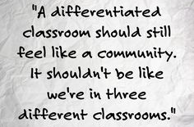
So how can we achieve this in our classrooms?

Slide 6
Before the Lesson / Planning
Things to consider when planning your lesson.

Slide 7
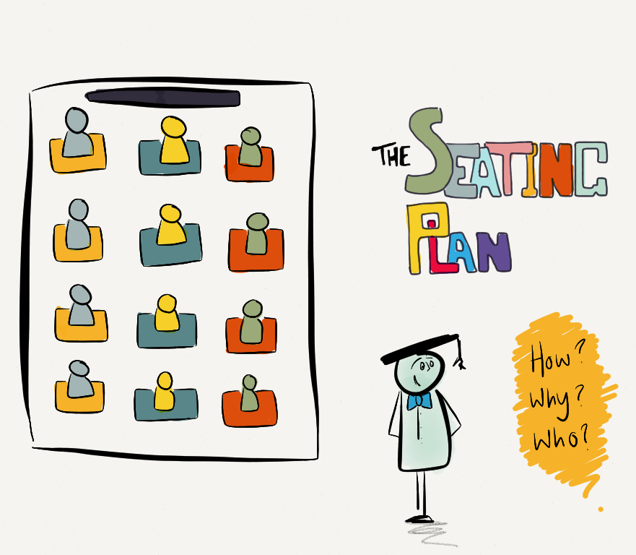
Seating Plans
Use seating plans to differentiate by:
Placing students of differing strengths next to each other.
Sitting students next to each other where you feel one will have a positive influence on the other.
Setting up the room so that when you go into group work, the groups you want are already sat next to or near each other.
Placing students with certain skills next to students who need to develop those skills.

Slide 8
Learning Objectives and Outcomes
Learning objective:
To be able to analyse language used by Romeo in Act 1.
I can identify oxymoron used in Romeo’s speech.
I can explain what Romeo’s use of oxymoron shows about his character.
I can examine multiple impressions created through Romeo’s use of oxymoron.
D
C
B
When planning, think about what students of different levels of attainment will be able to demonstrate by the end of the lesson.
I find these outcomes inform my plenaries – students can then reflect on where they are now, at the end of the lesson in relation to the learning objective.
They are also traffic lighted to show how they show increasing levels of difficulty (and can remove the need to use levels or grades).
Notes:
CAN share at the start of a lesson and return to at the end through a plenary OR just when considering planning a lesson and thinking about the different students in your class.

Slide 9
Analysis: Analyse, Appraise, Categorize, Compare, Contrast, Differentiate, Discriminate, Distinguish, Examine, Experiment, Explore, Investigate, Question, Research, Test.
Synthesis: Combine, Compose, Construct,
Create, Devise, Design Formulate, Hypothesise, Integrate, Merge, Organise, Plan, Propose, Synthesise, Unite.
Evaluate: Appraise, Argue, Assess, Critique, Defend, Evaluate, Examine, Grade,
Inspect, Judge, Justify, Rank, Rate,
Review, Value.
Knowledge: Arrange, Define, Describe, List, Match, Memorise, Name, Order, Quote, Recognise, Recall, Repeat Reproduce, Restate, Retain.
Comprehension: Characterise, Classify, Complete, Describe, Discuss, Establish, explain, Express, Identify, Illustrate, Recognise, Report, Relate, Sort, Translate.
Application: Apply, Calculate, Choose, Demonstrate, Dramatise, Employ, Implement, Interpret, Operate, Perform, Practise, Role-Play, Sketch, Solve, Suggest.
Use BLOOM to differentiate learning outcomes from Knowledge to Evaluation.
Blooming Bloom!

Slide 10
Learning objective:
To be able to analyse language used by Romeo in Act 1.
I can identify oxymoron used in Romeo’s speech.
I can explain what Romeo’s use of oxymoron shows about his character.
I can examine multiple impressions created through Romeo’s use of oxymoron.
D
C
B
Your turn!
Think of a lesson you will teach later this week.
In table groups, help one another to come up with a learning objective for the lesson and 3 differentiated outcomes in relation to it.
Notes:
CAN share at the start of a lesson and return to at the end through a plenary OR just when considering planning a lesson and thinking about the different students in your class.

Slide 11
After the Lesson: Differentiated Feedback
“The most powerful single moderator that enhances achievement is feedback.” – John Hattie
Using feedback in the classroom to develop learning.

Slide 12
What problems do you face with marking and feedback?
Why is it important?

Slide 13
What problems do you face with marking and feedback?
Feel that you should be marking students’ work as a measure of your worth: for accountability purposes, rather than to give feedback?
Feel that the quality of feedback is measured by how much you have written on students’ work?
Feel that verbal/oral feedback is important but not as valid as written marking (and difficult to do in a class of 30+)?
Feel guilty if every piece of work is not marked thoroughly?
Wonder if your marking really makes any impact on student progress?

Slide 14
Key principles of effective feedback
EXPERTS
Students need time and opportunities to make improvements on their work.
Focussing feedback (oral or written) on success and improvement needs against the learning objective or success criteria leads to students embedding their improvements and applying them in subsequent pieces of work.
Feedback offers guidance on how to improve further and ‘close the gap’ between where they are now and the next step in their learning.
Comment-only feedback leads to higher gains than grades alone or grades with comments.
Teachers should model feedback processes so students can take control over their own marking (and learning).

Slide 15
Practical Implications

Slide 16
1. PLAN for feedback in your Scheme of Learning.
Look at the hand-out.
I have found this really useful when planning for feedback and marking with my classes.
It has focused my attention on the pieces of work I need to mark to ensure students can make the most progress.
It also reminded me of the importance of building in TIME and opportunities for students to put their targets into practice.
It also allows me to stagger the key pieces of work to mark around my other classes.
Notes:
Year plans – marked what formative/book marking tasks would be wise.
P/C p.102 from feedback book

Slide 17
2. Focus feedback on success and improvement needs against the learning objective, success criteria, or mark schemes.
In English at Fairfield, we established learning ladders outlining the success criteria and increasing levels of challenge for each skill set required at GCSE.
We now print these ladders for students to stick in their books for peer marking and use the same ladders for our marking of WWW/EBI.
This allows our feedback to focus on the learning and next steps, whilst our handwritten comments can praise students’ effort separately.
It also allows students to see the steps beyond those they have achieved to continue striving for success.
Notes:
P/C examples of these in action from students’ books.

Slide 18
Writing to Describe:
Success Criteria
Example!
Sustain a THIRD PERSON PERSPECTIVE throughout my description. E.g. The smell of roses wafts… The park was…
Introduce the setting in a way that my reader can imagine it clearly. E.g. Perhaps by using effective ADJECTIVES – “vast blue ocean”; VERBS – “Teenagers sauntered to school”; ADVERBS – “Children ran clumsily”.
Sequence my ideas consciously in paragraphs. E.g. Chronologically; using different “camera lenses” to “zoom” in and out of objects in my description.
Use a variety of ADVERBIALS to link ideas in and between paragraphs. E.g. As the sun sets on the park, When the bell rings, the dining hall…
Employ a range of STYLISTIC DEVICES to interest and engage my reader. E.g. Perhaps by using SIMILES – “The earth was like a blue and white marble.” METAPHORS – “The lion’s fiery mane…” PERSONIFICATION – “Cold and unfeeling, the moon shone in the sky.”
Vary my sentence lengths and structures to add detail or create pace in my description. E.g. Perhaps using a series of short sentences/lists to create a busy/bustling sense of place or longer sentences to create a calm/serene sense of place.
Use a varied range of STYLISTIC DEVICES to achieve an intended effect. E.g. Using contrast to emphasise an object or setting.

Slide 19
3. Offer guidance on how to improve further.
Differentiated improvement prompts are important to remember.
  Example prompt (particularly supportive of lower attaining students).
  Scaffold prompts (suitable for most students as it provides more structure to improve their work).
  Reminder prompts (most suitable for higher attaining students).
Then allow TIME for students to read and RESPOND to their improvement comment.

Slide 20
3. Feedback offers guidance on how to improve further.
Example prompt (particularly supportive of (very) low attaining students).
Choose one of these statements that you think was important for… and/or offer one of your own.
Consider these facts about… and give 2 more from what you have learned.
Add 3 more adjectives to this list describing…

Slide 21
3. Feedback offers guidance on how to improve further.
Scaffold prompts (suitable for most students as it provides more structure to improve their work).
A question: Can you explain why a reader would want to read more of the story after Chapter 4?
A directive/instruction: Describe how Bruno feels about what he sees in Chapter 4.
An unfinished sentence: John Boyne creates an air of mystery in Chapter 4 when…

Slide 22
3. Feedback offers guidance on how to improve further.
Reminder prompts (most suitable for higher attaining students).
Say more about...
Explain why you think this...
Explain how this is different to…
Compare this to…

Slide 23
WWW – I can… / EBI – Next time, I must… |  | Reading Fiction
P | Make a POINT about a significant moment for a character or theme in the text, stating where it is in the text and what is happening.
E | Support my point with relevant EVIDENCE from the text, usually in the form of a direct quotation.
Ex 1 | Explain the effect or impression created by my chosen piece of EVIDENCE using “because” to explain my thinking in more detail, without repeating words from my quote.
Ex 2 | ExPLORE a second, and different, effect or impression created by my EVIDENCE, without repeating words from my quote.
L | EXPLORE the impression(s) created by a single word, phrase or stylistic device being used in my EVIDENCE. (LANGUAGE)
A | EXPLAIN the impact my piece of EVIDENCE has on the AUDIENCE or READER.
C | EXPLAIN how the influence of different HISTORICAL or CULTURAL CONTEXTS affects the impressions created by my EVIDENCE.
Ev | EVALUATE how the effects or impressions created by my piece of EVIDENCE compare to OTHERS from across the text. Perhaps how a character or theme has changed or developed.
OR:
List 3 words to describe Bruno in the quote you have chosen. (Easy)
Why do you think Bruno is scared here, according to your quote? (Medium)
Remember to EXPLAIN your thinking in detail. (Hard)
Differentiated feedback – I’d choose ONE of these options depending on where the student was in their learning.

Slide 24
4. Comment only feedback is best (within a scheme of learning).
When planning schemes of learning and when to assign levels to pieces of work, consider giving the grades separate to your formative comments.
It’s proven that feedback given with grades is not effective.
In English, we now only give a summative grade at the end of a unit of work and get students to reflect on their assessments to write their own WWW/EBI.
We put more time and effort into our formative marking mid-way through a scheme of learning, as this has the most IMPACT on student progress.

Slide 25
5. Model good feedback.
Through your own marking, make sure your feedback is clear and focuses on the LEARNING OBJECTIVE / SUCCESS CRITERIA and CLOSING THE GAP (between where they are now and where they need to be!).
Offer students (particularly lower down the school) comment banks on the board, or learning ladders / success criteria that students should use to write peer/self-assessment comments.
Insist on this!

Slide 26
There’s not enough time now…
…but in your resource booklets there is a template you may want to use when planning for feedback in units of work if you want to use it for September.

Slide 27
Time Permitting…

Slide 28
Successful Strategies for differentiation
I will leave this PowerPoint with SLT and see if they could email it around to staff or save it somewhere you can all access it…

Slide 29
Starter Activities
Things to consider when differentiating the start of your lesson.

Slide 30
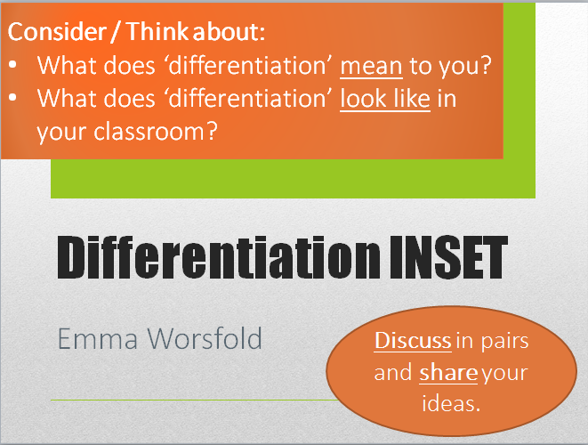
‘Consider’ Questions
Not so much a starter, but a way to get students thinking about the lesson and keeping them engaged, while the rest of the class are still writing the title, date or L.O., or I’m doing the register.
Keep the question open or opinion-based so that ALL students, of ALL needs, can access it.

Slide 31

Using Different Media
By using a range of media in your lessons, or across a unit of work, you will be differentiating.
The range of material will ensure that students are kept engaged, the content’s memorable and that there are different opportunities for accessing the content.
Media include:
  Videos
  Songs
  Animations
  Computer games
  Newspaper articles

Slide 32
Using Punctuation to Help Your Argument
EXAMPLE
Sunday, 21 November 2021
Learning Objective:
To understand how punctuation can be used to emphasise meaning in a speech and guide the reader’s tone of voice.
Consider:
What do you already know about punctuation?
What do you feel confident using accurately?

Slide 33

What difference does punctuation make?
Ron Burgandy follows EVERYTHING written on his teleprompter.
How does the punctuation error affect the meaning of what he says?

Slide 34
Your turn…
In pairs, help one another to devise one or two ‘consider’ questions for a lesson you will teach later this week.
  Keep them open-ended (to invite multiple responses)
  Tap into students’ personal opinion (so there’s no right or wrong answer).
Now consider a piece of media you could use to showcase the skills needed that lesson.
  Youtube has many interesting clips
  Recent, topical newspaper articles
  Music / Songs / Poetry
  Interactive games
Take this opportunity to think more creatively.

Slide 35
Inclusive Activities
Activities that include all students of all levels of attainment.

Slide 36
Questioning
Not so much an ‘activity’, but an important strategy to employ when differentiating a lesson.
Often, I use paired discussion with a question stimulus on the board. Then I will nominate students in the class (no hands up!) to check their understanding. This is best if there is a range of “correct” answers I’m looking for.
If it’s a question asking for an opinion or a prediction, however, nominating students is fair game! There’s no right or wrong answer, or fear of failure for students of different levels of attainment.

Slide 37
Analysis: Analyse, Appraise, Categorize, Compare, Contrast, Differentiate, Discriminate, Distinguish, Examine, Experiment, Explore, Investigate, Question, Research, Test.
Synthesis: Combine, Compose, Construct,
Create, Devise, Design Formulate, Hypothesise, Integrate, Merge, Organise, Plan, Propose, Synthesise, Unite.
Evaluate: Appraise, Argue, Assess, Critique, Defend, Evaluate, Examine, Grade,
Inspect, Judge, Justify, Rank, Rate,
Review, Value.
Knowledge: Arrange, Define, Describe, List, Match, Memorise, Name, Order, Quote, Recognise, Recall, Repeat Reproduce, Restate, Retain.
Comprehension: Characterise, Classify, Complete, Describe, Discuss, Establish, explain, Express, Identify, Illustrate, Recognise, Report, Relate, Sort, Translate.
Application: Apply, Calculate, Choose, Demonstrate, Dramatise, Employ, Implement, Interpret, Operate, Perform, Practise, Role-Play, Sketch, Solve, Suggest.
Use BLOOM to inform questioning and differentiate the level of challenge posed by your questions.
Blooming Questions

Slide 38
Key Word Activities
Lower attainers:
  Wordsearch activities (with key words for the topic in)
  Use to establish a word bank for the lesson.
  Also good for weaker spellers and vocabulary.
Middle attainers:
  Crossword activities (clues or definitions for key words for the topic)
Higher attainers:
  Devise their own crossword clues for key words in the topic.

Slide 39
Key Word Activities
Match up the key word to the definition.
  Poetic devices: Alliteration – When a consonant sound is repeated in a poem.
Create an example of the key word in action.
  The tortoise tiptoed to the toilet.
Link the key word to the wider world of learning.
  Consider: How will learning these key words help you:
    In this subject in school?
    In other subjects?
    In later life?
Again, consider BLOOM’s taxonomy or SOLO taxonomy to increase challenge.

Slide 40
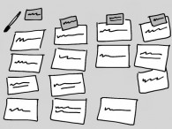
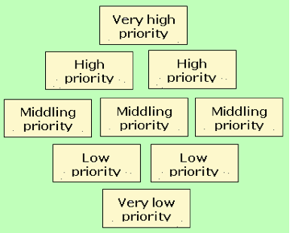
Card Sort Activities
A card sort is a good activity because it allows students to sort, order and match information.
It is accessible because the information is visible and can be physically manipulated.
However, some students will find the parallel cognitive processes hard to cope with if they do not have clear instructions about how they are meant to order them.

Slide 41
Your turn…
In pairs, help one another to devise a card sort activity on the blank resource provided.
Diamond 9 card sort requires students to create a ‘diamond’ shape, with cards at the bottom being what they believe to be least important, and those at the top being most important.
Category sort – sorting cards into categories. This could be used for themes, word classes (sort all verbs, nouns, past tense verbs), topics etc.

Slide 42
Talk for learning
Talk-based learning is almost universally inclusive and allows almost all students to access the activity (and is very effective!).
Using talk in the classroom to develop learning.

Slide 43
Group Discussion
Give a group of students a set of instructions or activities they must complete together and discuss along the way. Perhaps solving a problem, devising an activity or game, discussing themes or opinions around a topic.
Consider how you’re grouping students – a group of high-attaining students can challenge them further; mixed attainment groupings allow weaker writers or readers to use their stronger speaking skills to access (and show off) higher level thinking.
Encourage turn-taking, asking questions, resolving differences, encouraging all students to contribute to the discussion before they can move on to the next activity.

Slide 44
What makes a successful group discussion?
EXAMPLE
Group Discussion: Success Criteria
Listen closely and attentively, engaging with what is heard through perceptive responses Make significant contributions that move discussions forward Engage with others’ ideas and feelings, recognising obvious bias or prejudice and referring to precise detail
Challenge, develop and respond to what they hear in thoughtful and considerate ways, seeking clarification through apt questions Analyse and reflect on others’ ideas to clarify issues and assumptions and develop the discussion Identify useful outcomes and help structure discussion through purposeful contributions
Sustain concentrated listening, showing understanding of complex ideas through interrogating what is said Shape direction and content of talk, responding with flexibility to develop ideas and challenge assumptions Initiate, develop and sustain discussion through encouraging participation and interaction, resolving differences and achieving positive outcomes
D-C
B-A
A-A*

Slide 45
You will be working in small groups of 3 or 4 to explore the poem. Discuss the following:
What’s the message of the poem? (What’s it about?)
How do you know?
What’s the writer’s attitude in the poem? (How does Robert Burns feel?) How do you know?
What words or phrases stand out to you as being significant? Why? (Language? Language features? E.g. Metaphors?) Highlight them in the poem and discuss why they stood out to you.
What’s your personal response to the poem?
(Your opinion?)

Slide 46
You will be working in small groups of 3 or 4 to explore the poem. Discuss the following:
How does the poem deal with the following topics:
  Human beings, agriculture and the natural world?
  The importance of shelter and housing?
  The suffering of the downtrodden?
  Power and powerlessness?
  The fight for survival – what’s acceptable if your survival is at stake?
  Poverty and wealth?
What is Steinbeck saying about these same issues in the novel?
Why do you think he chose to connect his book with this poem?

Slide 47
Debates
Provide the class with a provocative statement about the topic they are studying that is sure to garner some strong opinions.
  Assign sides for students to argue
    Allow each “team” to DISCUSS a range of arguments and supporting points together before the debate takes place.
    Again, this allows students to have some more time to think through the argument and also to develop their thinking.
  Debate around the room (more active)
    Students move to one end of the room if they agree with the statement, or the other if they disagree. Nominate students to explain why they’re standing where they are.
    OR give them some group discussion time to develop some ideas.

Slide 48
Drama
Hot seating (take on the role of someone from your topic)
  Get a willing participant to be the person in question.
  Get the class to ask questions of them to demonstrate understanding of the topic.
Taking on a role (assigning roles of people from a topic)
  In groups, assign roles to students (e.g. world leaders / characters from a book / some scientists and protesters…)
  Get students to argue the ideas of the person they are in character as – good for exploring SMSC issues.
All of these activities are more active and kinaesthetic. They get students moving around and engaged more.

Slide 49
Your turn…
Discuss how you could incorporate talk-based activities into a lesson (or a number of lessons) you will teach this week.
  Debate?
  Group Discussion?
  Drama? Taking on a role?

Slide 50
Resources

Slide 51
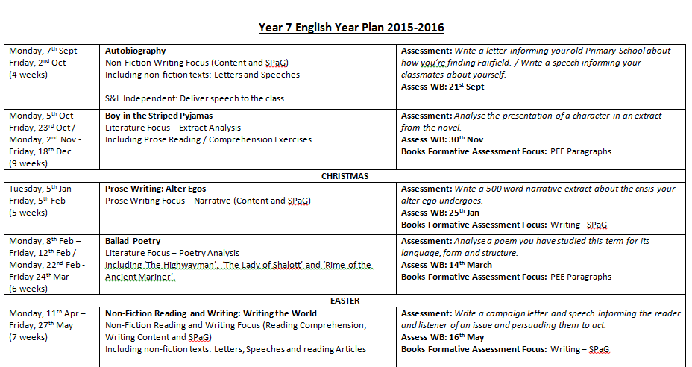

Slide 53


