Slide 1
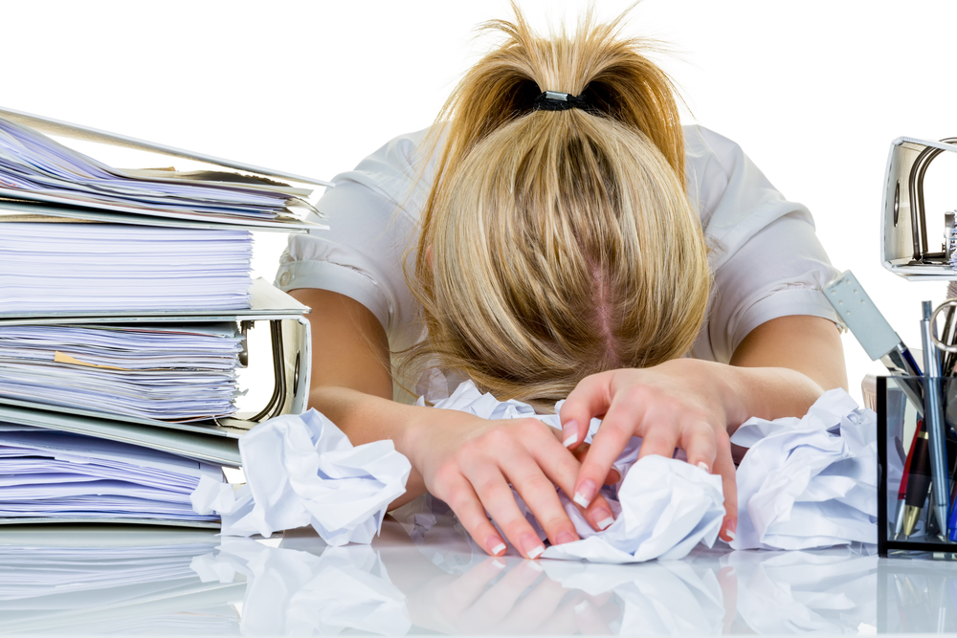
REVISION - Felt like this yet?

Slide 2

The ChildLine National Exam Stress Survey revealed that:
96% of students feel anxious about exams (no matter what your friends say they ARE stressed too),
59% of students feel pressure from family,
64% of students would like more support with exams and exam stress.

Slide 3
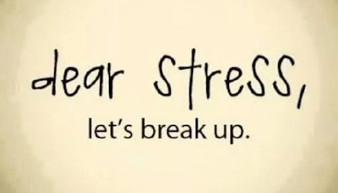
Exam anxiety and stress is NORMAL…
Don’t worry over your worry. That just adds to your stress, take power and be proactive…
You ARE in control!
https://www.youtube.com/watch?v=hnpQrMqDoqE
Notes:
https://www.youtube.com/watch?v=pvM_TtQi9DU

Slide 4
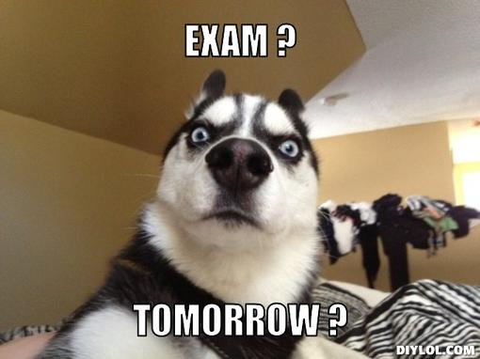
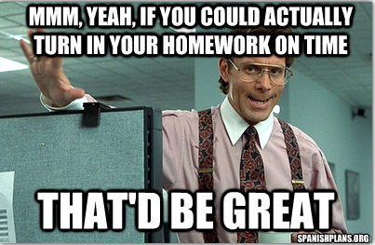
The best way to deal with stress is to feel in control!
One way of dealing with stress is removing the thing that causes you stress. However, that is not always possible.
We all have different things that cause us stress:
Notes:
https://prezi.com/jicorm7d7vkw/are-you-being-smart/?utm_campaign=share&utm_medium=copy

Slide 5


Don’t forget - If you are still trying you ARE coping…
Gentle exercise
Remember that you are not alone
Picture your success
Exams are not the be all and end all
Get enough sleep
Diet
A productive environment
You ARE Stronger then you feel!

Slide 6
Are you being SMART?
Specific
Set actual topics – revise things one at a time.
Measurable
Split revision into short 20 minute session – set a time scale and reward yourself.
Action
Actually have fun with your revision. DO different things.
Realistic
There is not point setting goals you know you wont follow.
Balance revision with relaxing.
Time
Study takes time. Give yourself enough.

Slide 7
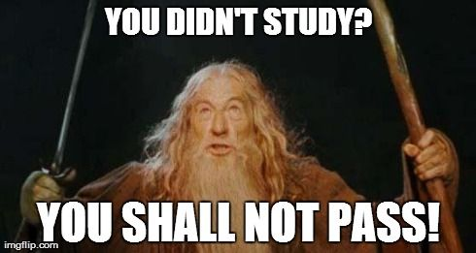
BUT remember:

Slide 8
Heavenly Father,
Help me to find your peace through the anxiety and stresses of exams. I ask for this gift and choose to lean upon you at this time.
Lord, come and remind me of your unfailing love.
Remind me that you hold me safe, you understand me, and you cherish me.
I lay down my fears before you.
I leave them at the foot of the cross, for you have overcome the world.
I choose to give you all my concerns, worries and fears of failure.
I trust that your loving hand will hold me through these exams and lead into a bright future.
Amen.

Slide 9
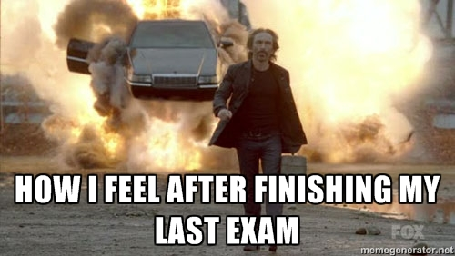
They will be over soon…

