Slide 1
You Can Do This…
https://www.youtube.com/watch?v=QGJuMBdaqIw

Slide 2
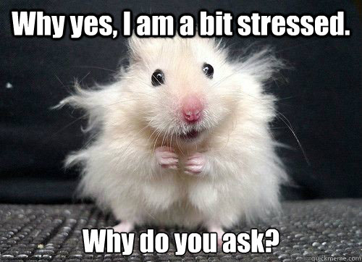
A Simple Solution… to Stress

Slide 3
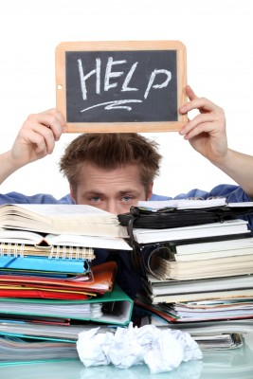
Stress and anxiety is a behaviour that is meant to keep us safe from harm.
However, too much stress over a long time is very difficult to manage.
How to
Manage!

Slide 4
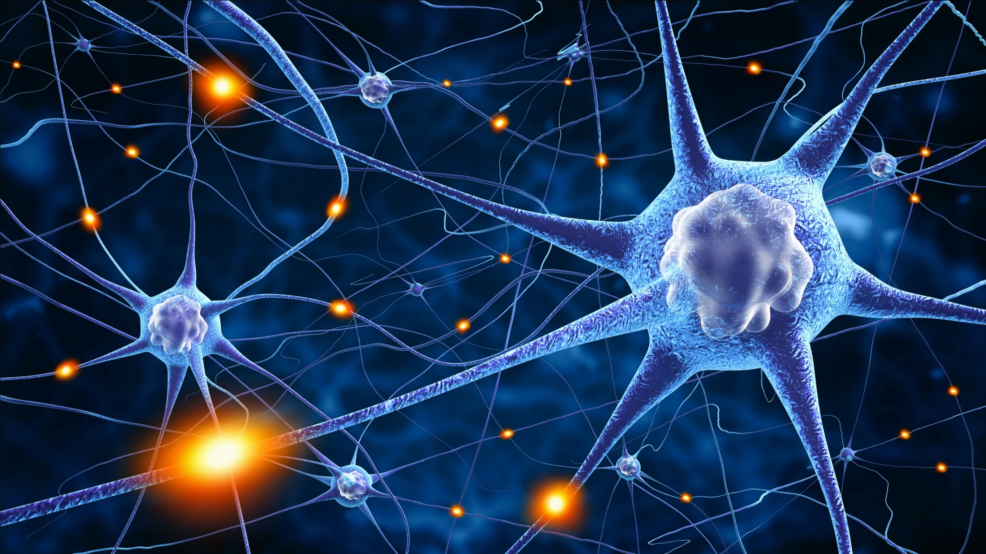
A Stressed Brain…
A lot of our anxiety is truly “in our heads” — our stress comes from our worrying brains ruminating on all the worst possible scenarios.
… if we change our thinking we can reduce our stress.

Slide 5
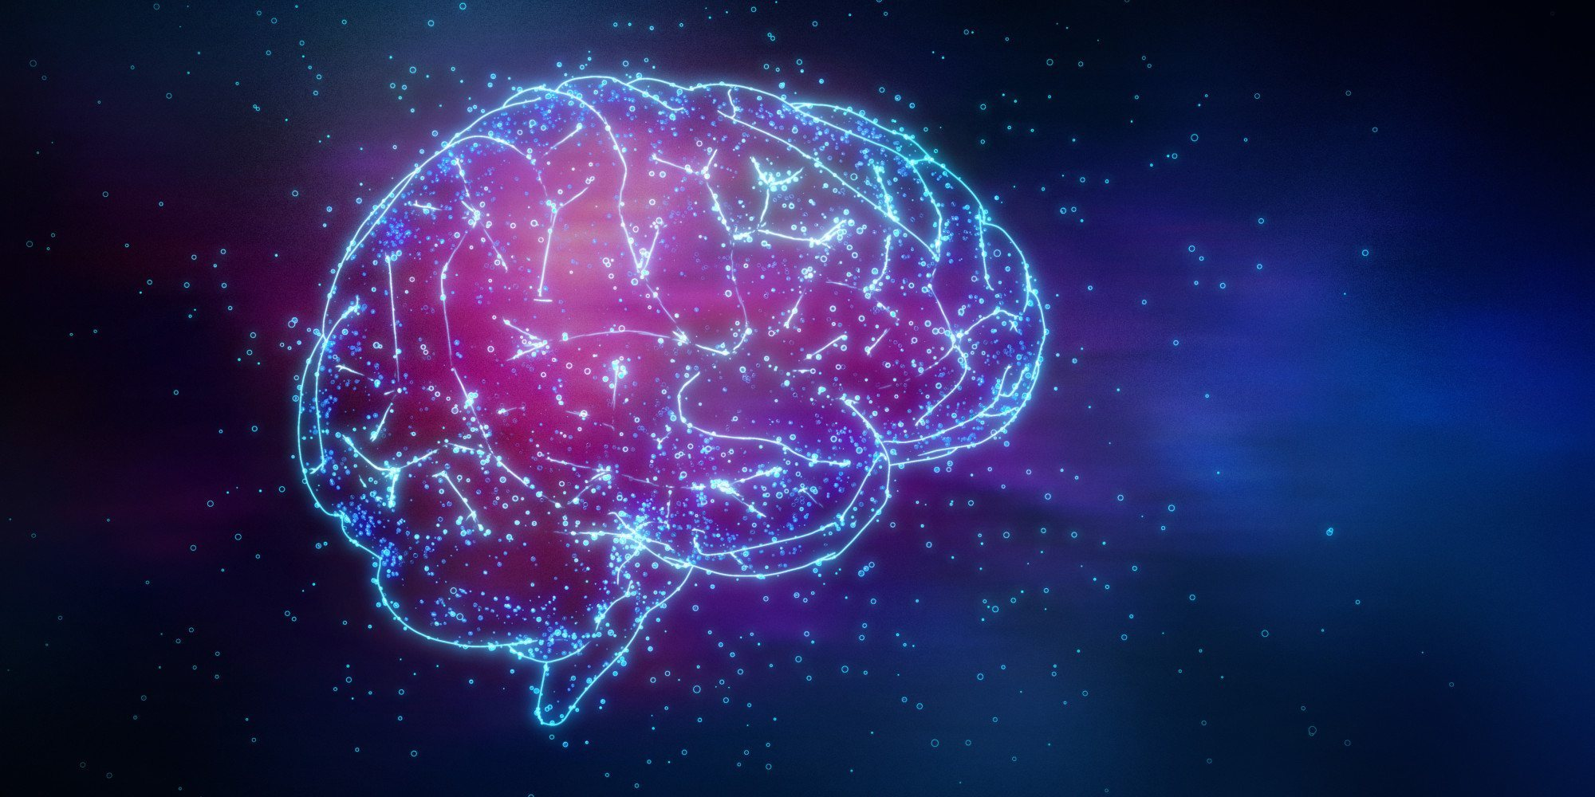
Is the brain the same thing as your mind?
Where actually is your mind?
Notes:
Do an experiment… close eyes, clap your hands – where is your mind now?

Slide 6
What is the mind?
The element of a person that enables them to be aware of the world and their experiences, to think, and to feel; the faculty of consciousness and thought.

Slide 7
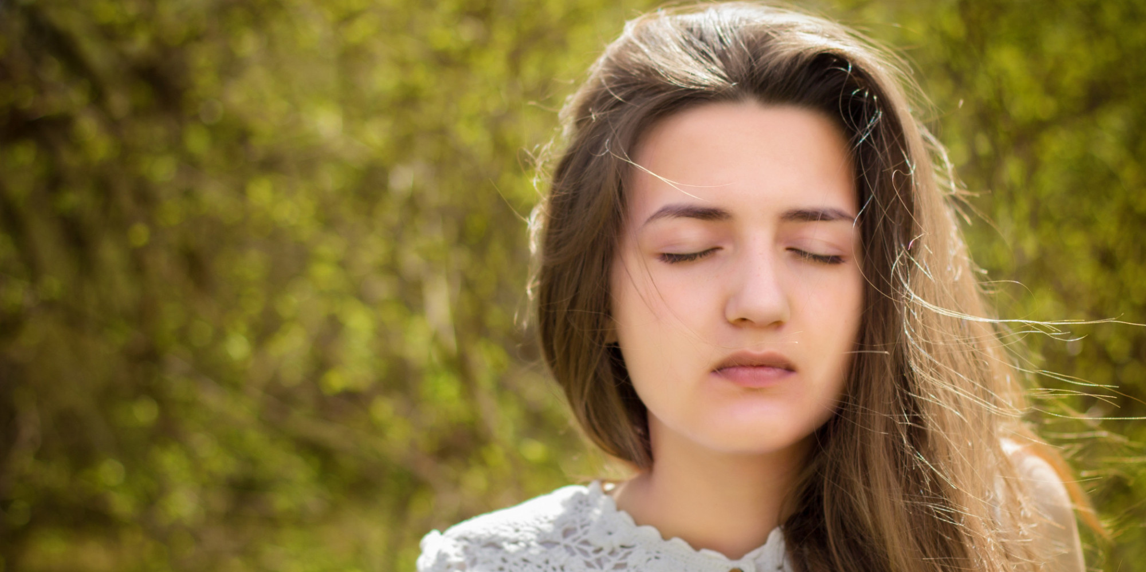
Becoming mindful…
https://www.youtube.com/watch?v=Csga4tg5Pq0
… means becoming self-aware.

Slide 8
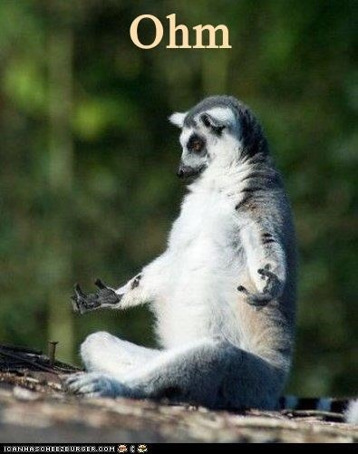
There are lots of ways to be mindful…
Lets try one technique…
7/11 technique

Slide 9

Our mind is full of thoughts rushing around our heads… like buses.

Slide 10
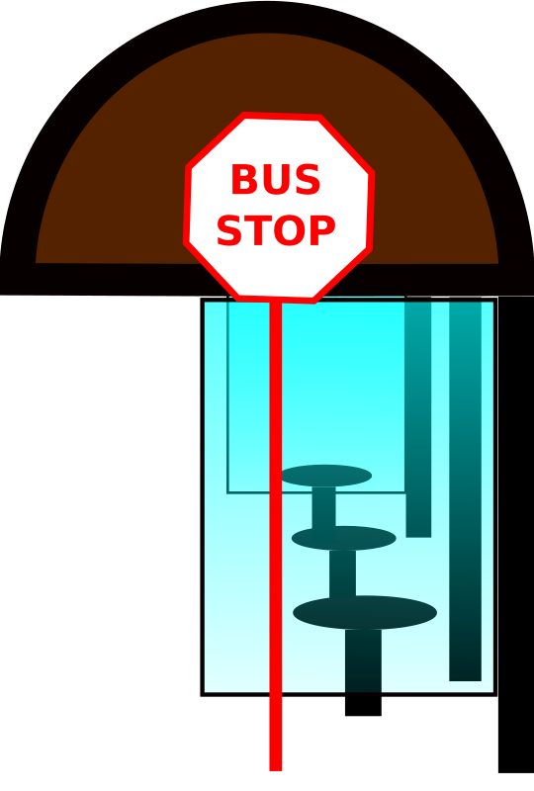
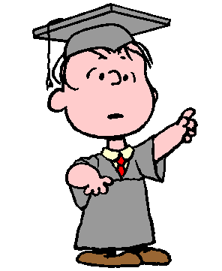




BANG!!
Notes:
Most of them time we live our lives on "autopilot". Our minds seem to have a will of their own. Thoughts come and go, and it seems as though we don’t have much say in what thoughts turn up in our head.

Slide 11
Practice letting your thoughts pass you by:
Lunch
The Weather
Family
Revision
Summer Holidays
A recent argument
Chocolate
Exams
Something someone said online
Which were the thoughts that your ‘boarded the bus for’?
These might be your trigger thoughts, you need to practice – ‘staying at the bus stop’

Slide 12

Studies show that:
Students who meditate before an exam perform better than students who do not,
Have improve concentration,
Can reduce the symptoms of anxiety, stress and depression.

Slide 13
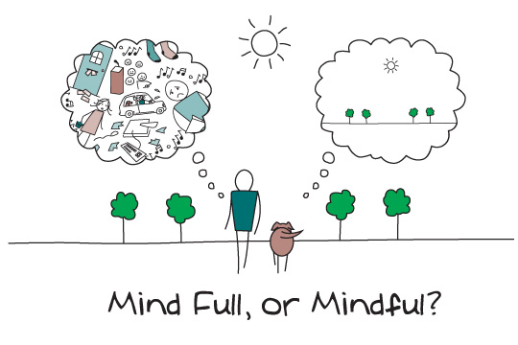
It is ok to have a busy mind but it needs to be a mindful one also.

Slide 14
Dear Lord,
Thank you so much for all things. I know very little of the world, and only ask for the ability to cope with the challenges of this life in a way that honours you.
I know that you love us & the things that happen to us in this life are lessons that we must face. I wish only for the ability to face them with love, mindfulness, strength, joy, & honour. So that my life can be a lesson to myself to also to others.
I will cope as I know I have you by my side.
Amen

Slide 15
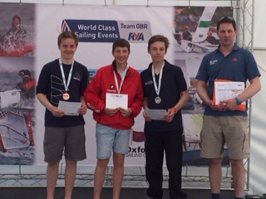
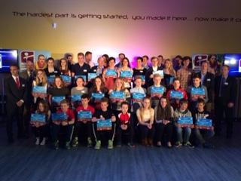
Halo Sports Foundation Awards
Matt received a Sports Aid Award for Sailing, and Fynn received an award for Swimming.
The Awards were presented by Sascha Kindred OBE , gold medal winning Paralympic swimmer and patron of the Halo sports foundation.

