Slide 1

Heading towards the finish line…
Learning Objectives:
To practice using a range of memory enhancing techniques.
To discuss the importance of exam practice and provide the tools for pupils to access the materials they need.

Slide 2
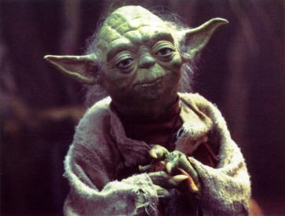

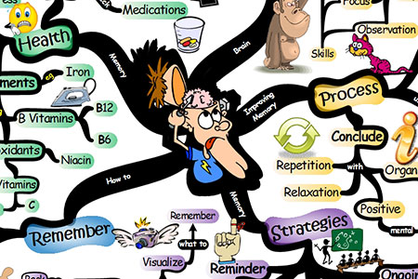
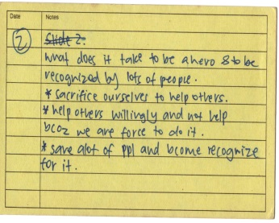
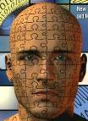
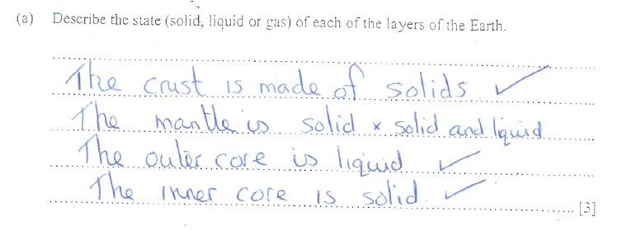
The 4 step process…
Timetabling and being organised
Creating and organising revision resources e.g. Mind maps & Flash Cards
Mind Tricks
Card Cover
Sticking to it and adapting it where possible
Practice
Understanding!
Past Papers

Slide 3

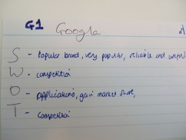


Jedi Mind Tricks!
Stands
For
Something
Mnemonics
01642
800 800
Chunking
Association
Card Cover
Loci
By Rote
Please remember different techniques work
better for different people!

Slide 4
Leading up to the exams…
You should have all of your flash cards and mind maps made.
You should now be reviewing them and improving your recall.
Continue to pay attention in class and complete all your homework.
The final step is to start Practising

Slide 5
So now you know these key terms can you apply them?
Sun | Solar System | Planets | Moons
Big Bang | Comets/ Asteroids | Galaxy | Universe
Milky Way | Earth | Vacuum | Parallax
Light-years | Hydrogen nuclei | Helium | Redshift

Slide 6
Read the question carefully!!!
Some scientists were studying the universe and made a discovery about a star.
The star was 4.3 light years away. A planet the same size as the Earth was orbiting the star.
(a) Draw a ring around the correct answer to complete the sentence.
The scientists knew how far away the star was by measuring the change in
(1)
 |  | light waves.
 | frequency of the | seismic waves.
 |  | sound waves.

Slide 7
Finding test papers…
http://www.ocr.org.uk/qualifications/by-type/gcse/
Always try to complete these papers in the allotted time.
The first few papers – use your notes and revision guides. Then try to complete the papers without any support.
Work with another person when marking these papers, if you can discuss and teach one another this will really support your learning.
Keep working on these papers – questions are often repeated or similar so you might just cover the same questions that could come up in your exam!

Slide 8
The last few days before your exams…
Don’t imagine that life will go on as ‘normal’ during important examinations. It wont.
You will need to change you habits and make some sacrifices during this time.
You also need to look after yourself too.
Try to remain positive, don’t tell yourself you “can’t do it anyway” – that’s just opting out.

Slide 9

In the Exam Hall…
This is a high stress environment so take control!

Slide 10
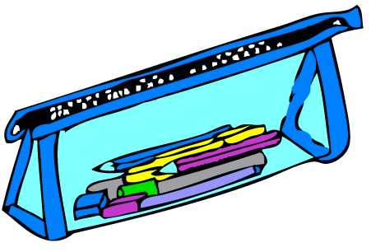
Bring the correct equipment… don’t waste time and stress over it.

Slide 11
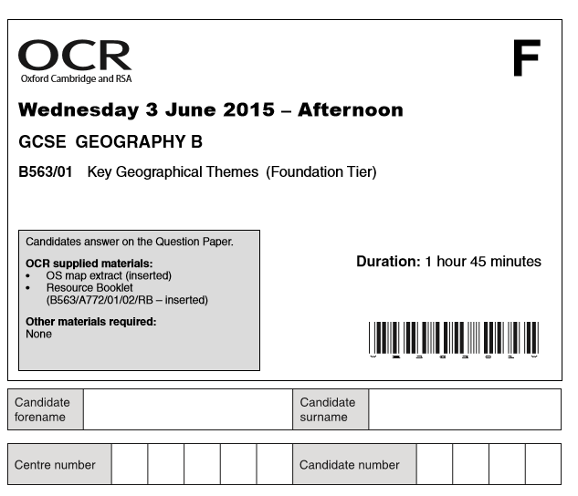

Read the front page of the paper:
Make sure you take note of how much time you have.
How many sections or marks are there?
Make sure you know when to move on… sometimes you have to move on.

Slide 12
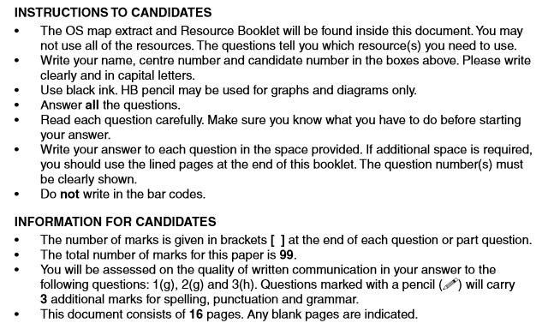
Only answer the questions you are instructed to answer.
This paper has 99 marks and three sections
Check all the pages – do not miss questions.

Slide 13

Always leave time to PROOF READ!!!

