Slide 1

How to improve your maths skills

Slide 2

Learn the formulas
Create flash cards for each formula
Put the Question on one side and the formula on the other
Test yourself or better still work with a friend and test each other.
For the ones you can’t remember – write them on post-it notes and stick them around your room!

Slide 3

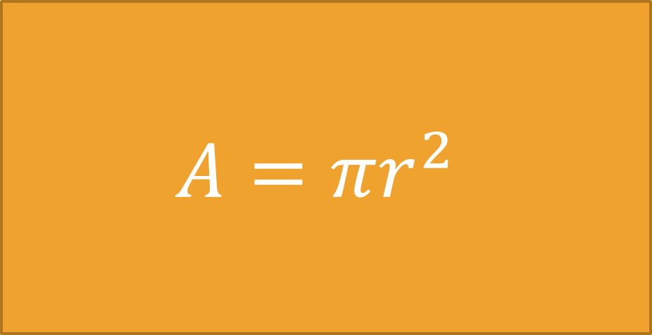
Area of a Circle
$$A=πr^{2}$$
Remember: r=$\frac{d}{2}$

Slide 4
Make short notes on each topic
You could use mind maps to do this
For some Topic Flow Diagrams may be useful
Use mathswatch (KNOW YOUR LOGIN)
Use mymaths (RHOMBUS)

Slide 5
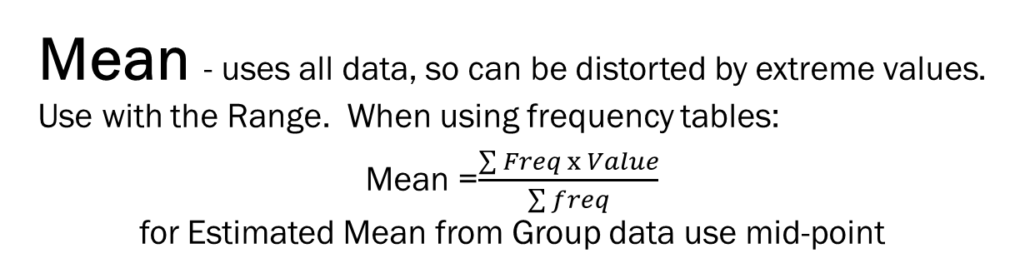
Mean - uses all data, so can be distorted by extreme values. Use with the Range. When using frequency tables:
Mean =$\frac{\sum{Freq x Value}}{\sum{freq}}$
for Estimated Mean from Group data use mid-point
Median - Middle of SORTED data. Use with IQR. To find Estimated Median from Group data, draw Cumulative Frequency Curve. (Plot Cum Frequency against UPPER BOUND) Draw BOXPLOTS
Can find from Histograms by finding the vertical line that divides the area (frequency) into two equal sections.
Mode – most frequent
Only average that can be used with qualitative data.
Can be called the modal
value or group
Averages
& Range
Range = Highest value - Lowest

Slide 6
Solving Equations
Linear
Quadratic – rearrange to have 0 on one side
Other
Can you factorise?
Trial and Improvement
or
Recursive Iteration
Take all x’s (variable) to one side – numbers to the other. Keep x’s positive. Use same method for inequalities
Yes
No
Quadratic Formula
If a=1 then use completing the square
Graphical Solution

Slide 7
Review Vocabulary
Learn Key Words and Facts
Understand what the words in the question require you to do

Slide 8
Finally and most importantly
Practice
Practice
Practice
And then do more Practice

Slide 9
Past Papers
Consider the timing
Highlight key words to ensure you are answering the question correctly.
Check for sense
Add units where applicable
Check the required degree of accuracy.

