Slide 1
Spider Diagrams
Year 11

Slide 2
Why Spider Diagrams?
Spider diagrams condense the material
Short, snappy information
When using different colours it helps for us to picture it

Slide 3
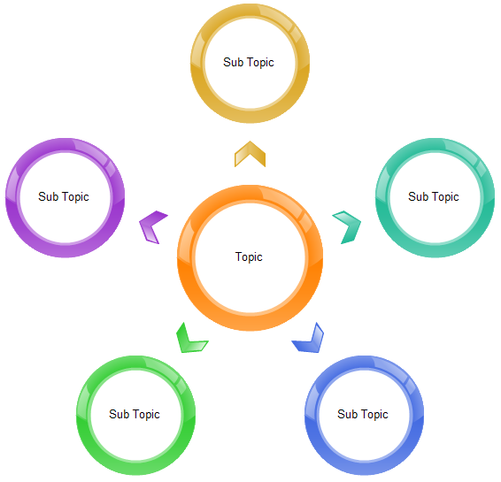

Slide 4
Key Elements
On an effective spider diagram you will need to following elements:
Main topic
Sub topics (Different colours)
Short and key information

Slide 5
Check List
First of all you need to have a Check List of your main topic.
For example, today we’re looking at:
Mark’s Gospel – The Early Ministry of Jesus
Have a look down the Check List and put a tick next to the topic if you’re 100% sure you know that topic.

Slide 6

St Mark’s Gospel
On our Spider Diagram we need write in 3 elements:
A brief overview of the story
What it means to us today
A key quote

Slide 7
Jesus Baptism – Mark 1:9-11
Feeding of 5000 – Mark 6:30-44
Jesus Heals a Paralytic – Mark 2:1-12
Mark’s Gospel – Early Ministry of Jesus
Jesus Heals Jairus’ Daughter – Mark 5:21-43
Titles of Jesus
The Rejection at Nazareth – Mark 6:1-6

Slide 8
“You are my Son, whom I love; with you I am well pleased”
Baptised by John in the River Jordan.
Heaven opened up and a dove (Holy Spirit) flew down.
Voice (Father) came from Heaven.
Jesus present (Son).
Jesus is the Son of God and has authority from God.
He is beginning his ministry publically.
An example of how we baptise Christians today.
Jesus Baptism – Mark 1:9-11

Slide 9
Four men bring a paralytic man to Jesus and lower him through the roof.
Jesus forgives the man’s sins.
Jesus recognises that the scribes are questioning his authority and questions their doubt.
Jesus tells the man to get up and he does.
Everyone is amazed.
We should have faith like the 4 men.
This story mirrors Baptism – parents bringing their “helpless” child to be forgiven.
It shows Jesus’ divine authority.
The amazement of the crowd is a common theme throughout Mark’s Gospel.
“Which is easier?”
Jesus restores the man’s body as a visible demonstration of what he has already done invisibly in his soul.
Jesus Heals a Paralytic – Mark 2:1-12

Slide 10
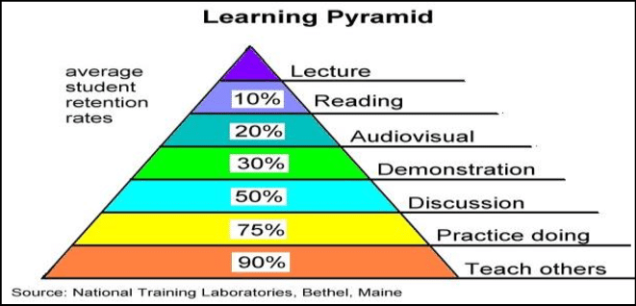

Slide 11
Cover and Recall
Once you have completed your Spider Diagram you need to be able to memorise it.
With a friend/family member ask them to test you on what is on your Spider Diagram.
Try teaching someone else the knowledge you have learnt!

