Slide 1


Year 11 – Study skills

Slide 2
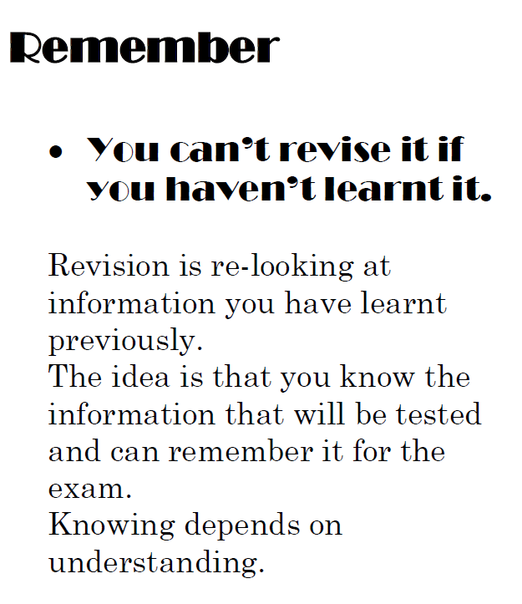
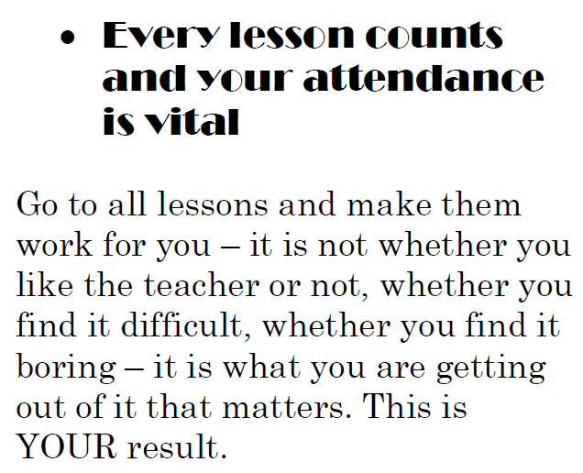

Slide 3
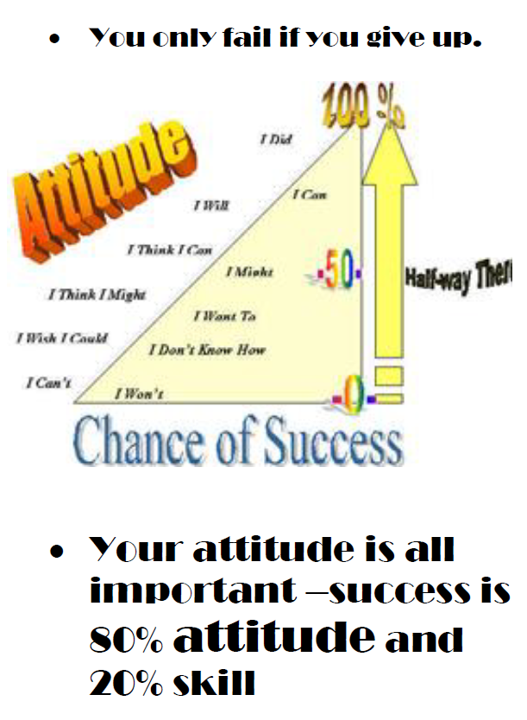
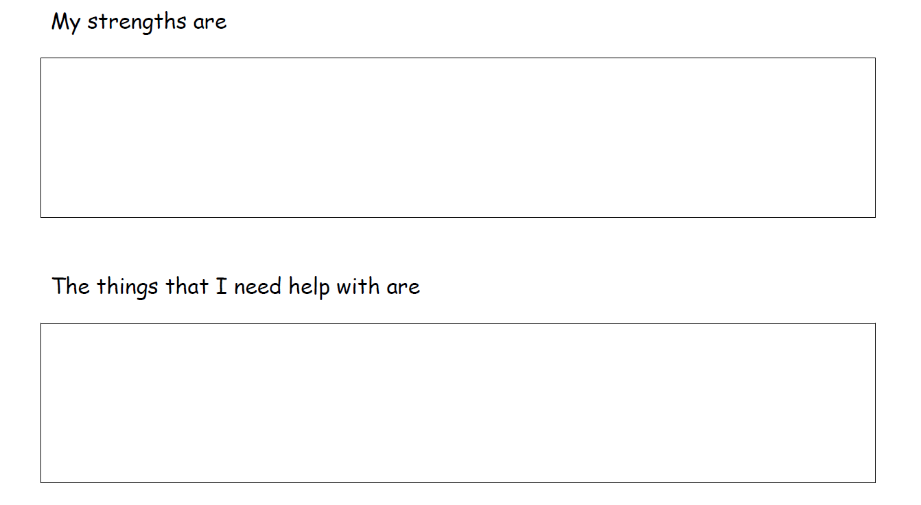
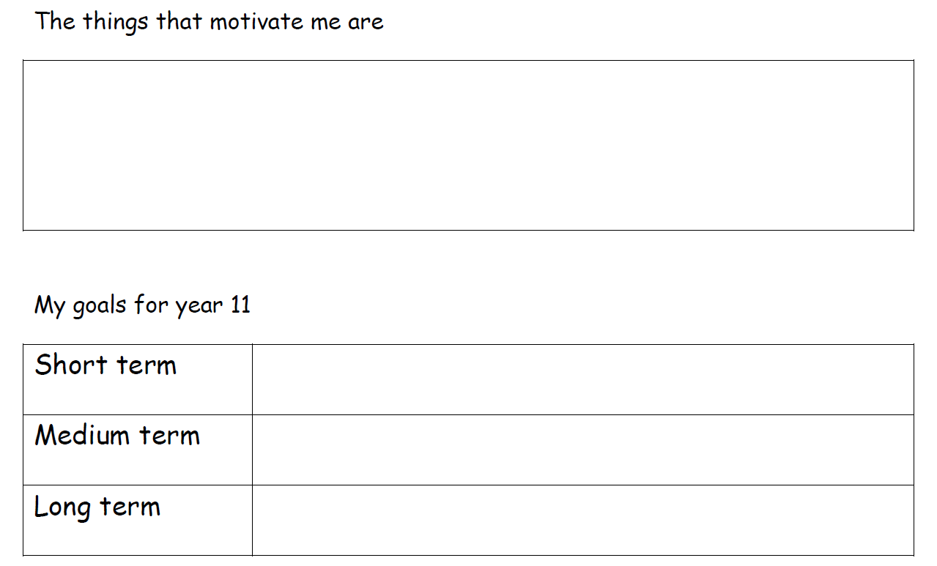

Slide 4
PE – most of the content especially paper 2
English Language and Literature confident
Food Tech – completed all work up to date
French – practiced speaking exam and past paper
Additional help on Levers in PE
Maths – Non calculator paper
Playing sport at the weekend
Meeting with friends
Socialising with my family
Ensure my practical video is handed in before Oct half term
Complete all revision notes before Mocks
Leave St Mary’s with the grades I need for sixth form.

Slide 5
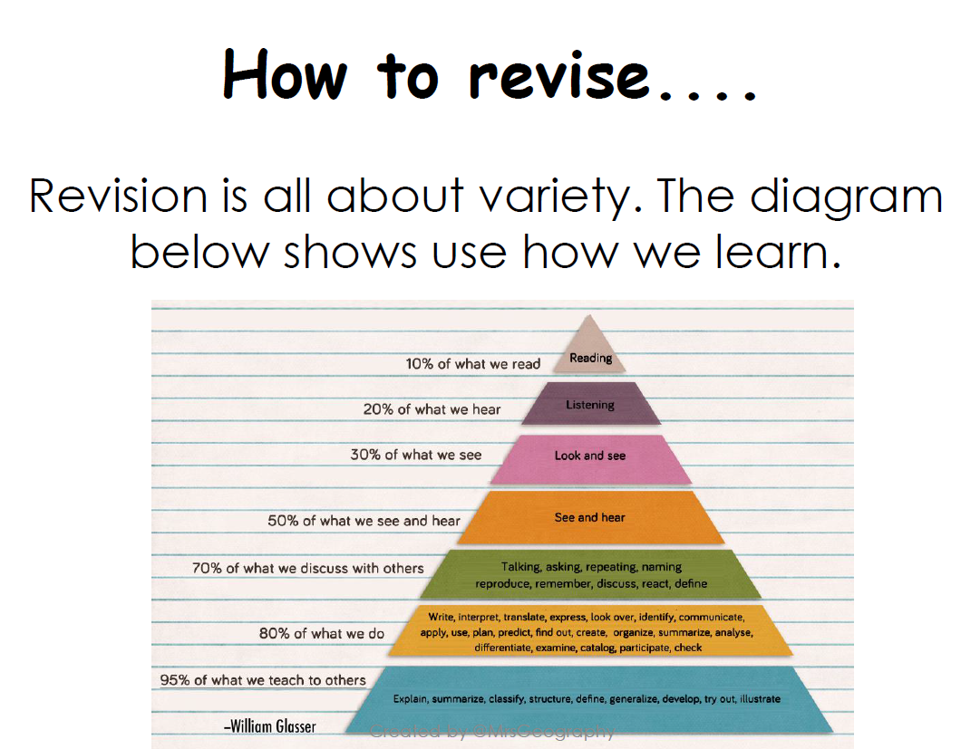

Slide 6
Revise…
What does that mean?
Different methods for different people
A bit about me….

Slide 7
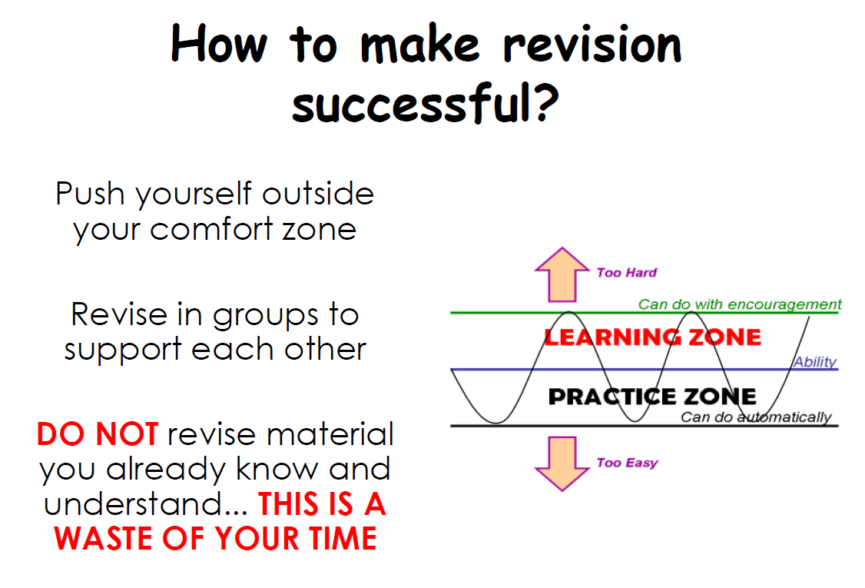

Slide 8
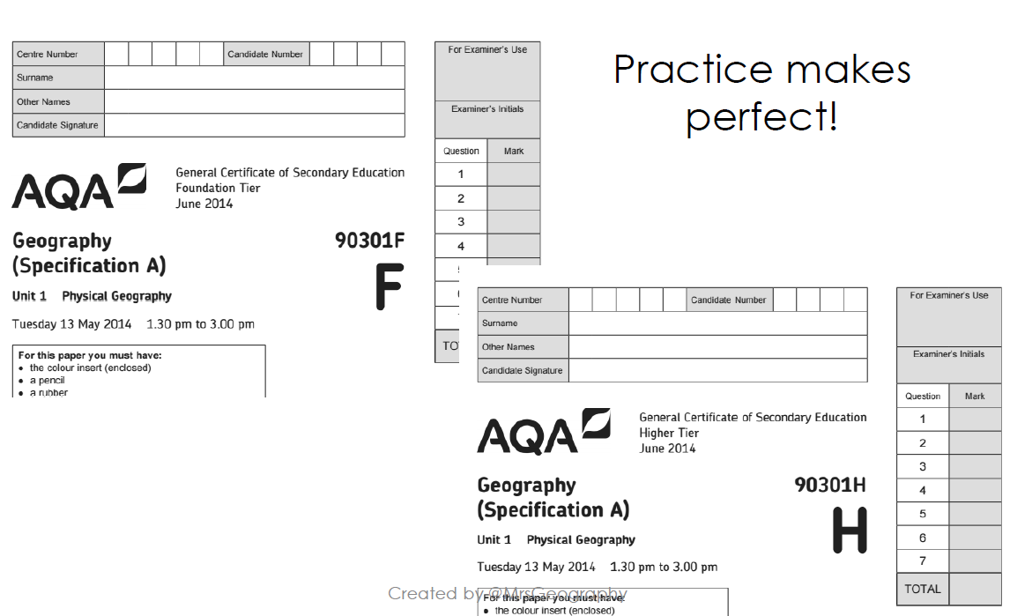

Slide 9
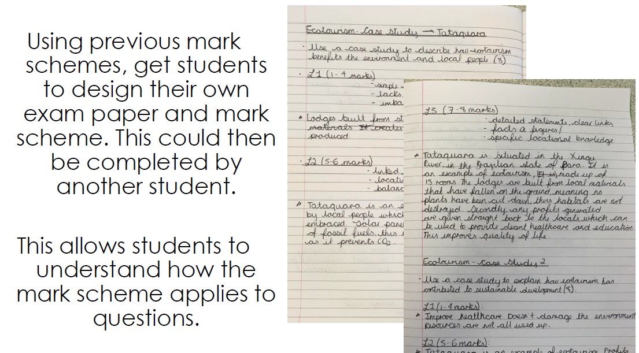

Slide 10
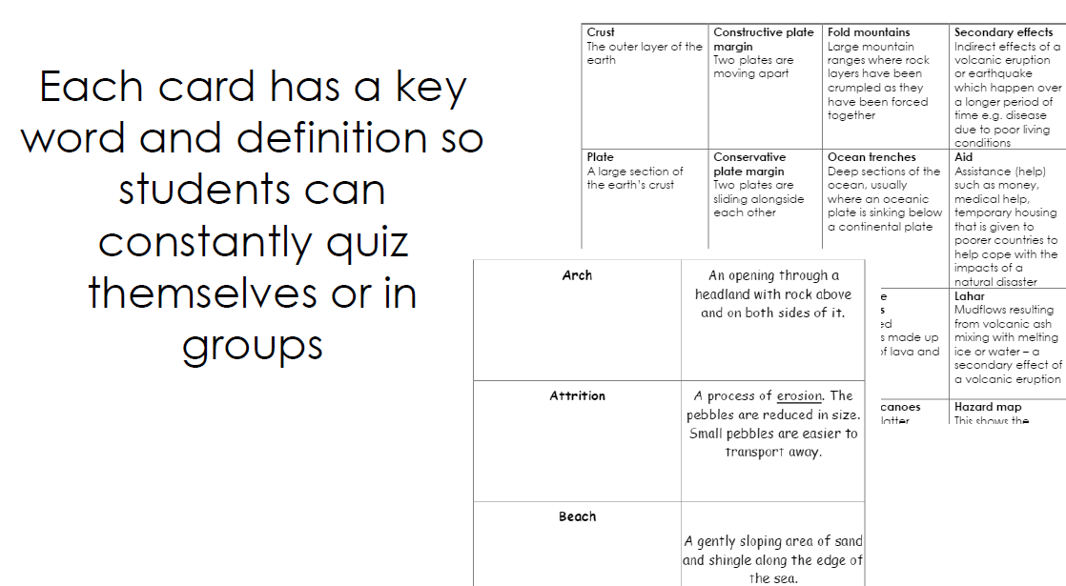

Slide 11
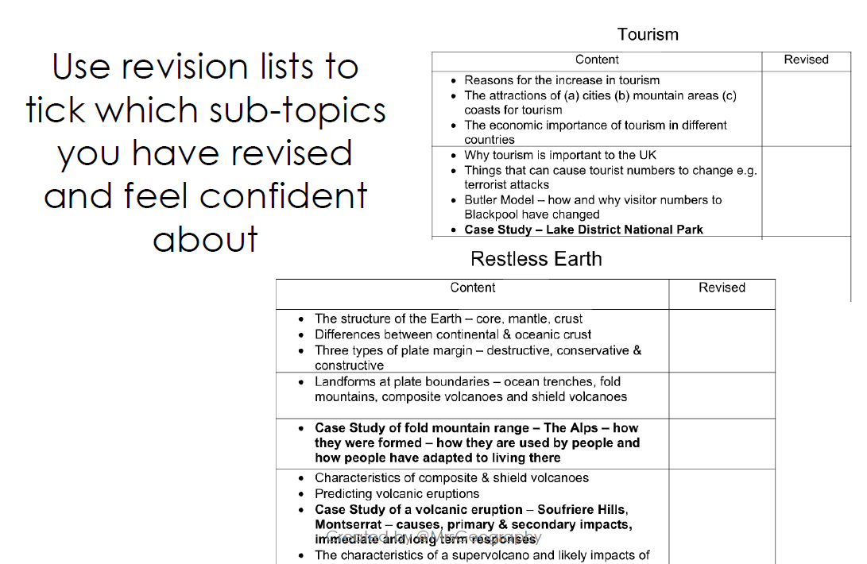

Slide 12
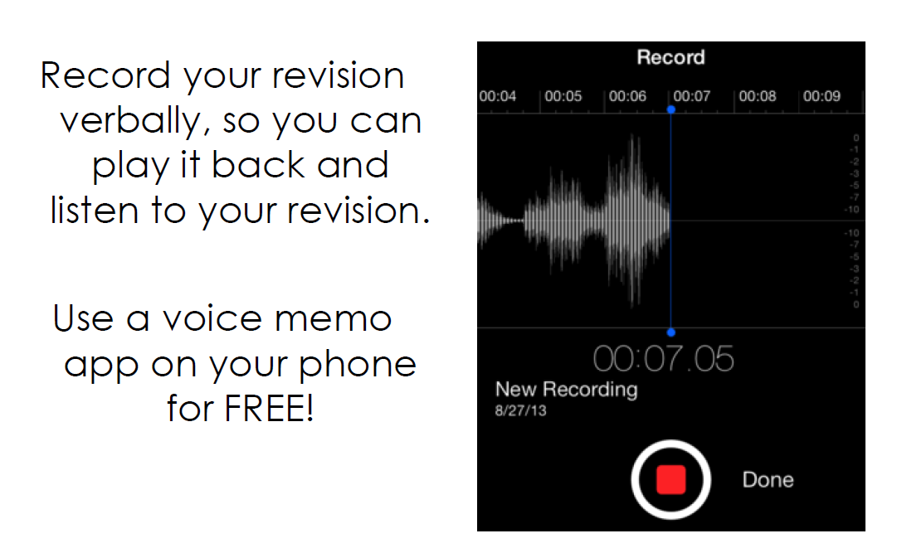

Slide 13
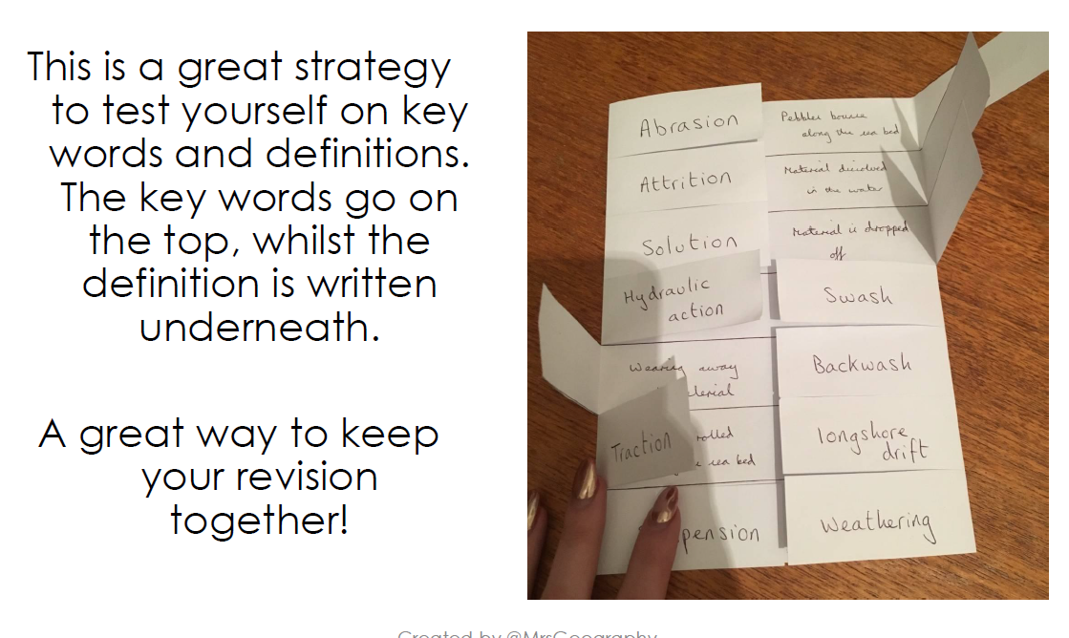

Slide 14
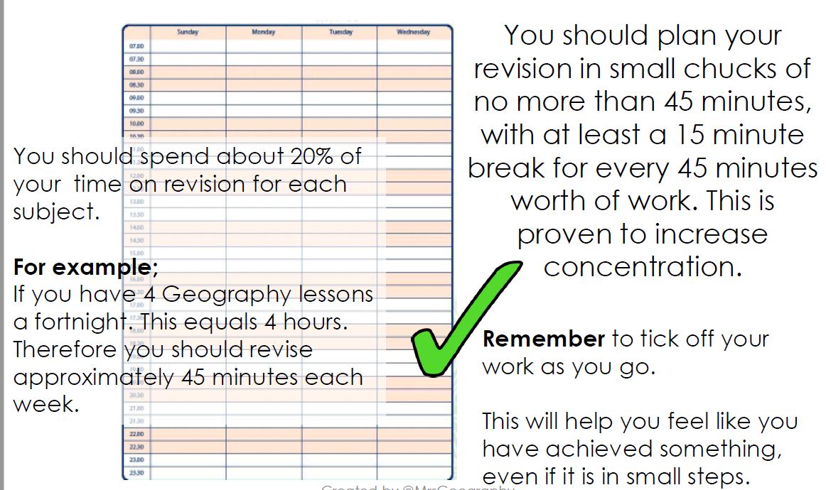

Slide 15
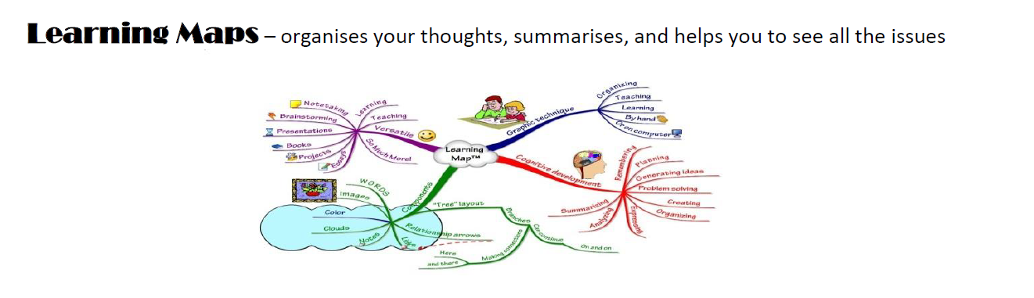
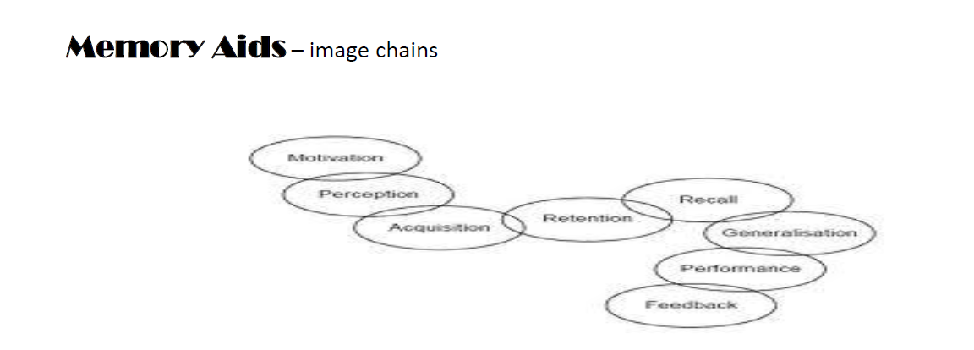

Slide 16
How I revised for my A levels
Spider diagram/picture diagrams
Highlight key text
Diagram/picture
Reread
Exam questions
-rewrite mark scheme
Test in group
Flash cards
Audio voice memos
Made models

Slide 17
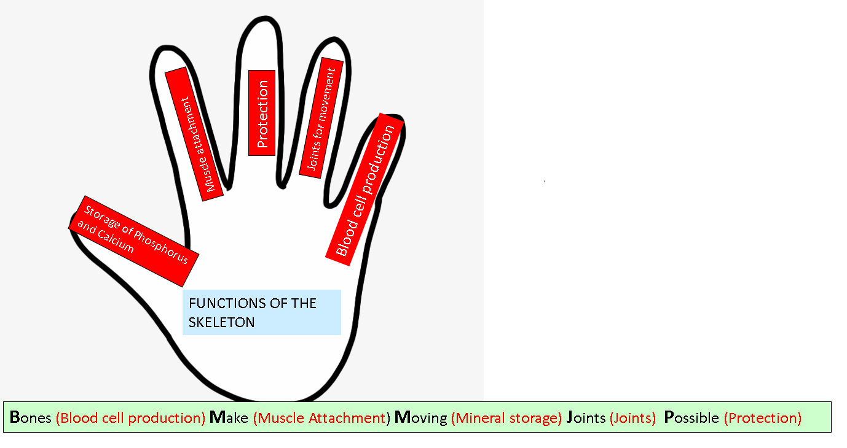

Slide 18
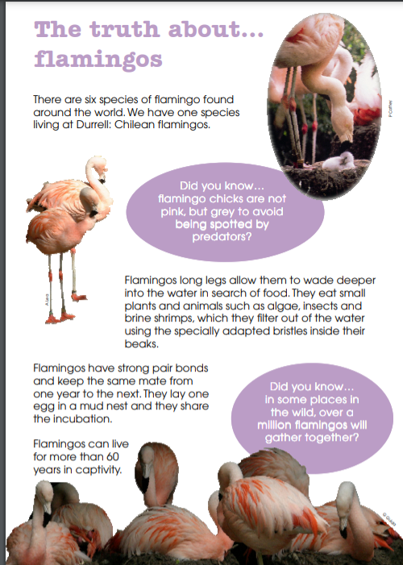

Slide 19
Using key facts
Long legs – wade into deep water
6 species
Diet – algae, insects, shrimps
Lay 1 egg into mud nest – share incubation
Chicks are born grey – avoid predators
Life span – 60 years
Same mate
1 million in a flock

Slide 20
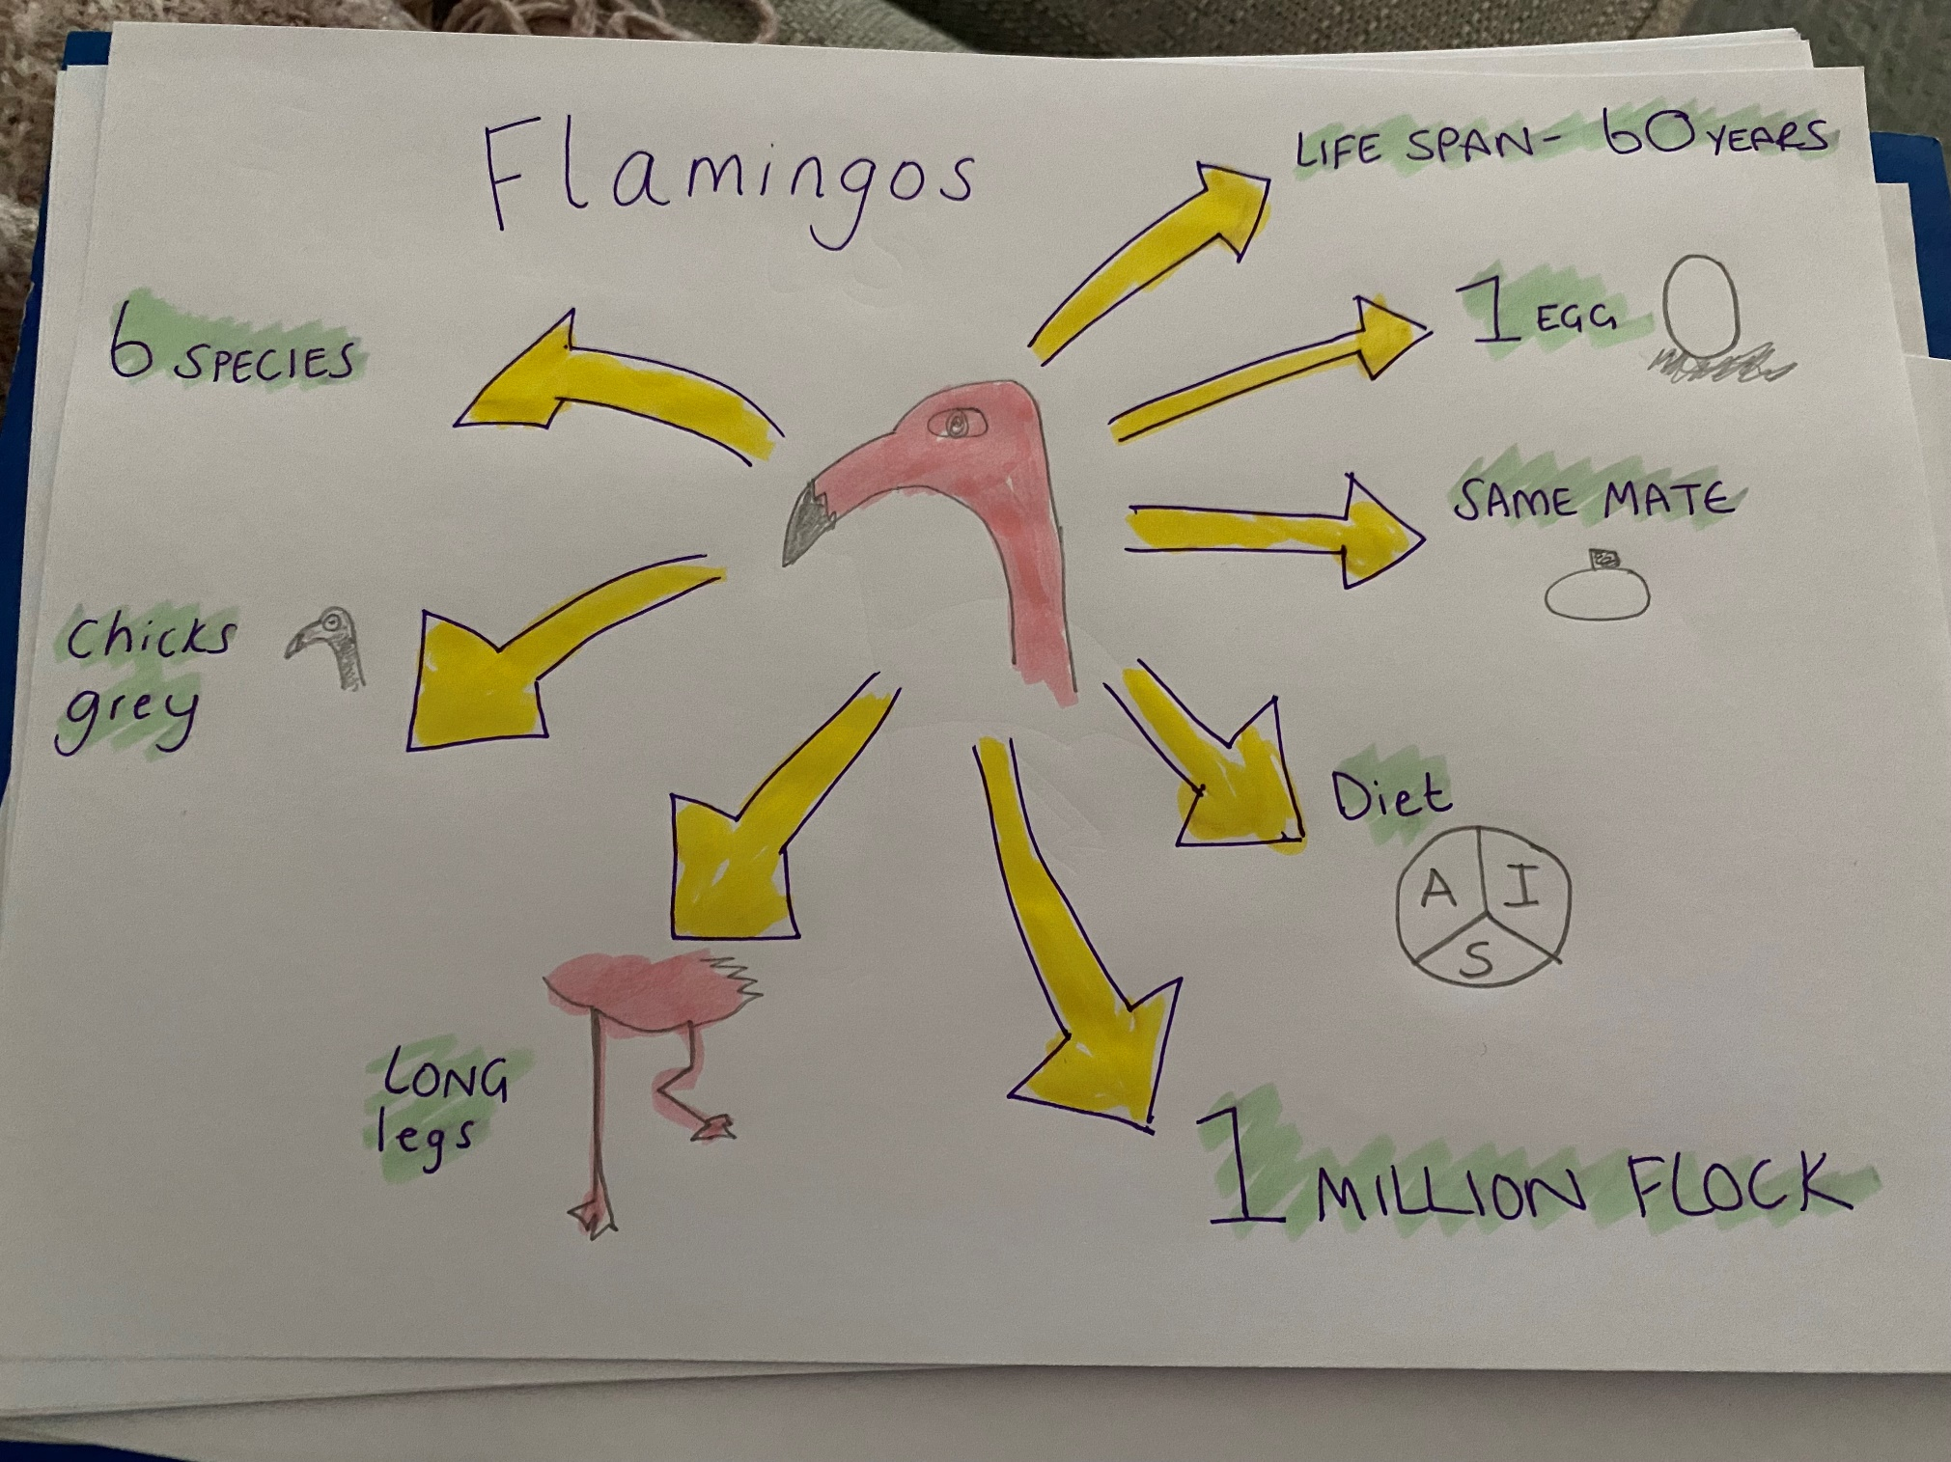

Slide 21
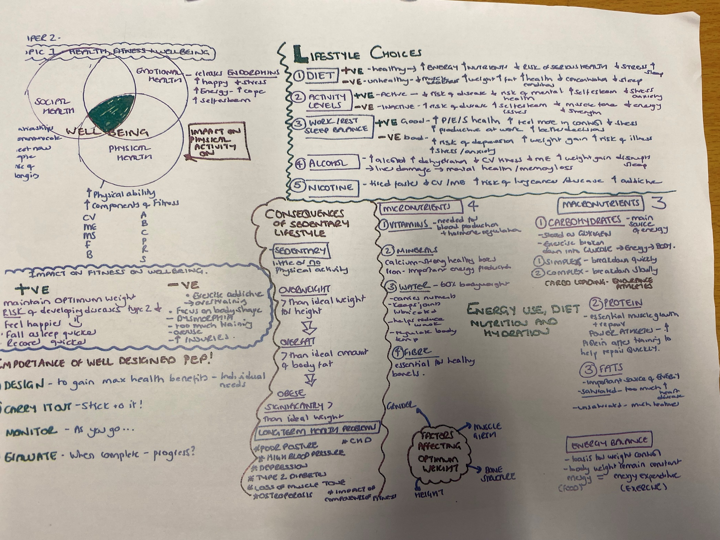

Slide 22
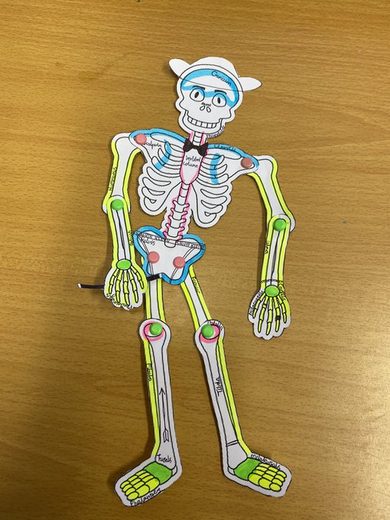

Slide 23
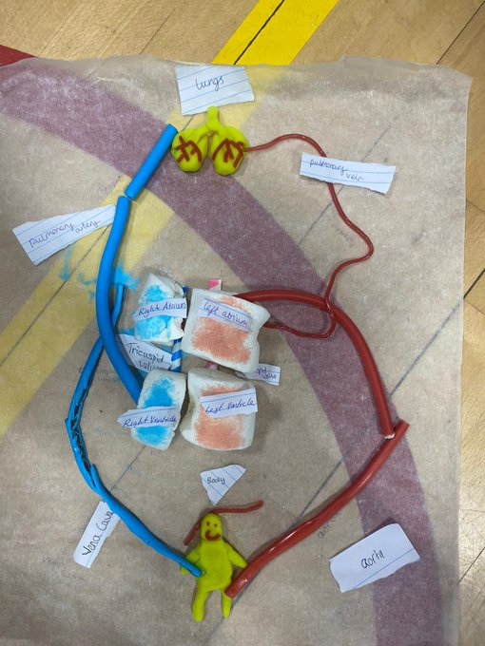

Slide 24
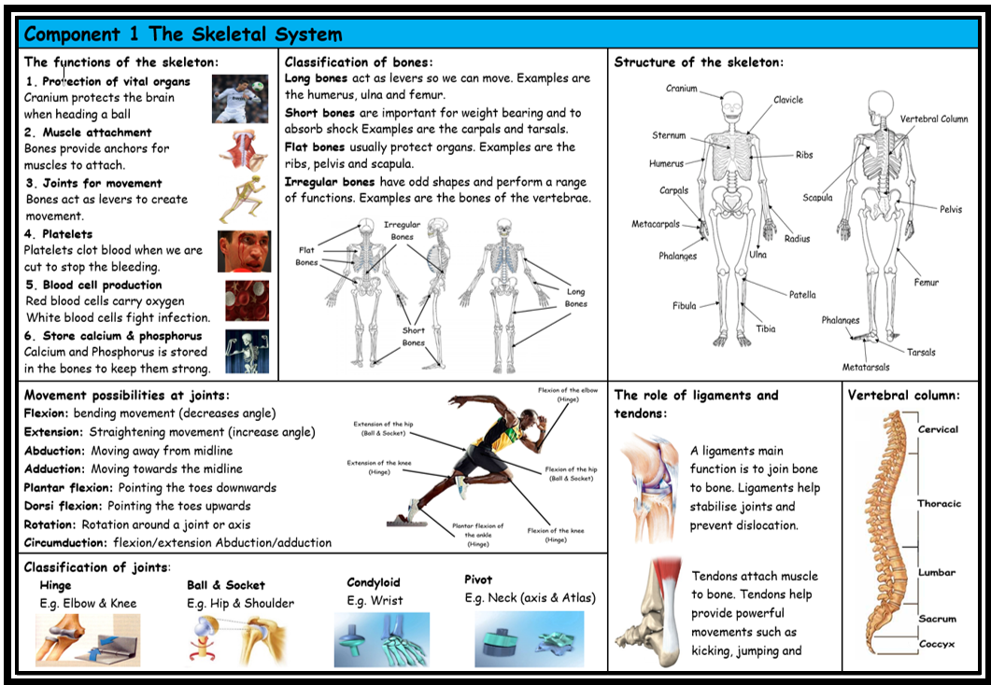

Slide 25
Over to you….
Find a topic
Highlight key text
Create a picture diagram to aid revision

