Slide 1
Spider Diagrams
Year 11

Slide 2
Why Spider Diagrams?
Spider diagrams condense the material
Short, snappy information
When using different colours it helps for us to picture it

Slide 3
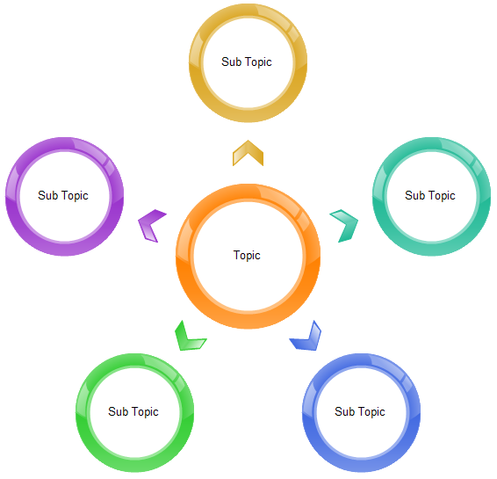

Slide 4
Key Elements
On an effective spider diagram you will need to following elements:
Main topic
Sub topics (Different colours)
Short and key information

Slide 5
Check List
First of all you need to have a Check List of your main topic.
For example, today we’re looking at:
The Triune God (Trinity)
Have a look down the Check List and put a tick next to the topic if you’re 100% sure you know that topic.

Slide 6

The Triune God
On our Spider Diagram we need to write in 3 elements:
Key information which include:
Key words
A key quote

Slide 7
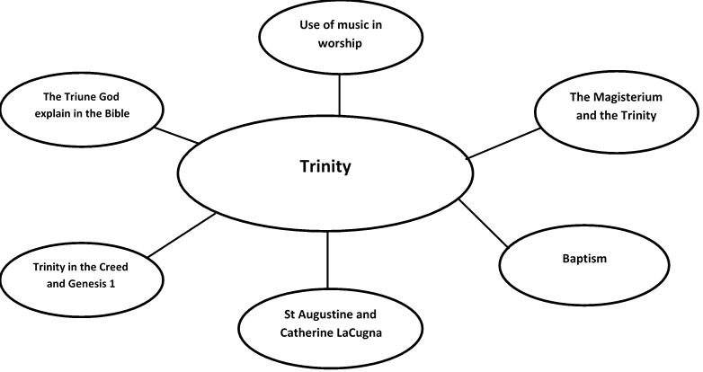

Slide 8
The Creed
God the Father
God the Father is he creator of all things.
God the Son
There is no distinction in nature between the Father and Son – ‘consubstantial with the Father’
God the Holy Spirit
The Holy Spirit comes from both the Father and the Son, uniting them in love.
Trinity in the Creed and Genesis 1
Genesis 1:1-3
The word ‘God’ is referring to the Father.
The phrase ‘wind from God’ can be translated as ‘breath’ or ‘spirit’. Shows the Holy Spirit was involved in creation.
God creates with his Word – reference to the Son (or Word) of God.
“In the beginning when God created the heavens and the earth, the earth was a formless void and darkness covered the face of the deep, while a wind from God swept over the face of the waters. Then God said, “Let there be light”; and there was light.”

Slide 9
Symbolism of Baptism
The start of a new stage of life as a Christian.
It’s joining in with Jesus’ death and resurrection.
Person being baptised commits their life to God.
Use of water symbolises the Holy Spirit which fills the person and sustains their faith in God.
Baptism
Importance of Baptism
It’s the first sacrament which welcomes a person in to the Church.
Cleanses a person of original sin.
Fills the person with the Holy Spirit.
Shares in the life of the Trinity.
Christians share in Christ’s victory over the power of sin and death.
“Go therefore and make disciples of all nations, baptizing them in the name of the Father and of the Son and of the Holy Spirit” – Matthew 28:19

Slide 10
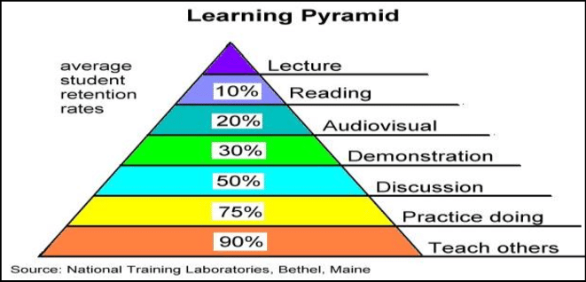

Slide 11
Cover and Recall
Once you have completed your Spider Diagram you need to be able to memorise it.
With a friend/family member ask them to test you on what is on your Spider Diagram.
Try teaching someone else the knowledge you have learnt!

