Slide 1
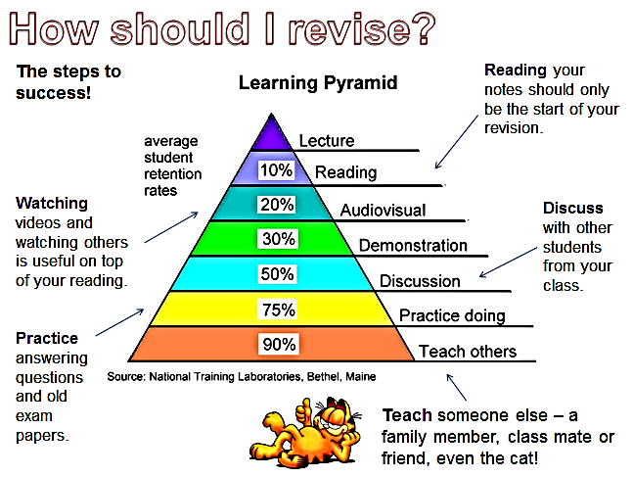

Slide 2
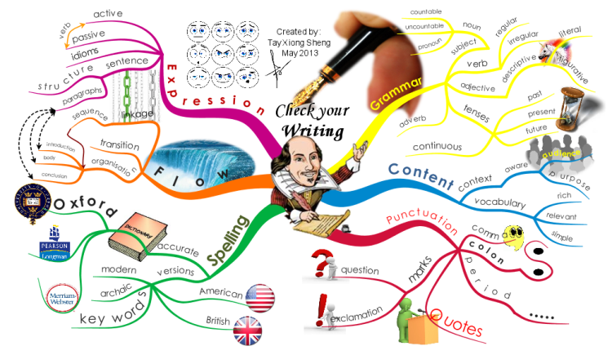
How to Create a Mind Map to Connect Ideas
Notes:
https://www.goconqr.com/en/examtime/blog/create-a-mind-map-connect-ideas/

Slide 3
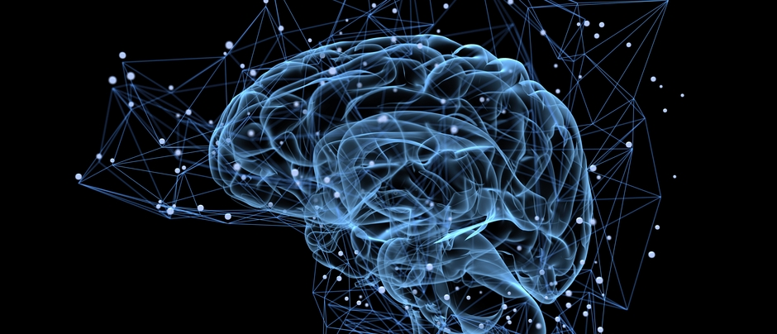
Mind Maps or Mind Mapping enhances our brain’s capacity for memorisation through the association of ideas.
Radiant Thinking
Power of Images
active cortical skills
Your brain wants to make connections
individuals have a recognition accuracy of images between 85 and 95%.
Linking Hemispheres

Slide 4
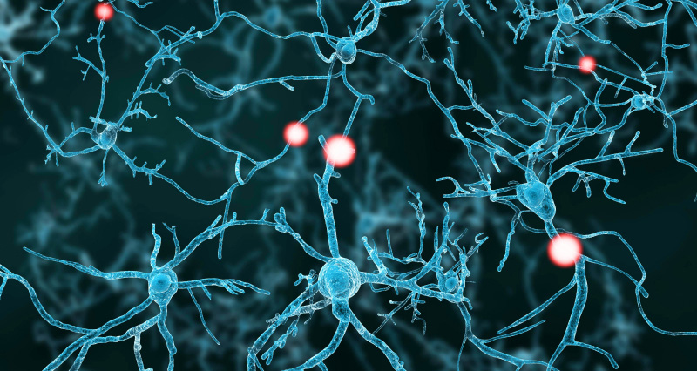
Power of Mind Maps
Mind maps creates connections in your brain both while creating but also studying your mind map.

Slide 5
First Step: The central idea
Steve Jobs 1955-2011

Slide 6
Second Step: The Main Branches
Charity work
Personal Life
Steve Jobs 1955-2011
Career

Slide 7
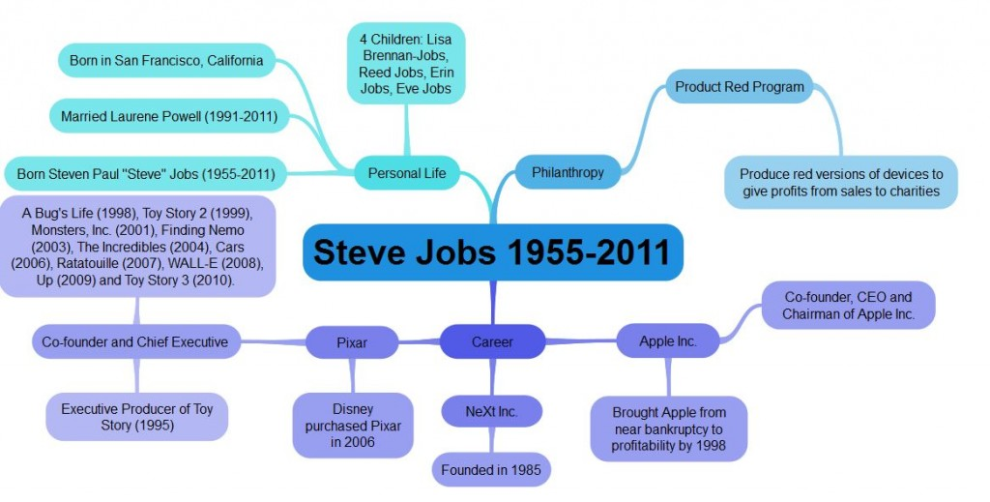
Third Step: Add the leaves…

Slide 8
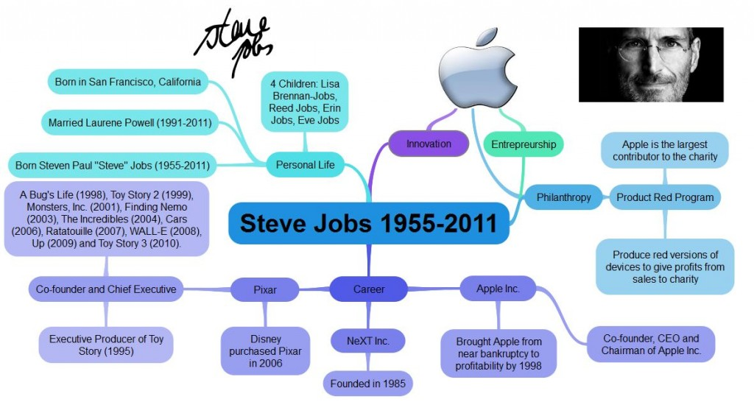
Third Step: Vines and flowers
Finally, it is highly recommended to add visual aids such as pictures to make it an even more visual map.
Also remember you can start to make connections between the branches like vines.

Slide 9
Lets have a go…
Sun | Solar System | Planets | Moons
Big Bang | Comets/ Asteroids | Galaxy | Universe
Milky Way | Earth | Vacuum | Parallax
Light-years | Hydrogen nuclei | Helium | Redshift
Universe
Galaxy
Physics
P1.1
The Earth in the Universe
1. Branches
2. Leaves
3. Flowers
4. Vines
Solar System

Slide 10
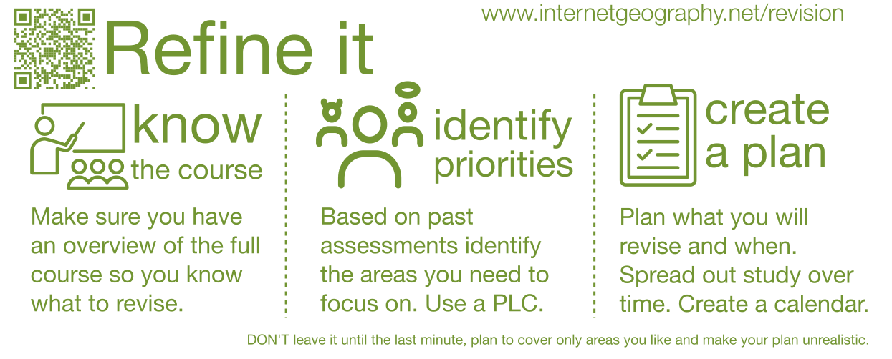

Slide 11
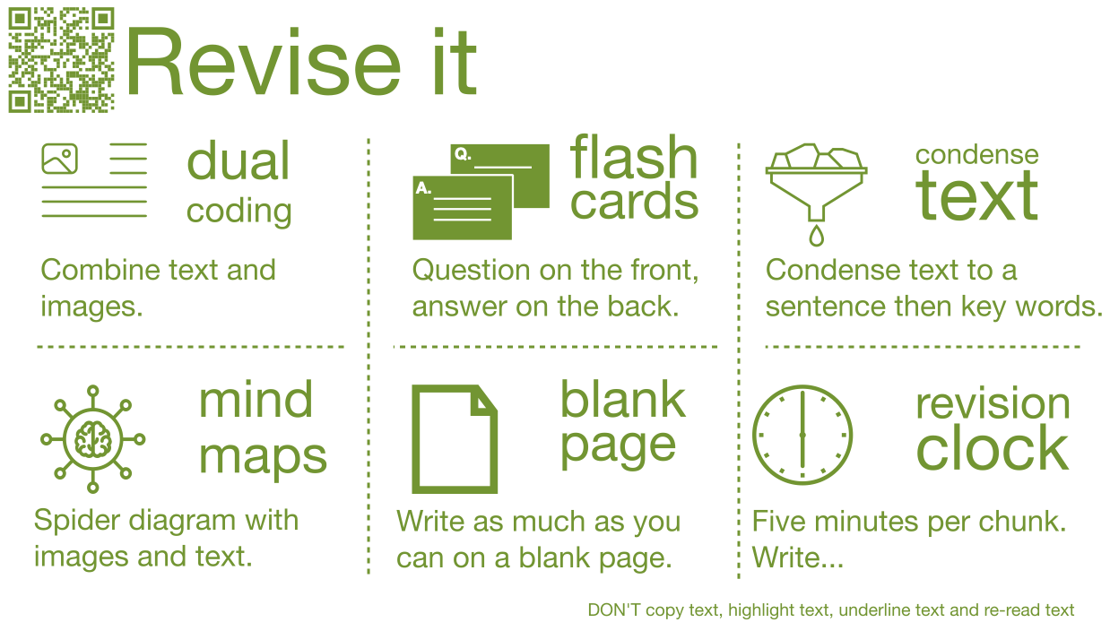

Slide 12


