Slide 1
Herefordshire’s economy: key facts
In employment | 94,700
Self-employed | 21,800
Student | 4,200
Looking after family/home | 2,100
Long-term sick | 5,500
Retired | 5,100
Other | 2,000
These numbers relate to the working age population (aged 16-64)
Claimant count | 3,700
Workless households | 7,100
Total enterprises | 10,350
Micro (0-9) | 9,320
Small (10-49) | 860
Medium (50-249) | 140
Large (250+) | 30
Data Source: ONS/NOMIS Herefordshire Labour Market Profile
Date last updated: 14 September 2021
Frequency of update: monthly

Slide 2
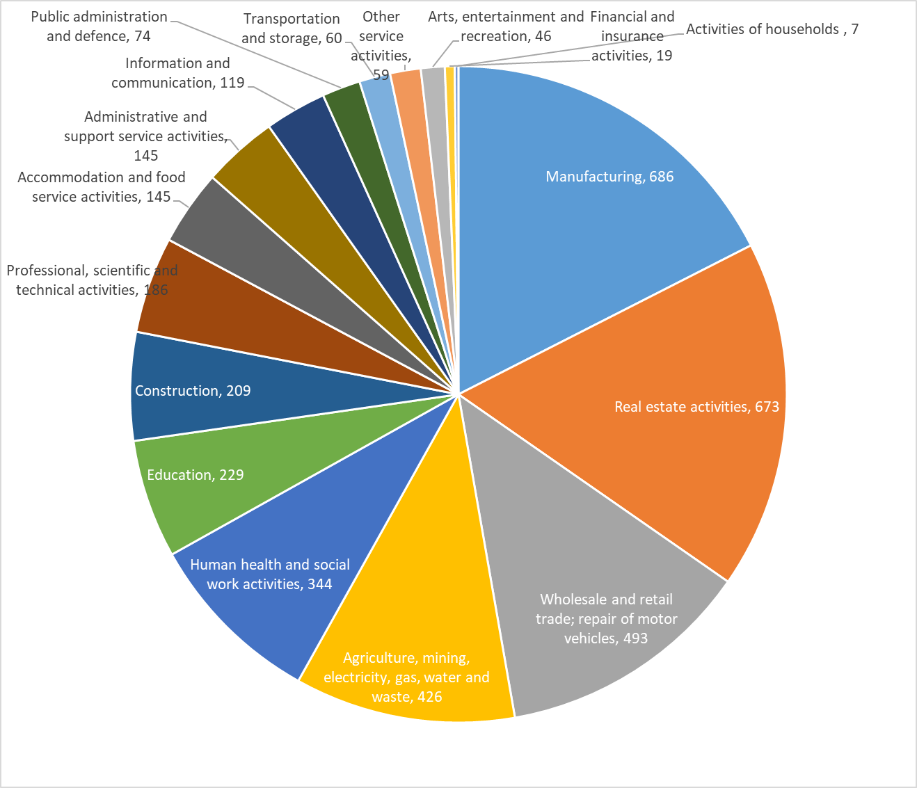
Industry sectors by contribution to Herefordshire GVA in 2019 - chained volume measures in 2018 money value (£ millions)
Source: ONS
Date last updated: May 2021
Frequency of update: Annually
HC data lead: IU

Slide 3
Herefordshire industries and employment by sector
Industry | Number | Proportion
Agriculture, forestry & fishing | 2,415 | 23%
Construction | 1,150 | 11%
Professional, scientific & technical | 1,140 | 11%
Business administration & support services | 825 | 8%
Retail | 630 | 6%
Manufacturing | 590 | 6%
Arts, entertainment, recreation & other services | 570 | 6%
Accommodation & food services | 545 | 5%
Information & communication | 470 | 5%
Wholesale | 350 | 3%
Property | 345 | 3%
Motor trades | 320 | 3%
Health | 285 | 3%
Transport & storage (inc postal) | 255 | 2%
Education | 180 | 2%
Financial & insurance | 110 | 1%
Public administration & defence | 110 | 1%
Mining, quarrying & utilities | 65 | 1%
TOTAL ENTERPRISES | 10,355
Industry | Total Employees | Full-time | Part-time | Total Employments
Manufacturing | 12,000 | 11,000 | 1,250 | 12,000
Health | 12,000 | 6,000 | 6,000 | 12,000
Retail | 8,000 | 3,500 | 5,000 | 9,000
Accommodation & food services | 8,000 | 2,500 | 5,000 | 8,000
Agriculture, forestry & fishing | 6,000 | 5,000 | 600 | 11,000
Education | 6,000 | 3,000 | 3,500 | 6,000
Business administration & support services | 4,500 | 3,000 | 1,750 | 5,000
Construction | 4,000 | 3,500 | 500 | 4,500
Professional, scientific & technical | 4,000 | 3,500 | 900 | 4,500
Arts, entertainment, recreation & other services | 3,500 | 1,750 | 1,750 | 3,500
Wholesale | 3,000 | 2,500 | 450 | 3,000
Motor trades | 2,250 | 1,750 | 400 | 2,250
Transport & storage (inc postal) | 2,000 | 1,250 | 600 | 2,000
Property | 1,500 | 1,000 | 500 | 2,250
Public administration & defence | 1,500 | 1,000 | 350 | 1,500
Information & communication | 1,250 | 1,000 | 200 | 1,250
Mining, quarrying & utilities | 900 | 800 | 75 | 900
Financial & insurance | 900 | 700 | 225 | 900
TOTALS | 81,300 | 52,750 | 29,050 | 89,550
Need to know: An enterprise can be thought of as the overall business, made up of all the individual sites or workplaces.
Employments includes employees plus the number of working owners.
Source: ONS/NOMIS
Frequency: annual
Last updated: May 2021

Slide 4
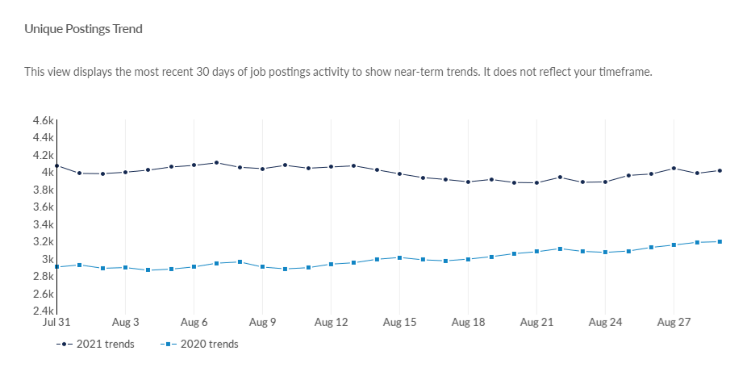
Job postings in Herefordshire
According to EMSI, in Herefordshire there were a total of 6,462 unique job postings in July 2021. This compares to 3.920 in July 2020 and 6,343 in July 2019.
Locally, job postings are now significantly higher than in the same period a year ago. This, in combination with the claimant count data appears to suggest that Herefordshire’s economy is recovering well from the economic turbulence of the past twelve months.
As at 29 August 2021 there were 4,015 unique job postings; 25.8% higher than on the same date last year.
Top posted occupations in July 2021 were nurses, care workers and home carers, and metal working production and maintenance fitters.
Note: the commentary to the above chart was incorrect last month. This view displays the count on each day of the most recent 30 days of job postings activity to show near-term trends. It does not show the cumulative total for the past 30 days.
Source: Emsi- economicmodelling.co.uk
Date last updated: 31 August 2021
Frequency of update: daily
HC data lead: Intelligence Unit
Need to know: A unique job posting is one that has been de-duplicated as postings can appear on multiple websites, multiple times. Data include voluntary, internships, side jobs and freelance.

Slide 5
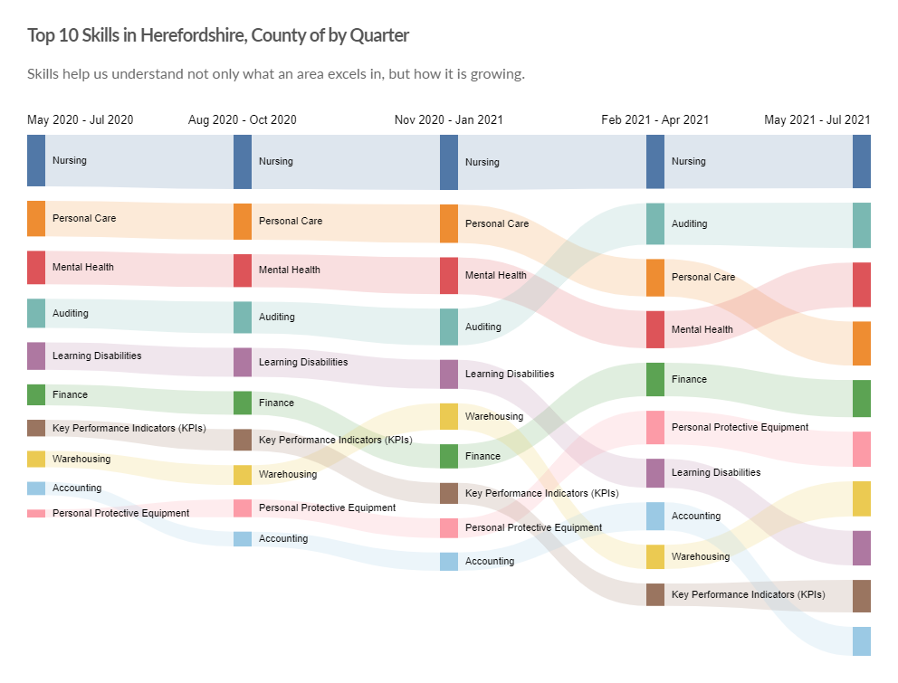
Top 10 in-demand skills in Herefordshire
Need to know: Hard skills are abilities that have been taught to or learnt by a person.
Source: Emsi- economicmodelling.co.uk
Date last updated: 31 August 2021
Frequency of update: monthly
HC data lead: Intelligence Unit

