Slide 1
Herefordshire’s economy: key facts
In employment | 93,400
Self-employed | 20,600
Student | 4,500
Looking after family/home | 3,200
Long-term sick | 5,900
Retired | 4,600
These numbers relate to the working age population (aged 16-64)
Claimant count | 3,015
Workless households | 7,000
Total enterprises | 10,385
Micro (0-9) | 9,345
Small (10-49) | 870
Medium (50-249) | 135
Large (250+) | 30
Data Source: ONS/NOMIS Herefordshire Labour Market Profile
Date last updated: 18 January 2022
Frequency of update: monthly

Slide 2
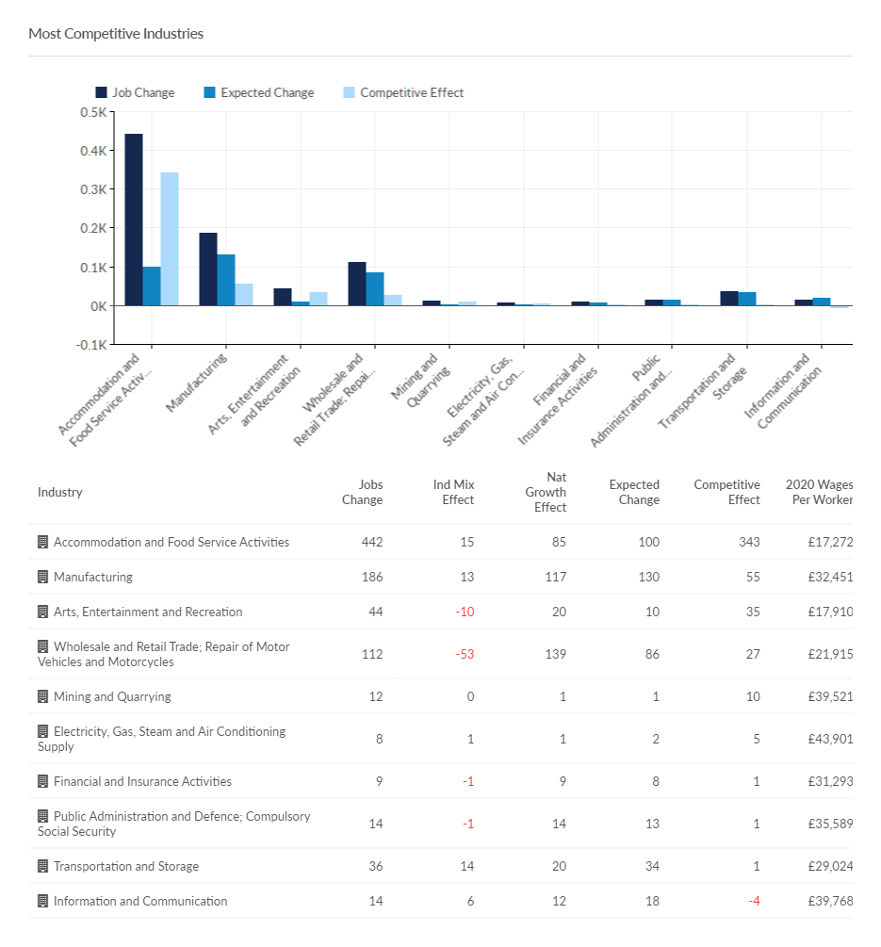
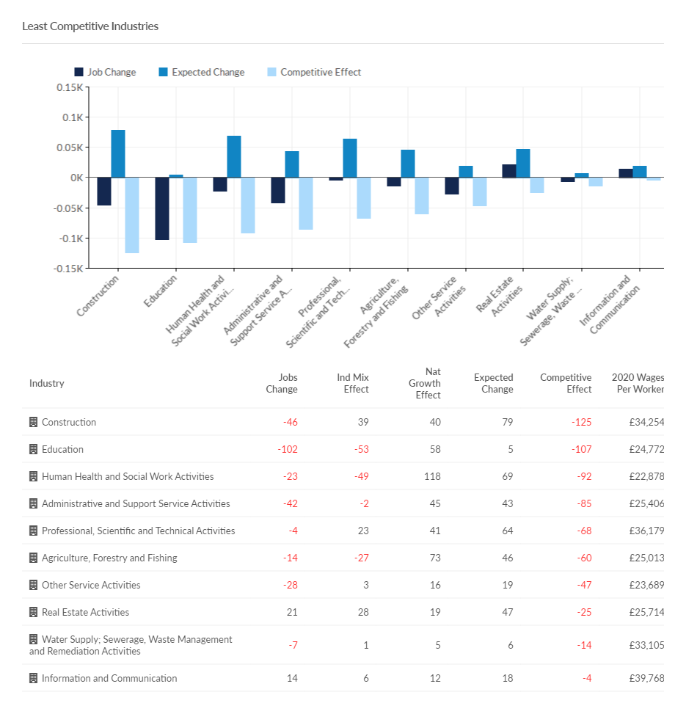
Herefordshire’s most and least competitive industries (2020-2021)
Source: Emsi- economicmodelling.co.uk
Date last updated: 11 January 2022
Frequency of update: annual
HC data lead: Intelligence Unit
Need to know: Competitive effect explains how much of the change in a given industry is due to some unique competitive advantage that the region possesses. This effect is calculated by taking the total regional growth and subtracting the national growth for the same industry. The regional growth that remains cannot be explained by national trends in that industry or the economy as a whole.

Slide 3
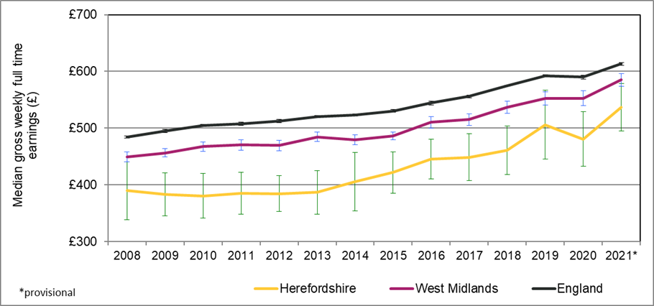
Earnings
The latest Annual Survey of Hours and Earnings (ASHE) reveals that the workplace-based median weekly earnings for people who work in Herefordshire is now £536.60 (± £42.07).
Herefordshire’s weekly earnings are significantly lower than that in England £613.30 (± £2.40). Herefordshire’s weekly earnings are not recorded as significantly different to the West Midland region’s in 2021, although the amount is lower £585.0 (± £11.47).
The county has the lowest median earnings of all 14 West Midlands authorities, also, consistently ranked as amongst the lowest in England and Wales (14th out of 111 top-tier authorities in 2021 provisional figures).
Annualised earnings are £27,980 (± £2,194), also significantly lower England £30,979 (± £125) but similar to the West Midlands region, £30,504 (± £598).
If we look at residents based weekly earnings as opposed to work place based weekly earnings, these are £535.50 (±67.17) and although lower compared to England and the West Midlands region although the differences are not significant.
Source: Annual Survey of Hours and Earnings (ASHE) available from NOMIS
Frequency: annual
Last updated: November 2021.
Need to know: workplace-based earnings includes all people who work in Herefordshire regardless of which county they live in. Residents-based weekly earnings includes all people who live in Herefordshire i.e. includes those who work outside the county

Slide 4
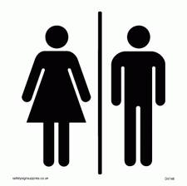
Gender pay gap
The gender pay gap (GPG ) is the difference between average hourly earnings (excluding overtime) of men and women as a proportion of average hourly earnings (excluding overtime) of men.
Although the gap is now 25% lower than it was a quarter of a century ago, it is still around 13 percentage points and in 2019 the average working-age woman in the UK earned 40% less than her male counterpart.
Recent research by the IFS as part of the Deaton Review found that the vast majority of the modest convergence in earnings of the past 25 years can be explained by the closing of the gender gap in education levels.
The divergence occurs with parenthood, when the gendered roles that mothers and fathers take on appear to be largely unrelated to their relative earnings potential.
The IFS found that persistent social norms around parenting are reinforced by a policy environment that sustains and incentivises a traditionally gendered division of labour, even when policies are ostensibly gender-neutral.
In 2021, women’s earnings in Herefordshire are 4% lower than men’s; a smaller gap compared the West Midlands region (10%) and England (9%).
Source: Annual Survey of Hours and Earnings (ASHE) available from NOMIS
Frequency: annual
Last updated: November 2021

Slide 5
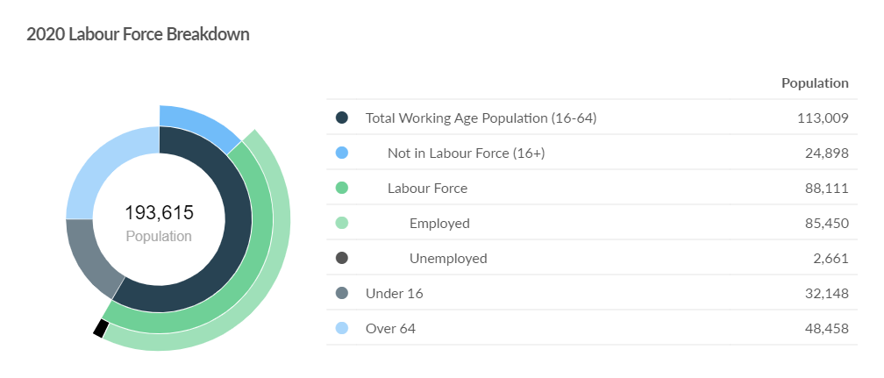
2020 Labour Force Breakdown
Source: Emsi-economicmodelling.co.uk
Frequency: annual
Last updated: December 2021

Slide 6
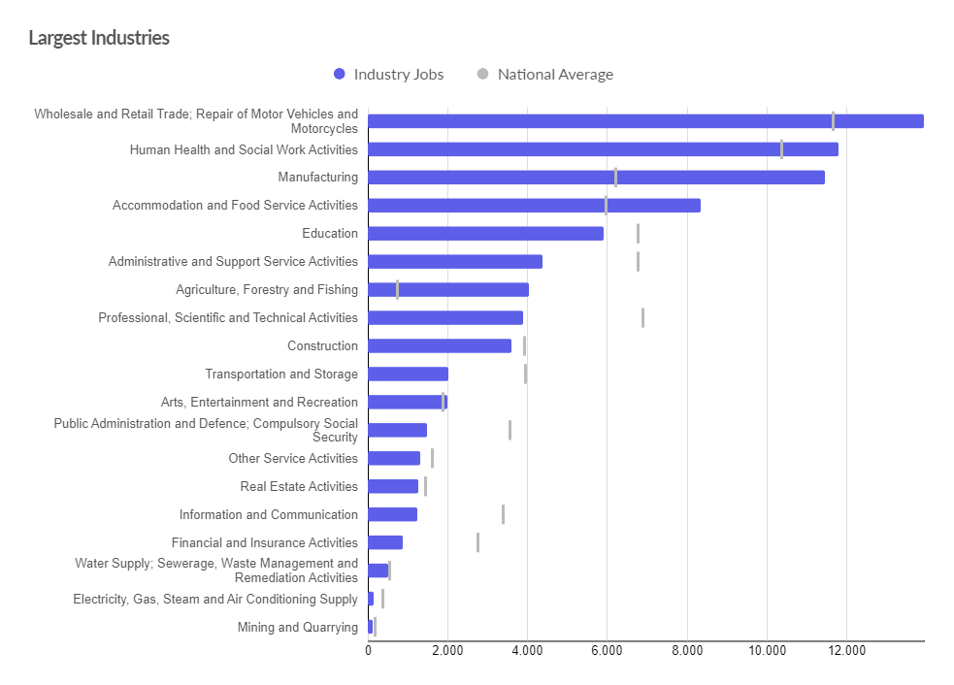
Herefordshire’s largest industries (by jobs)
Source: Emsi- economicmodelling.co.uk
Date last updated: 16 December 2021
Frequency of update: daily
HC data lead: Intelligence Unit

Slide 7
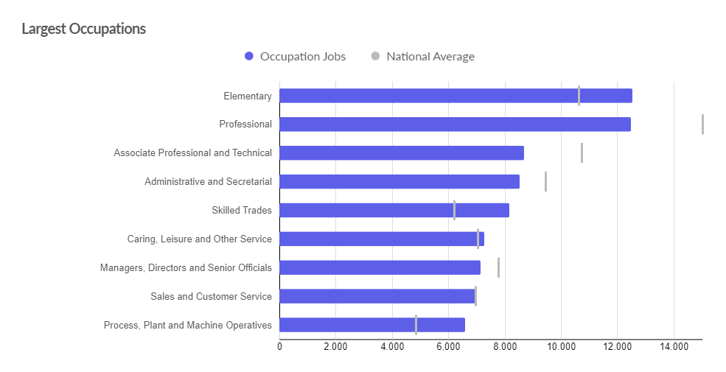
Herefordshire’s largest occupations
Source: Emsi- economicmodelling.co.uk
Date last updated: 16 December 2021
Frequency of update: daily
HC data lead: Intelligence Unit

Slide 8
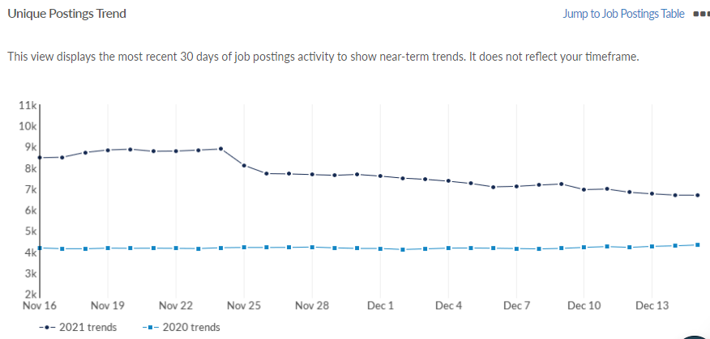
Job postings in Herefordshire
According to EMSI, in Herefordshire there were a total of 10,375 unique job postings in November 2021. This compares to 9,176 in the previous month.
Locally, job postings are now significantly higher than in the same period a year ago. This, in combination with the claimant count data appears to suggest that Herefordshire’s economy was pre-Omicron recovering well from the economic turbulence of the past twelve months.
As at 15 December 2021 there were 6,693 unique job postings; 54.9% higher than on the same day last year.
Top posted occupations in November 2021 were nurses, care workers and home carers, book-keepers, payroll managers and wages clerks, van drivers, sales and retail assistants, and sales accounts and business development managers.
Source: Emsi- economicmodelling.co.uk
Date last updated: 16 December 2021
Frequency of update: daily
HC data lead: Intelligence Unit
Need to know: A unique job posting is one that has been de-duplicated as postings can appear on multiple websites, multiple times. Data include voluntary, internships, side jobs and freelance.

Slide 9
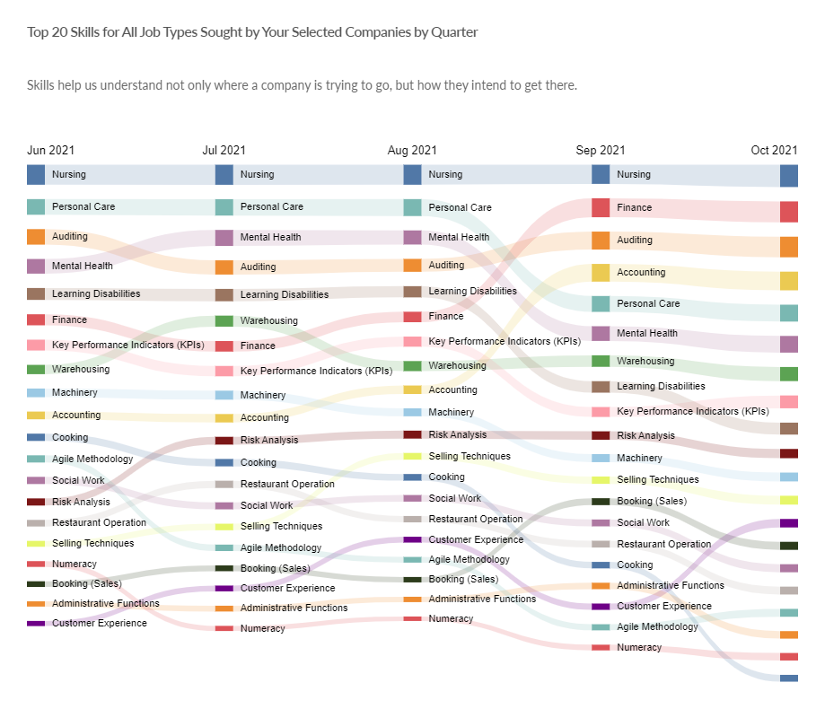
Top 10 in-demand skills in Herefordshire
In 2021 as a whole the top ten in-demand skills in Herefordshire (with number of citations) were:
Nursing 1,109
Auditing 1,103
Finance 958
Personal Care 902
Mental Health 869
Warehousing 846
Accounting 769
Key Performance Indicators (KPIs) 656
Learning disabilities 644
Machinery 553
Need to know: Hard skills are abilities that have been taught to or learnt by a person.
Source: Emsi- economicmodelling.co.uk
Date last updated: 16 December 2021
Frequency of update: monthly
HC data lead: Intelligence Unit

Slide 10
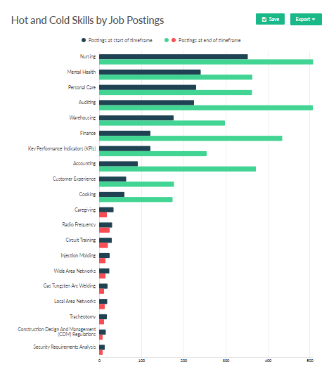
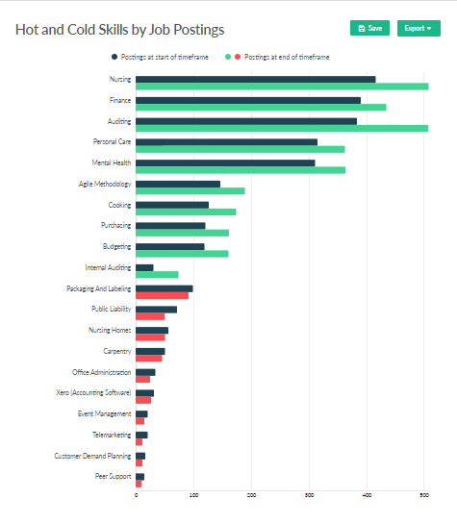
Hot and cold hard skills in Herefordshire
Hot and cold hard skills compared to 1 year ago (November 2020)
Hot and cold hard skills compared to 1 month ago (October 2021)
Need to know: Hard skills are abilities that have been taught to or learnt by a person.
Source: Emsi- economicmodelling.co.uk
Date last updated: 16 December 2021
Frequency of update: monthly
HC data lead: Intelligence Unit

Slide 11
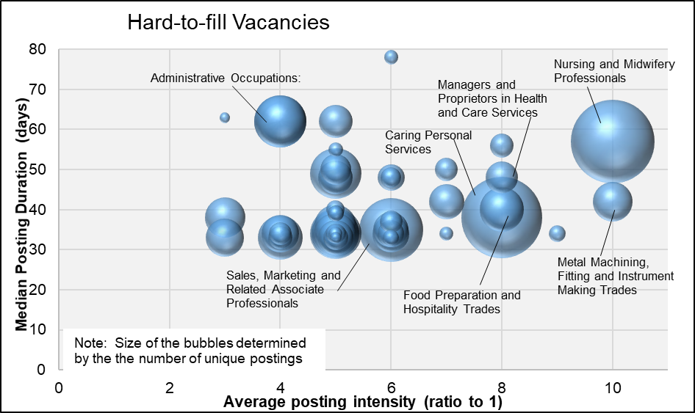
Hard-to-fill vacancies
There is no standard definition of a “hard-to-fill” vacancy but the chart shows occupations where there have been 10 or more unique Herefordshire job postings in October/November 2021 by median posting duration and job posting intensity.
This is the most timely proxy for “hard-to-fill” vacancies and although there are some issues associated with this methodology has been shown to be a robust approximation.
Those roles that appear highest on the chart for both measures can be regarded as most “hard-to-fill”.
Nationally, ONS reports that the number of job vacancies in October to December 2021 rose to a new record of 1,247,000, an increase of 462,000 from its pre-coronavirus January to March 2020 level, with most industries displaying record numbers of vacancies. However, the rate of growth in vacancies continued to slow down. The ratio of vacancies to every 100 employee jobs reached a record high 4.1 in October to December 2021.
Need to know: Posting Intensity is a ratio of total job postings to unique, or de-duplicated, job postings. A higher than average posting intensity can mean that employers are putting more effort than normal into hiring that position. Posting intensity is available by occupation, by job title, by company, and by region. The median posting duration (how long a posting was live before it was taken down) can be compared to the regional average for all postings in the region, giving an indication of whether these positions are harder or easier to fill than the typical job posting.
Source: Emsi- economicmodelling.co.uk
Date last updated: 16 December 2021
Frequency of update: quarterly
HC data lead: Intelligence Unit

Slide 12
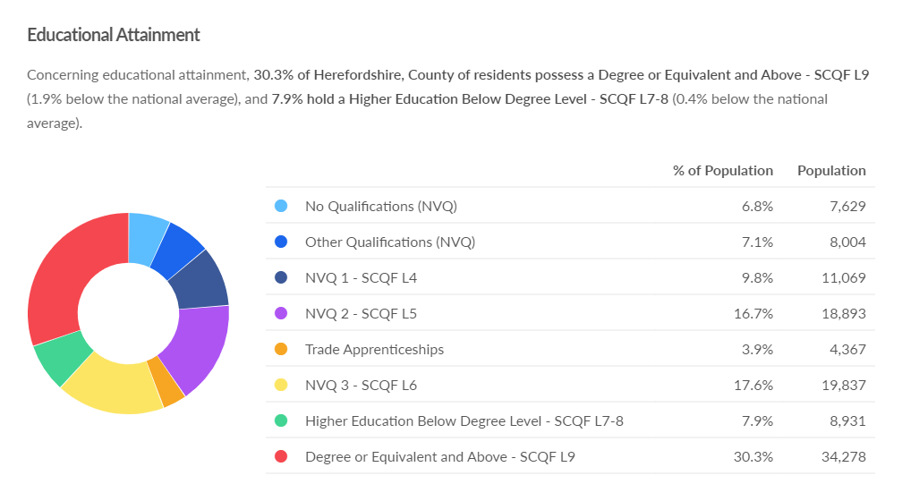
Workforce educational attainment
Source: Emsi- economicmodelling.co.uk
Frequency: Annual
Last updated: December 2021

