Slide 1

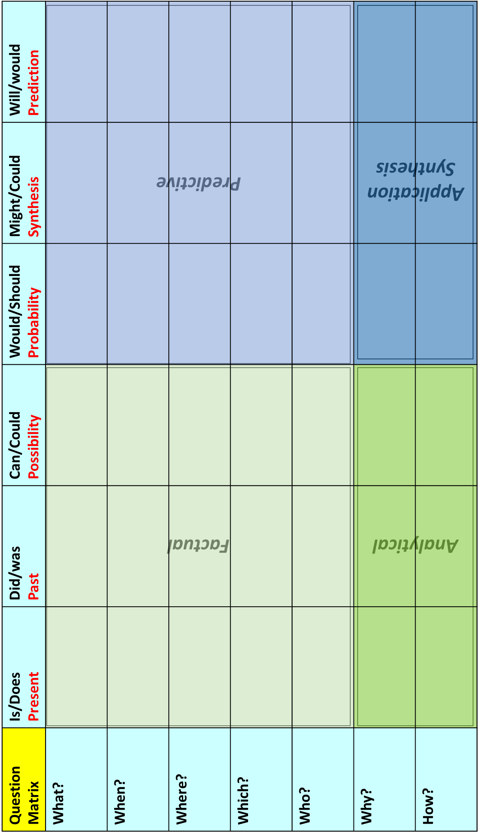
Challenge literacy through questioning: Use the Bloom’s grid to help build stretch and encourage articulacy.
e.g. ‘What is this image…’ right through to ‘Why might we expect to see this image…’

Slide 2
Literacy at SMRC
Simple cross curricular strategies
Three key ‘no planning’ strategies
Transferability
Explicit vocabulary instruction
Give students access to a bank of terms and define, revise and revisit them explicitly– subject glossaries do not contain terms that are only useful in one area but contribute student articulacy across subjects
Art – Abstract
Biology – atrophy
RE - Benevolence
English – Abstract nouns
PE – ‘reduced hippocampal atrophy…’
Targeting
‘Target’ vocabulary
Avoid the temptation to ‘dumb down’ language where possible. Provide specialist and challenging vocabulary and opportunities to acclimatise and immerse.
Unfamiliarity breeds panic
‘The river doesn’t wind it meanders’
If students are always only exposed to the simplest terms and the ‘watered down’ version anything else will appear incomprehensible
REWORD
Reframing
Offer students the chance to reframe the complex into the simple and vice versa. Let them explain ‘In their own words…’ and compare the two side by side
*Important here to reject misconceptions*
Hitler ascended to autocracy…
They had a monopoly on the market…
Hitler rose to be a dictator…
They completely dominated market, the only company…

Slide 3
Literacy at SMRC
Expanding and Summarising
Use the explicit stems and structures to develop complexity or provide clarity
Because, but, so…
Because-But –So
Use as a starter or as a prompt in questioning. The conjunctions will encourage students to think in concise or specific ways to expand or answer
Example - Biology:
‘Seeds need light to grow…’
Because…But…So…
Because light is an external trigger for germination…
But seeds also need moisture and the correct temperature…
But some seeds do not need light to germinate…
So access to sunlight can be important…
W5 and Blooms
‘Who, What, When, Where, Why’ and Rising Challenge
Use as part of questioning or as a acronym/ ‘structure strip’ in creating summaries or expansions
Example - Geography - Rift Valleys
Who
What
When
Where
Why
A rift valley is a lowland region that forms where the earth’s tectonic plates move apart. They are found both on land and at the bottom of the ocean, where they are created by the process of seafloor spreading…
TL;DR & WIRM
Too Long; Didn’t Read / What I Really Mean
Create concise summaries of block text with only the key events, details, or processes defined. Use the acronyms as a starter or within an assessment to reveal understanding and retrieval skills
In the Middle Ages religion was not a major factor in drawing people to Britain. Sometimes the people who conquered England embraced the Christian religion that they learned about in England, like the Danes. Sometimes the people who came were already Christian, like the Normans, and they brought their own ideas about Christianity into England.
However people did travel in this period of history, both to go on pilgrimages to Christian sites in Europe and to fight in the Crusades. The church in Britain throughout the Middle Ages was Catholic and under authority of the Pope in Rome.
TL;DR
Some immigrants to Britain adopted or continued their Christianity including the Normans. Some went abroad to fight in the Crusades.

