Slide 1
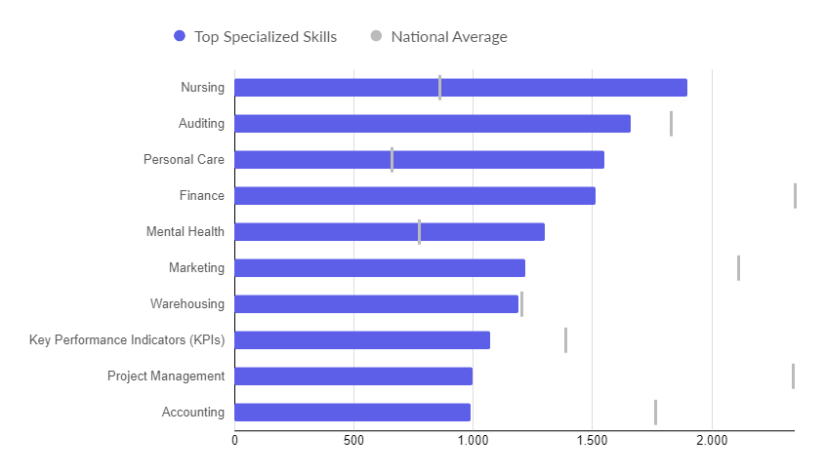
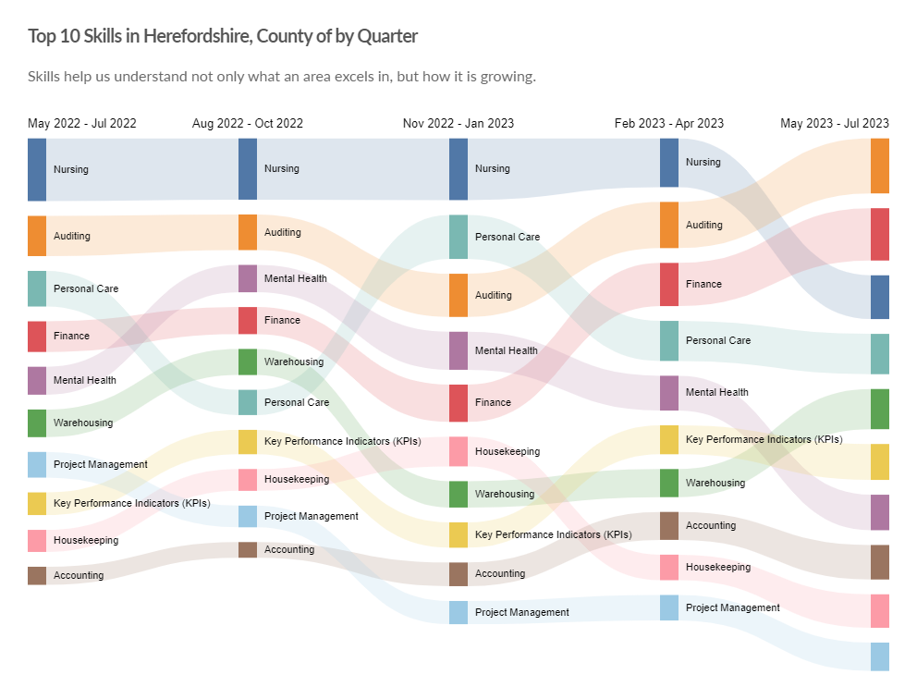
In-demand skills
Top hard skills
Top 10 hard skills by quarter
Need to know: Hard skills are abilities that have been taught to or learnt by a person.
Source: Lightcast (EMSI): economicmodelling.co.uk
Date last updated: 3 August 2023
Frequency of update: Monthly
Next update: September 2023

Slide 2
Hard to fill vacancies
Key points
There is no standard definition of a “hard-to-fill” vacancy but the table below shows those occupations (SOC 3 level) for the period July 2022 to June 2023 with a higher than average posting intensity. Those which also have a higher than average median posting duration (highlighted in red) are likely to be those most difficult to fill.
This is the most timely proxy for “hard-to-fill” vacancies and although there are some issues associated with this methodology, it has been shown to be a robust approximation.
Need to know: Posting Intensity is a ratio of total job postings to unique, or de-duplicated, job postings. A higher than average posting intensity can mean that employers are putting more effort than normal into hiring that position. Posting intensity is available by occupation, by job title, by company, and by region. The median posting duration (how long a posting was live before it was taken down) can be compared to the regional average for all postings in the region, giving an indication of whether these positions are harder or easier to fill than the typical job posting.
Source: Lightcast (EMSI): economicmodelling.co.uk
Date last updated: July 2023
Frequency of update: Monthly
Next update: t.b.c.

Slide 3
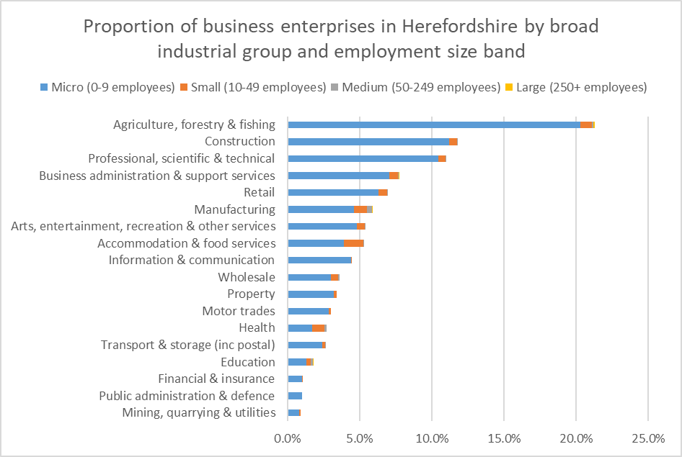
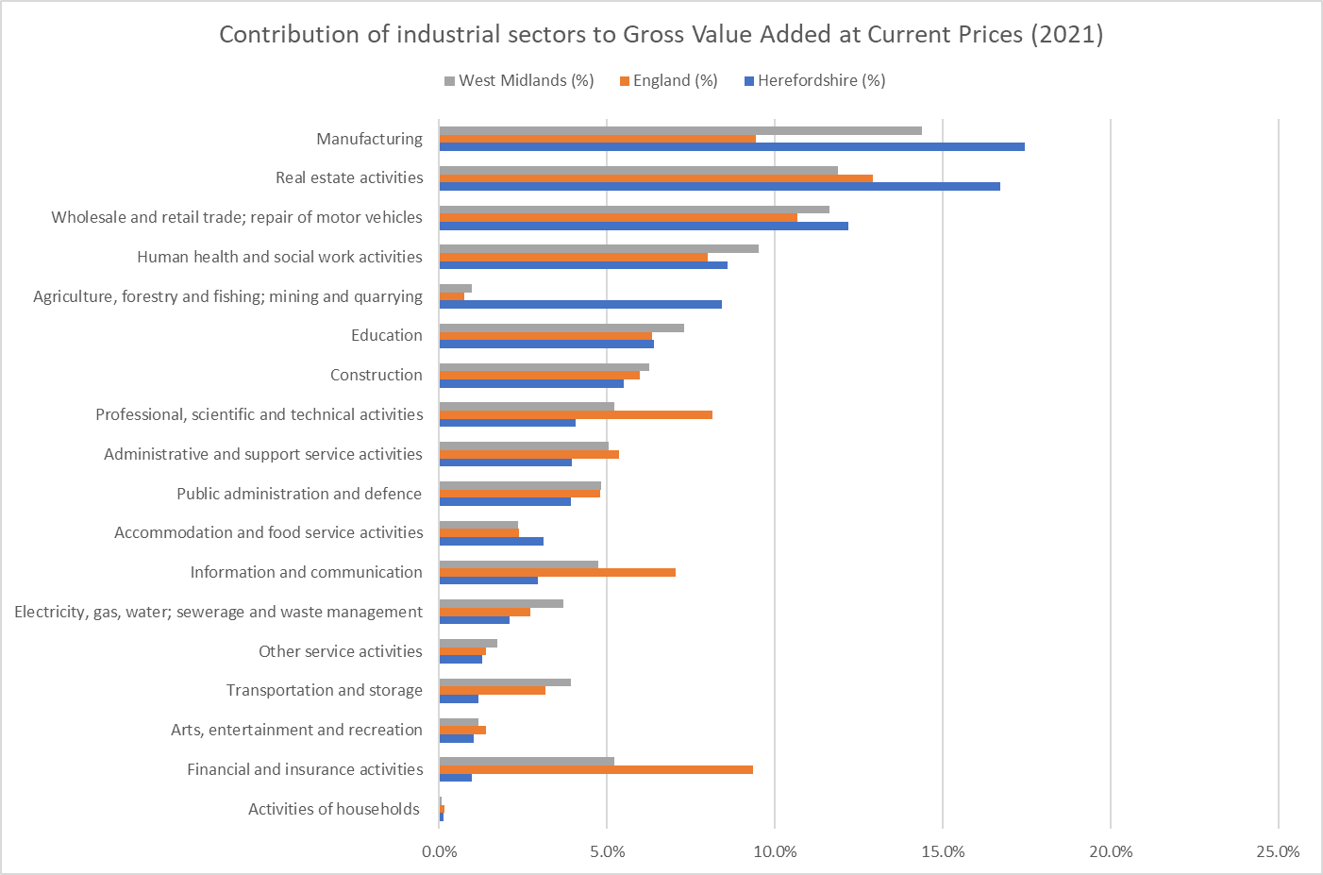
Numbers of businesses (enterprises) by industry and size, and contribution to the value of economic output by industry
Data source: ONS – NOMIS
Frequency: Annually
Last updated: 28 September 2022
Next update: 31 October 2023.
Key point:
The structure of Herefordshire’s economy is significantly different to nationally and regionally, largely due to the rurality of the county, with agriculture, real-estate activities and manufacturing accounting for a greater proportion of economic output and financial and insurance activities and information and communication much less.
Data source: ONS
Frequency: Annually
Last updated: 25 April 2023
Next update: March 2024.

Slide 4
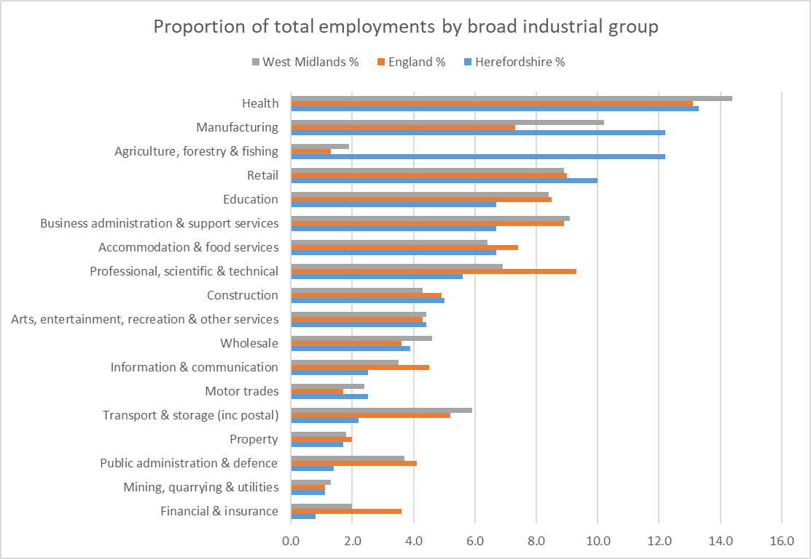
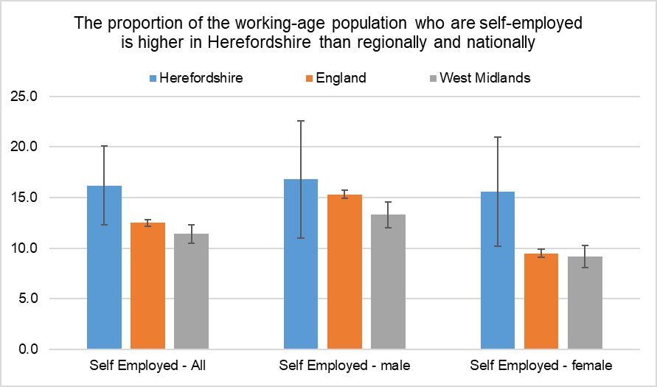
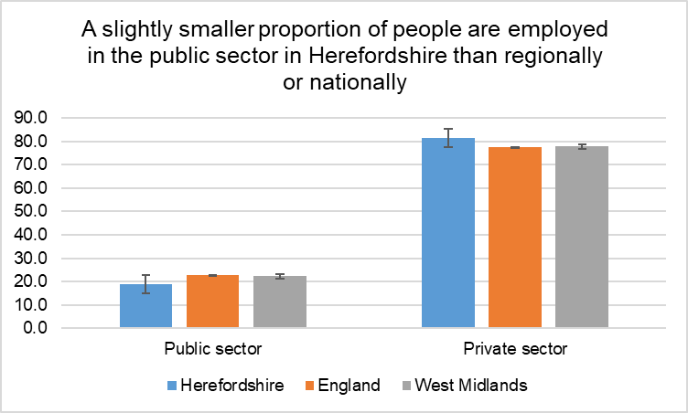
Distribution of jobs
Data source: ONS – NOMIS
Frequency: Quarterly
Last updated: 15 August 2023
Next update: 17 October 2023
Data source: ONS – NOMIS
Frequency: Quarterly
Last updated: 15 August 2023
Next update: 17 October 2023
Data source: ONS – NOMIS
Frequency: Annually
Last updated: 13 October 2022
Next update: 30 October 2023
Key points:
A higher proportion of jobs are in agriculture and manufacturing than nationally. A greater proportion of people are self-employed than nationally. Most jobs are in the private sector.

