Slide 1

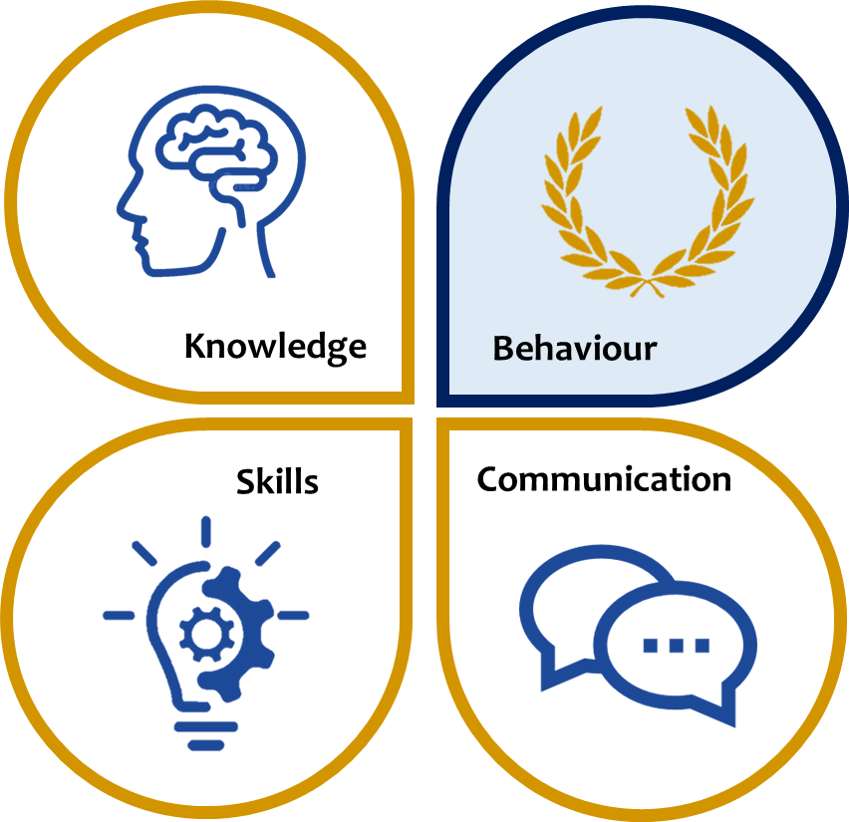
KS3 ASSESSMENT IN ART & DESIGN
Our KS3 Art and Design curriculum, which reflects the national curriculum is designed to ensure that all pupils produce creative work, become proficient in discipline-specific skills, can evaluate and analyse creative works and learn about great artists, makers and designers. In Art, DT, Textiles and Food they will learn about or how to…
 | Knowledge | Skills | Communication
Year 7 | Appropriate health and safety regulations and practices for the specialism: knife skills, embroidery, machinery operation etc. The principles of basic nutrition (the eat well guide) and health and safety in food technology Material types and properties: clay, cotton, polyester, plastics, metals, sustainability, durability Creative techniques and processes: embroidery, clay firing, food preparation, plastic manufacture Renowned artists, chefs, designers and creators: e.g. surrealism, Relevant contexts e.g. artists, movements, industries, styles: Italian cuisine, pop art, fashion designers etc. Collage and embroidery | Organise, develop, design and evaluate projects in four specific disciplines: DT, ART, TEXTILES and FOOD Projects in each year are outlined below In completing their projects students should be able to… Produce appropriate creative work Record appropriate observations Make decisions about appropriate materials and mediums Handle different materials and tools safely and effectively Evaluate their own work and that of others using specialist language Design and create prototypes Use specialist tools, techniques and processes and machinery Research, organise and prepare effectively Modify designs and approaches appropriately Use different elements of colour, texture and media Synthesise skills and knowledge from across the subject rotation | Accurate use of spelling, punctuation and grammar in written communication Contribute effectively to class discussion Articulate their ideas about a design, a process, an artist… Structure their ideas and projects effectively using appropriate sequencing Ask and answer questions effectively Use standard English and appropriate specialist subject terminology where possible
Year 8 | Rules of machinery operation inc. Laser cutter Joining methods in woods Using clay to produce 3D representation of creative ideas Understanding cultural differences in Art. Learning about the Mexican Catholic Festival “Day of the Dead” in food technology. Develop observational drawing skills and tonal work with colour Understanding the different cooking methods and how it affects the nutritional value of food. Product Analysis, Tie dye, Anchor stitch
Year 9 | Investigating design used in other cultures CADCAM Understanding casting and hand finishing metals Portraiture, harmonious and complementary colours; Colour schemes and Synaesthesia. Understanding the different types of food poisoning bacteria and the difference between macro and micro nutrients. Artist analysis, stencilling, polystyrene printing, mono printing
Year | DT | Art | Textiles | Food
7 | Pen tidy | Clay Tile | Cacti Art | Chef School
8 | Multi purpose box | Clay Skull | Jellyfish Textile Art | Master Chef
9 | Jewellery | Portrait | Pop Art | Takeaways
*This table is not exhaustive and seeks to reflect some of the major knowledge, skills and communication developed in this subject area.

