Slide 1

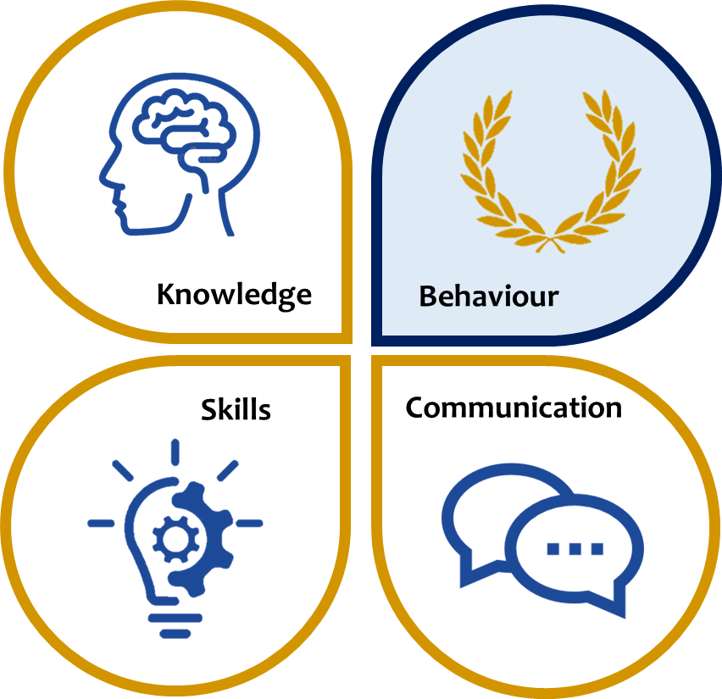
KS3 ASSESSMENT IN GEOGRAPHY
Our KS3 Geography curriculum, which follows the national curriculum aims to ensure all students develop strong contextual knowledge, understand key geographical processes, and are competent in key skills including collection, analysis and interpretation. We teach students about or how to…
 | Knowledge | Skills | Communication
Year 7 | Introduction to geography Natural resources Economy Weather and Climate Russia | Literacy Numeracy Organisation Self-reflection Improving own learning Problem solving Working with others Atlas skills OS map skills Interpret / annotate photos Interpret / annotate aerial photos Use statistical data Plot graphs Conduct geographical enquiry Conduct fieldwork Interpret cartographical data Use geographical information systems Use Google Earth Draw diagrams, cross sections, sketches Interpret models of geographical theory Sequence ideas and information | Accurate use of spelling, punctuation and grammar in written communication Contribute effectively to class discussion Distinguish between command words effectively eg: name, describe, explain, assess Present information effectively in different forms – diagrams, annotations, essays Draw comparisons Explain key concepts and processes clearly Articulate reasons Argue effectively / debate Ask and answer questions effectively Use standard English Reflect critically
Year 8 | Rivers Development Population Coasts Asia
Year 9 | Earthquakes and volcanoes Africa Glaciation The Middle East Climate Crisis
*This table is not exhaustive and seeks to reflect some of the major knowledge, skills and communication developed in this subject area.

