Slide 1

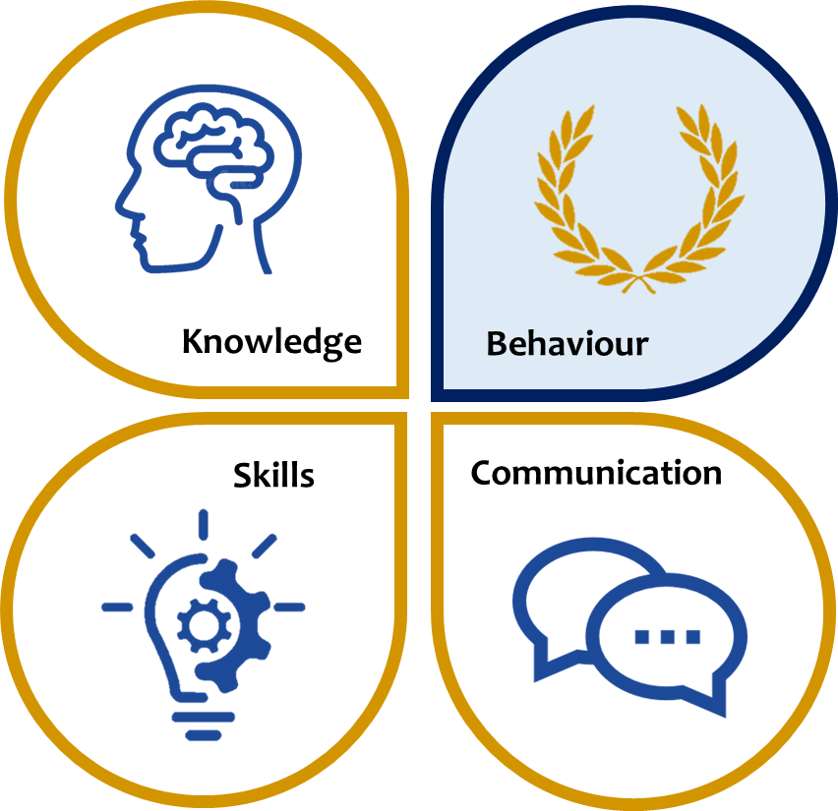
KS3 ASSESSMENT IN HISTORY
Our KS3 History curriculum, which reflects the national curriculum is designed to ensure all students understand Britain and its influences in the wider world, world civilisations and empires, methods of historical enquiry and much more. Students will be taught about or how to…
 | Knowledge | Skills | Communication
Year 7 | How to study History England in 1066 William the Conqueror Rulers and the rules in the Middle Ages Castles | Understand chronology Identification of significant events Interpret Evaluating sources Summarising details Make connections Draw contrasts Analyse trends over time Synthesising information form a rang of artefacts | Use accurate spelling, punctuation and grammar in written communication Contribute effectively to class discussion Articulate their ideas Structure their ideas effectively using appropriate sequencing Design, develop and present information ready for delivery to an audience Deliver presentations, speeches and performances to an audience Meet the needs of their audience Ask and answer questions effectively Use standard English Adapt language to suit purpose and audience
Year 8 | The Renaissance The Tudors Elizabethan England Industrial Britain Votes and Elections
Year 9 | The Slave Trade The Causes of World War 1 The significance of World War 1 The making of the modern world The Holocaust
*This table is not exhaustive and seeks to reflect some of the major knowledge, skills and communication developed in this subject area.

