Slide 1

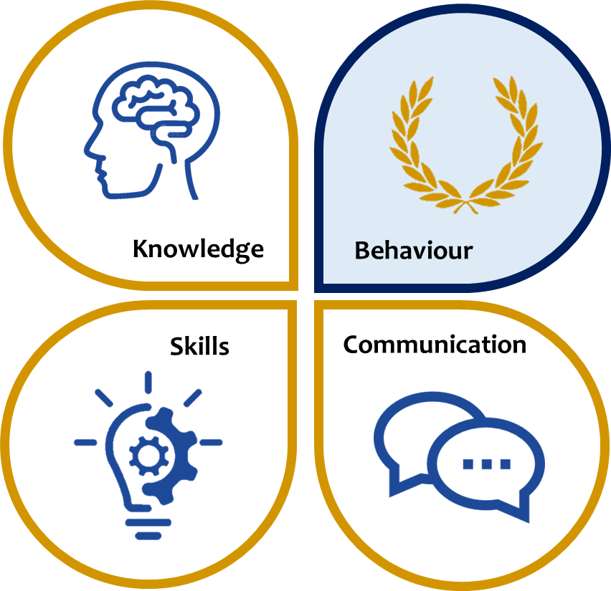
KS3 ASSESSMENT IN RELIGIOUS EDUCATION
RE is at the core of the curriculum at St Mary’s. which follows the national curriculum and the ‘Source to Summit’ model, provides students with wide range of spiritual and theological knowledge, helps them develop vital evaluative and critical thinking skills and provides a forum for thoughtful communication.
 | Knowledge | Skills | Communication
Year 7 | (Source to Summit) Creation and covenant Prophecy and promise Jesus in the Gospels The Sacrament of Eucharist, the Last Supper and Passover Pentecost The Catholic Church and other Christian faiths | Investigating by asking relevant questions Interpreting by drawing meaning from artefacts Reflection Empathy Evaluation Analysis including Comparison and contrast Synthesis Application | As relevant to the topic studied Accurate use of spelling, punctuation and grammar in written communication. Development of RE specific vocabulary including key theological and disciplinary language. Contribute effectively to class discussions Justify positions and perspectives Debate effectively using a range of methods Articulate ideas with clarity
Year 8 | The Old Testament Covenant People The New Testament The Ten Commandments The Beatitudes Reconciliation and Peace Equality and justice Islam
Year 9 | Creation, religion and science The sanctity and dignity of life Judaism beliefs and teachings Judaism - practices
*This table is not exhaustive and seeks to reflect some of the major knowledge, skills and communication developed in this subject area.

