Slide 1

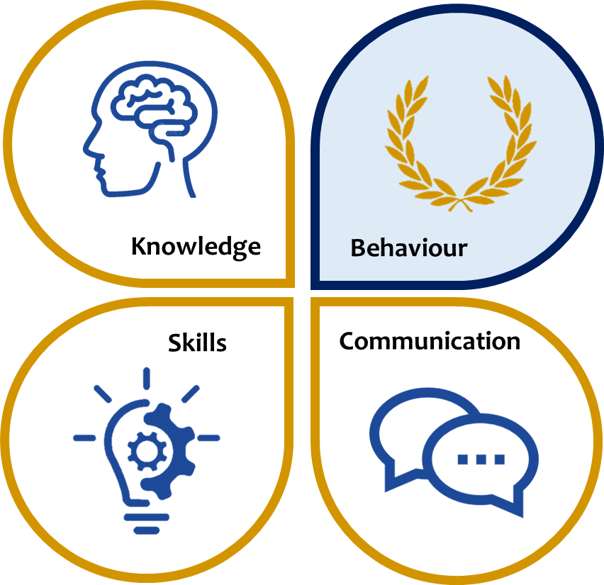
KS3 ASSESSMENT IN MATHS
Our KS3 Maths curriculum, which follows the national curriculum and the White Rose Maths model, helps students become fluent in the fundamentals of mathematics, ensures that students can reason mathematically and ensures they can solve problems with increasing sophistication.
 | Knowledge | Skills | Communication
Year 7 | Whole numbers and decimals Measures, perimeter and area Expressions and formulae Fractions, decimals and percentages Angles and two-dimensional shapes Graphs including: coordinates, straight line, time series Number including: mental and written calculation Statistics including: bar charts, pie charts and averages Time | Work mathematically as relevant to the area of study: Apply numeracy skills: add, subtract, multiply and divide Work out using written steps Work out using calculator steps Apply the correct order of operations (BIDMAS) Use letter symbols effectively Simplify and factorise effectively Calculate mathematical formulas using standard units Make predictions and reason deductively Plot graphs and interpret data accurately | Accurate use of spelling, punctuation and grammar in written communication Contribute to class discussion and questioning Explain and justify thinking/solutions Articulate the sequence required for an effective calculation
Year 8 | Whole numbers and decimals including primes, squares, cubes and indices Transformations including symmetry and tessellation Equations Written and calculator methods Constructions including triangles, bisectors and scale drawing Sequences: including term to term and term to position rules 3D shapes including isometric drawings and volume Ratio and Proportion Probability including Venn diagrams
Year 9 | Fractions decimals and percentages: including percentage problems Equations – constructing, solving and trial and improvement Written multiplication and division – decimals Graphs: straight line, gradient, and y= mx+c Measures, perimeter and area: Graphs – distance and time
*This table is not exhaustive and seeks to reflect some of the major knowledge, skills and communication developed in this subject area.

