Slide 1

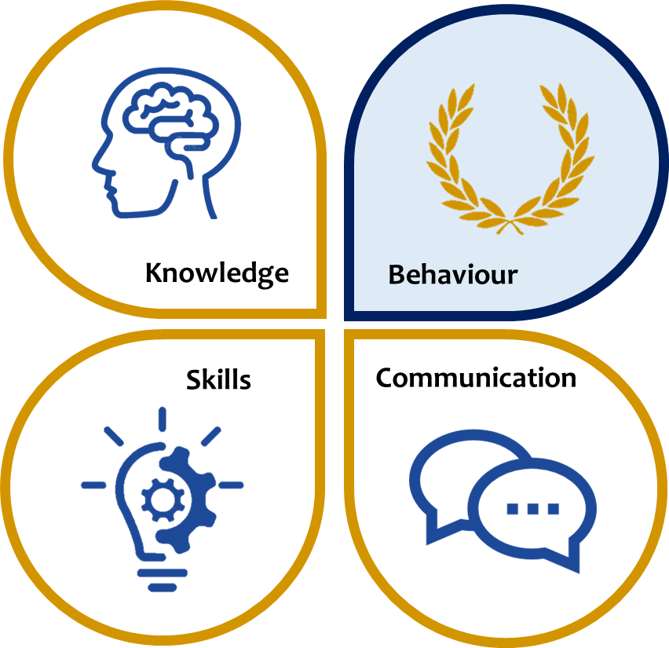
KS3 ASSESSMENT IN SCIENCE
Our KS3 Science curriculum, which follows the national curriculum, aims to develop scientific knowledge and understanding in biology, chemistry and physics. We seek to develop students understanding of the natural world and equip them with the knowledge and skills to understand the implications of science for the future.
 | Knowledge | Skills | Communication
Year 7 | The Solar System Electricity Rocks and Geology Chemical Reactions Reproduction Acids and Alkalis Cells Energy Forces Particles and Solutions | Work scientifically as relevant to the topic studied: Work safely in labs Control variables Predict and write hypotheses Plan and organise experiments Draw scientific apparatus, models and diagrams Observe, measure and calculate results Plot graphs and interpret data Calculate scientific formulas using standard units Conclude and evaluate effectively | As relevant to the topic studied Accurate use of spelling, punctuation and grammar in written communication including spelling key terms correctly Contribute effectively to class discussion Articulate their ideas about a text, a topic, a character, a writer… Articulate sequences, concepts, processes and key ideas Understand bias and effectively review Structure investigations and conclusions
Year 8 | Atoms, Elements, Compounds and Mixtures Food and Digestion Heating and Cooling Adaptations Microbes Respiration Light and Sound
Year 9 | Plants and Photosynthesis Environmental Chemistry Speed, Pressure and Moments Reactions of Metals and Metal compounds Inheritance and Selection Atomic Structure Fitness and Health Gravity and Space Patterns of Reactivity
*This table is not exhaustive and seeks to reflect some of the major knowledge, skills and communication developed in this subject area.

