Slide 1

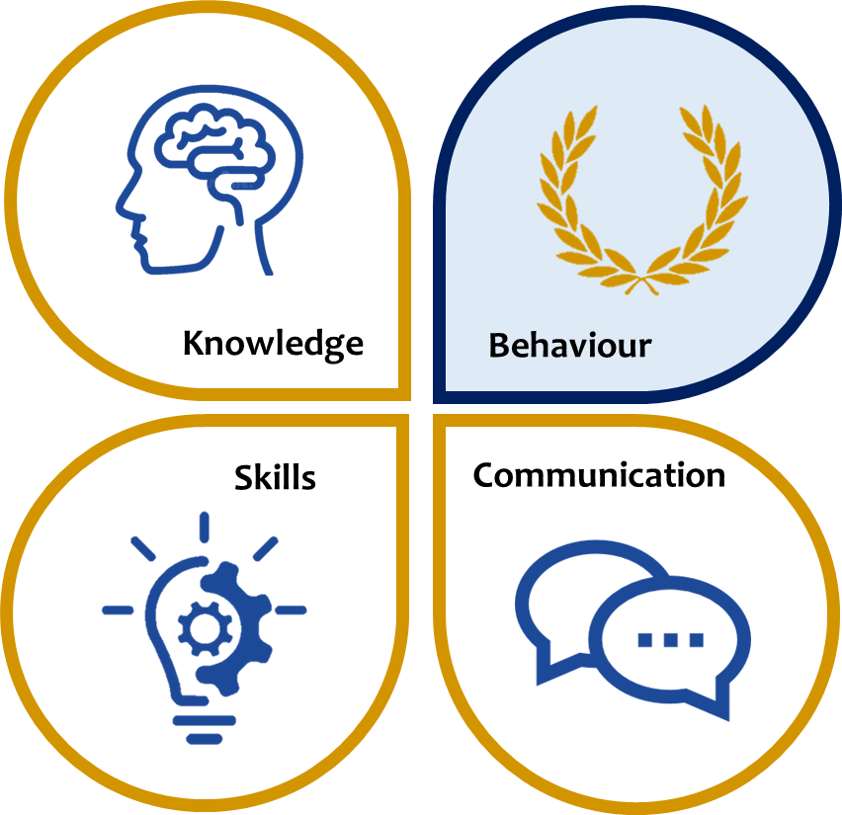
KS3 ASSESSMENT IN HISTORY
Our KS3 History curriculum, which reflects the national curriculum is designed to ensure all students understand Britain and its influences in the wider world, world civilisations and empires, methods of historical enquiry and much more. Students will be taught about or how to…
 | Knowledge | Skills | Communication
Year 7 | How history is constructed and the work of historians England pre-1066 William the Conqueror and the Battle of Hastings Norman methods of conquest (including impact in Wales and local castles such as Goodrich) Importance and use of religion in the Middle Ages, including growth of Christianity and Islam. Life of a medieval peasant Rulers and the ruled in the Middle Ages (Thomas Becket, Magna Carta and Peasants’ Revolt) | The following skills are built upon with developing complexity during the KS3 Programmes of Enquiry: Understand chronology Identify significant events Interpret sources and interpretations Evaluate sources and interpretations Summarise details Make connections Draw contrasts Analyse trends over time Synthesis of information form a range of sources. This will enable students to be able to… understand and make judgements on the usefulness of sources. describe historical detail. explain cause and consequence, & change and continuity, making complex links and reaching judgements. analyse significance of key historical people, events and periods. | Articulate ideas Contribute effectively to class discussion Ask and answer questions effectively Use accurate spelling, punctuation and grammar in written communication Use standard English when speaking and writing Structure their ideas effectively using appropriate sequencing Adapt language to suit purpose and audience Design, develop and present information ready for delivery to an audience Deliver presentations, speeches and performances to an audience
Year 8 | The significance of the Renaissance (key inventions as drivers of change e.g. the Printing Press) The Tudors and religious change Elizabethan England and the ‘Golden Age’ The Industrial Revolution Dangers of industry (accidents, health and political developments with the vote)
Year 9 | The Slave Trade The Causes of the First World War The significance of the First World War (developments in tactics and technology of war, the impact on life at home) The making of the modern world (female suffrage campaign, roaring 20s and Nazi Germany) The Holocaust
*This table is not exhaustive and seeks to reflect some of the major knowledge, skills and communication developed in this subject area.

