Slide 1

YEAR 11
REVISION & SUPPORT

Slide 2


YEAR 11
REVISION & SUPPORT
This is THE YEAR…
5 years of work…
A long summer of freedom…
YOUR CHOICE!

Slide 3
YEAR 11
REVISION & SUPPORT
TIMESCALES
When should I start revising?
AUTUMN 1
Sept/Oct
AUTUMN 2
Nov/Dec
3 TERMS
SPRING 1
Jan/Feb
SPRING 2
Feb/Mar
8 MONTHS
32 WEEKS (Total)
24 WEEKS (Teaching)
SUMMER 1
Apr/May
EXAMS
SUMMER 2
Jun/Jul
120 TEACHING DAYS

Slide 4
YEAR 11
REVISION & SUPPORT
TIMESCALES
When should I start revising?
AUTUMN 1
Sept/Oct
AUTUMN 2
Nov/Dec
YESTERDAY!
SPRING 1
Jan/Feb
SPRING 2
Feb/Mar
LAST YEAR
SUMMER 1
Apr/May
EXAMS
SUMMER 2
Jun/Jul
BUT IF NOT, NOW!

Slide 5
YEAR 11
REVISION & SUPPORT
HOW ARE SMRC GOING TO SUPPORT ME?

Slide 6




YEAR 11
REVISION & SUPPORT
1
2
3
4
5
LESSONS
STUDY SKILLS
REVISION
SESSIONS
MOCKS
RESOURCES
OUSTANDING TEACHING
HELP WITH REVISION SKILLS
RECAPS, REVISION, PRACTICE
PRACTICE, DIAGNOSIS
TOO MANY TO MENTION…

Slide 7

YEAR 11
REVISION & SUPPORT
1
LESSONS
YOUR LESSONS ARE THE MOST IMPORTANT PART. STAY FOCUSSED, STAY CONSISTENT AND YOU WILL BE FINE
OUSTANDING TEACHING
YOUR TEACHERS DO THIS EVERY YEAR – THEY KNOW WHAT IT TAKES – LISTEN TO THEM
ASK FOR HELP AND BE SPECIFIC ABOUT IT

Slide 8

YEAR 11
REVISION & SUPPORT
2
STUDY SKILLS
EVERY WEDS A STAFF MEMBER WILL LEAD A SESSION IN THE MAIN HALL
HELP WITH REVISION SKILLS
20-30 MINS OF EXPERT ADVICE
THEN STRUCTURED REVISION TIME
RESOURCES AVAILABLE:
FLASHCARDS, WALLETS, STATIONERY, FOLDERS
BICCIES SUPPLIED!

Slide 9

STUDY SKILLS - Y11 STUDENTS
E V E R Y
W E D S
MOCK EXAMS BEGIN IN AUTUMN 2: NOV/DEC, RESULTS AVAILABLE IN JAN
_
3 : 3 0
4 : 4 5
Session | Date | Focus | Speaker/Lead
1 | 24/9/2025 | Introduction: Basic Study Skills | Mr Cassidy
2 | 1/10/2025 | Retention and Memory : Dual Coding | Miss Deegan
3 | 8/10/2025 | Revision Resources: Cards & Mind Mapping | Mrs Beaumont/Mrs Challenger
Work Experience Week
5 | 22/10/2025 | Student: Creating a revision Timetable 3:30-4:30 | Mr Giampalma
 | 22/10/2025 | PARENT SESSION 4:30-5:00pm A special session on how to support your child | Mr Cassidy & Mr Giampalma
Half Term
6 | 5/11/2025 | Good Habits and Routines Sports Hall | Ms Walton/JPE/MLL
7 | 12/11/2025 | Using technology to revise Sports Hall | Mrs Avery
8 | 19/11/2025 | Spaced Practice and Interleaving | Mr Coyne
9 | 26/11/2025 | Self Quizzing: identifying what I don’t know! | Mr Williams
MOCK EXAMS BEGIN

Slide 10
YEAR 11
REVISION & SUPPORT
3
REVISION
SESSIONS
STAFF RUN THESE SESSIONS FOR FREE IN THEIR OWN PRIVATE TIME. RESPECT THEIR COMMITMENT TO YOU:
ATTEND AND IMPROVE YOUR CHANCES
RECAPS, REVISION, PRACTICE
POST MOCKS YOU SHOULD TREAT THE SCHOOL DAY AS 9:15-4:30
THE TT WILL BE UPDATED POST MOCKS

Slide 11
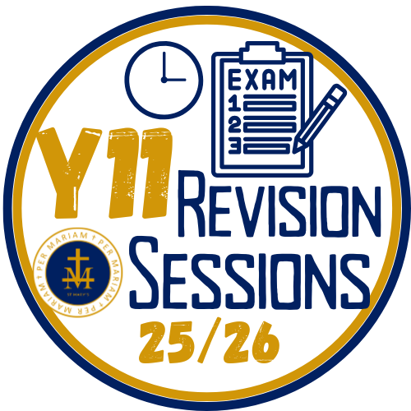
REVISION - Y11 STUDENTS
D A I L Y
SESSIONS
We know how crucial Y11 is for our students: Staff continually offer high quality support through expert teaching in lessons, subject revision sessions and revision resources. Routine attendance at revision sessions in conjunction with independent practice contributes effectively to strong attainment and positive GCSE outcomes.
3 : 3 0
_
4 : 3 0
TT1 AUT 1
MOCK EXAMS NOV/DEC, GCSES BEGIN MAY/JUN
Mon |  | Tue |  | Wed |  | Thu |  | Fri
SUBJECT, TEACHER | RM | SUBJECT, TEACHER | RM | SUBJECT, TEACHER | RM | SUBJECT, TEACHER | RM | SUBJECT, TEACHER | RM
MUSIC [Lunch] | Mus | RE Mr Coyne | LC3 |  |  | ENGLISH Mr Cassidy | 19 | PE Mr Griggs
HISTORY Mr Williams | 2 | ART Miss Deegan | Art |  |  | MUSIC Mrs Goldup | Mus | Biology Mrs Leslie
DT Mr Mortimer | DT3 | FOOD Miss Lavis | FT
TEXTILES Ms Chan | Tex
FOOD Miss Lavis | FT
Mon Lunch |  | Tue Lunch |  | Wed Lunch |  | Thu Lunch |  | Fri Lunch
Music | Mus | French Speaking | 7 | French Speaking | 7 | French Speaking
French Speaking | 7

Slide 12
YEAR 11
REVISION & SUPPORT
4
MOCKS
A SERIES OF PAPERS JUST LIKE THE REAL EXAMS.
TEST WHAT YOU KNOW AND YOUR EXAM TECHNIQUE
PRACTICE, DIAGNOSIS
MOCKS
CHRISTMAS
MOCK RESULTS
PRACTICE
GCSES

Slide 13
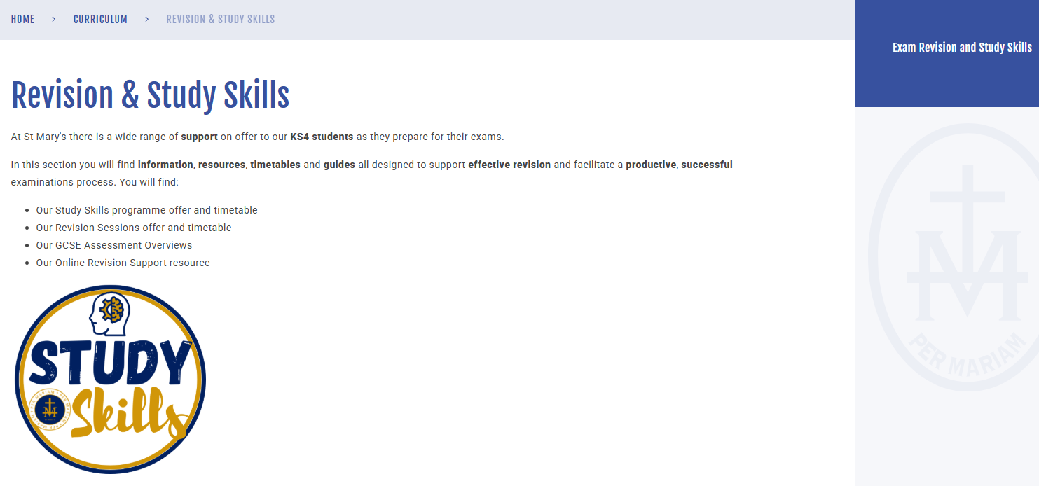
YEAR 11
REVISION & SUPPORT
5
RESOURCES
LIBRARY – FULL OF PAST PAPERS, REVISION CARDS, REVISION GUIDES, ICT RESOURCES…
YOUR PARENTS ARE RECEIVING A PACK TODAY WITH STUDY SKILLS TT, REVISION TT, GCSE OVERVIEWS AND ONLINE REVISION RESOURCES
WEBSITE!

Slide 14
REMEMBER
EVERY WEDS 3:30 MAIN HALL

