Slide 1


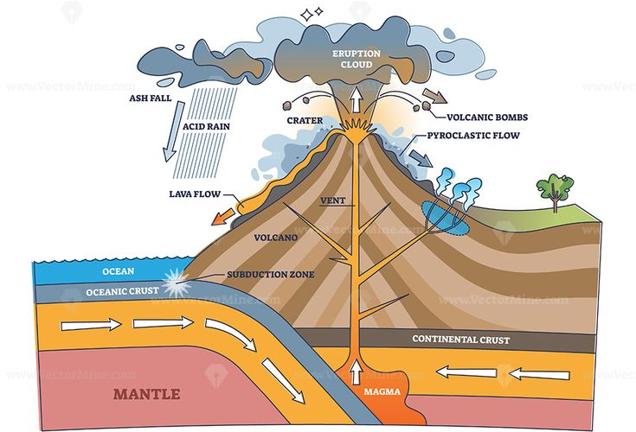



Geography
Year 9 Unit 11
Earthquakes & Volcanoes
Name: …................................................ Class: …..................
Learning checklist
1 | Can we ever know enough about tectonics to live safely?
2 | Do continents fit together like jigsaw pieces?
3 | Where are the world’s earthquakes, volcanoes and mountain belts?
4 | What is happening beneath our feet?
5 | What happens at plate boundaries?
6 | What do we know about earthquakes?
7 | Can people manage risk living in earthquake zones?
8 | What do we know about volcanoes?
9 | Can people manage risk living near volcanoes?
10 | Review
Homework Challenges
Task 1: | Learn keywords and definitions for a test.
Task 2: | Use data to draw proportional squares on Pacific centred map. | Create a 3D model of a tectonic boundary with labels.
Task 3: | Describe what the data shows. Explain the correlation between data. | Describe the movement and explain how hazards are formed.
Revision | Complete Seneca Learning assignment.
Test | Read questions carefully. Look for command and key words as well as number of marks available/amount of space.

