Slide 1

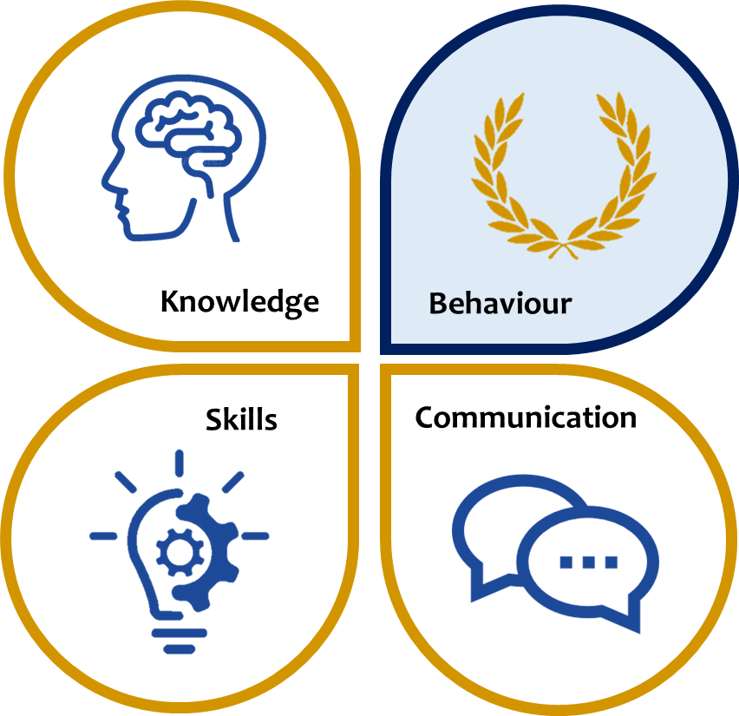
KS3 ASSESSMENT IN SCIENCE
Our KS3 Science curriculum, which follows the national curriculum, aims to develop scientific knowledge and understanding in biology, chemistry and physics. We seek to develop students understanding of the natural world and equip them with the knowledge and skills to understand the implications of science for the future.
 | Knowledge |  |  |  | Skills | Communication
Year 7 | Autumn | Spring |  | Summer | Work scientifically as relevant to the topic studied: Work safely in labs Identify variables Predict and write hypotheses Plan, organise and conduct experiments Draw scientific apparatus, models and diagrams Observe, measure and calculate results Plot graphs and interpret data Calculate scientific formulas using standard units Conclude and evaluate effectively | As relevant to the topic studied Accurate use of spelling, punctuation and grammar in written communication including spelling key terms correctly Contribute effectively to class discussion Articulate sequences, concepts, processes and key ideas Understand bias and effectively review Structure investigations and conclusions Apply scientific knowledge to novel situations or different contexts (synthesise) Use chemical formulae accurately Write word and symbol equations accurately
 | Term 1 Introduction to science Cells Particles | Term 2 Waves and light Atoms and elements Organising a body |  | Term 3 Acids and alkalis Chemical Reactions Reproduction After end of year exam: The Solar System
Year 8 | Autumn | Spring |  | Summer
 | Forces Microbes Food and digestion | Electricity and Magnetism Periodic table Separation techniques |  | Adaptations and classification Respiration Energy
Year 9 | KS3 Sept – Jan Plants and Photosynthesis Fit and healthy Speeding up Pressure and Moments Reactions of Metals Reactivity series Plants and Photosynthesis Plants for food |  | Students begin preparing for their GCSEs from Feb – July Biology: B1 You and Your genes’ Chemistry: C1 Air and Water Physics: P2 Sustainable Energy
*This table is not exhaustive and seeks to reflect some of the major knowledge, skills and communication developed in this subject area.

