Slide 1
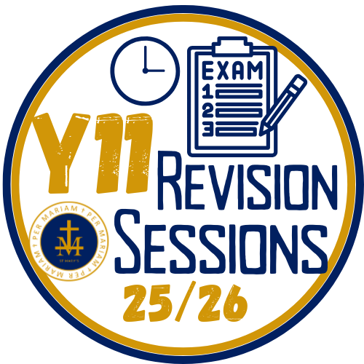
REVISION - Y11 STUDENTS
D A I L Y
We know how crucial Y11 is for our students: Staff continually offer high quality support through expert teaching in lessons, subject revision sessions and revision resources. Routine attendance at revision sessions in conjunction with independent practice contributes effectively to strong attainment and positive GCSE outcomes.
SESSIONS
3 : 3 0
_
4 : 3 0
TIMETABLE 2 [JAN, SPRING 1]
GCSES BEGIN MAY/JUN
Mon |  | Tue |  | Wed |  | Thu |  | Fri
SUBJECT, TEACHER | RM | SUBJECT, TEACHER | RM | SUBJECT, TEACHER | RM | SUBJECT, TEACHER | RM | SUBJECT, TEACHER | RM
HISTORY Mr Williams | 2 | RE Mr Coyne | LC3 | MATHS [H] Mrs Harries | 13 | ENGLISH Mr Cassidy | 19 | PE Mr Griggs | PE
DT Mr Mortimer | DT3 | ART Miss Deegan | Art | MATHS [F] Miss Brazil | 12 | MUSIC Mrs Goldup | Mus | BIOLOGY Mrs Leslie | Lab 2/5
 |  | MATHS [H] Miss Davies | 10 | BUSINESS Mrs Avery | 21 | GEOGRAPHY Mrs Hughes | 4 | HOSPITALITY & CATERING Miss Baxendale | FT
 |  | MATHS [F] Mrs Todd | 14 | ENGLISH* Mrs Robins | 17 | MATHS [H]​ Mrs Todd​ | 14​
 |  | TEXTILES Miss Lloyd | Tex
Mon Lunch |  | Tue Lunch |  | Wed Lunch |  | Thu Lunch |  | Fri Lunch
Music | Mus | French Speaking | 7 | French Speaking | 7 | French Speaking
French Speaking | 7
* Check with teacher for start date

