Slide 1
M
PER MARIAM
Sacred Spaces PRAYER
Week commencing:
12th January

Slide 2


This half term at St Mary’s we are are growing to be curious about everything; and active in our engagement with the world, changing what we can for the better.
Curious and Active
PRACTICE your skills, REVISE your KNOWLEDGE and APPLY your learning to problems and in daily life

Slide 3
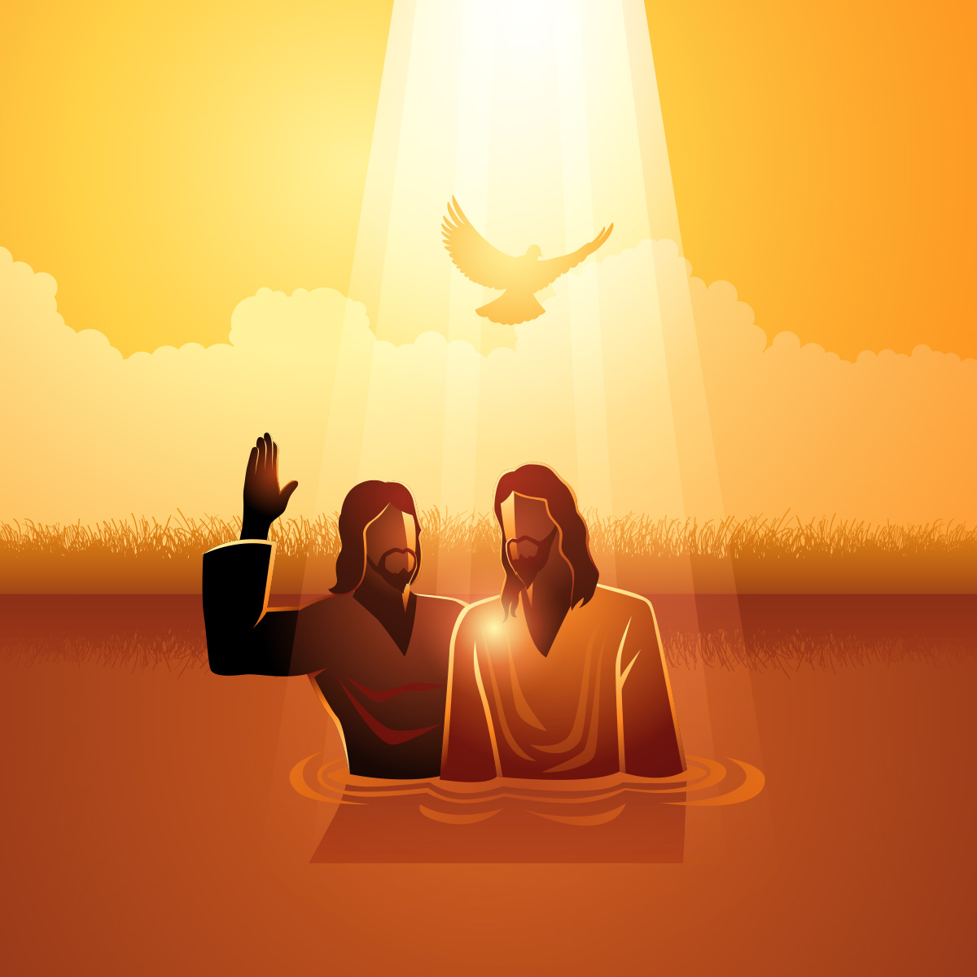
‘This is my own dear Son’
Baptism of the Lord

Slide 4

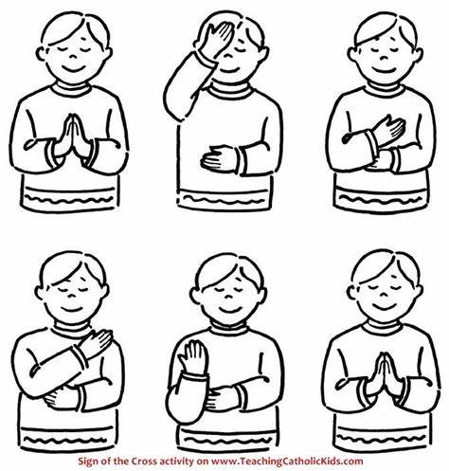
Let us remember that we are in the Holy Presence of God...
In the name of the Father
And of the Son
And of the Holy Spirit
Amen

Slide 5
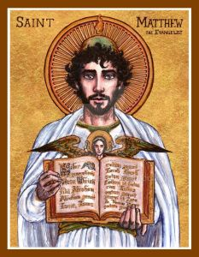
A reading
from
THE GOSPEL
According to
MATTHEW

Slide 6

At that time Jesus arrived from Galilee and came to John at the Jordan to be baptised by him. But John tried to make him change his mind. “I ought to be baptised by you,” John said, “and yet you have come to me!”
But Jesus answered him, “Let it be so for now. For in this way we shall do all that God requires.” So John agreed.
As soon as Jesus was baptised, he came up out of the water.
Then heaven was opened to him, and he saw the Spirit of God coming down like a dove and lighting on him. Then a voice said from heaven,
“This is my own dear Son, with whom I am pleased.”
Matthew 3;13-17

Slide 7


Scripture Sound Bite
“This is my own dear Son, with whom I am pleased.”
Jesus, though sinless, chose to be baptised by John the Baptist, who called people to repent. Why did Jesus, who had no need to repent, decide to be baptised?
One reason is that Jesus wanted to show his support and understanding for us. He wanted to share in our humanity and weaknesses. By being baptised, Jesus stood with those who were seeking forgiveness and a new start. He showed that he was not distant from us but very close, sharing in our struggles.

Slide 8
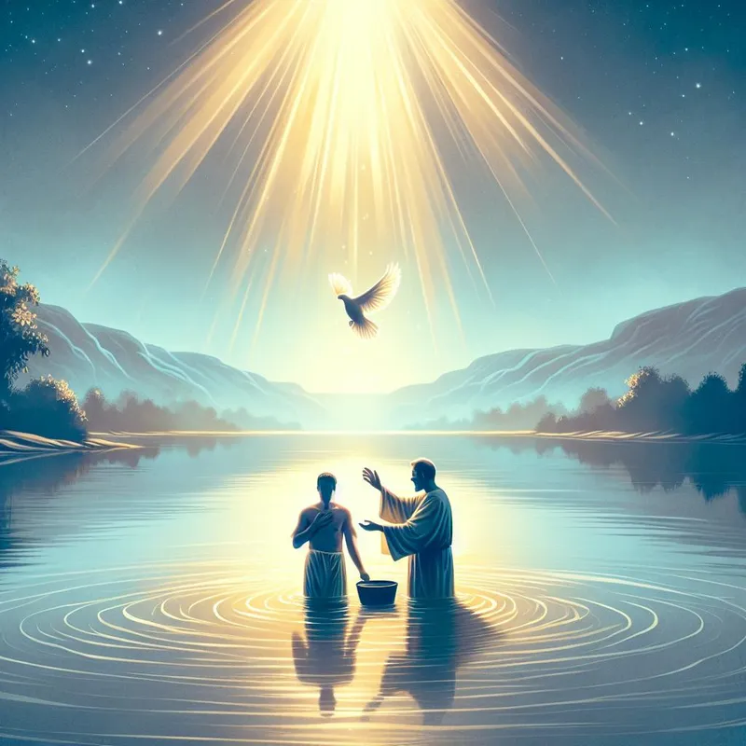
Silent prayer
As we think about the baptism of Jesus, we take a moment to reflect in silence.
Have we done our best to be God’s voice on earth?
We are all human and make mistakes, but we need to strive to follow God’s call each and everyday.
Use the gifts that God has given you to be a force for good.
We offer our intentions through Christ our Lord,
Amen

Slide 9
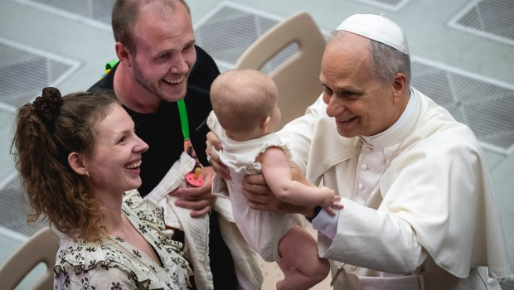
“
Baptism makes us witnesses of Christ. We are called to share our experience of faith with others, witnessing to the love of Christ.
“
BRIGHT IDEA
Notes:
Gospel
John 14:15-21

Slide 10

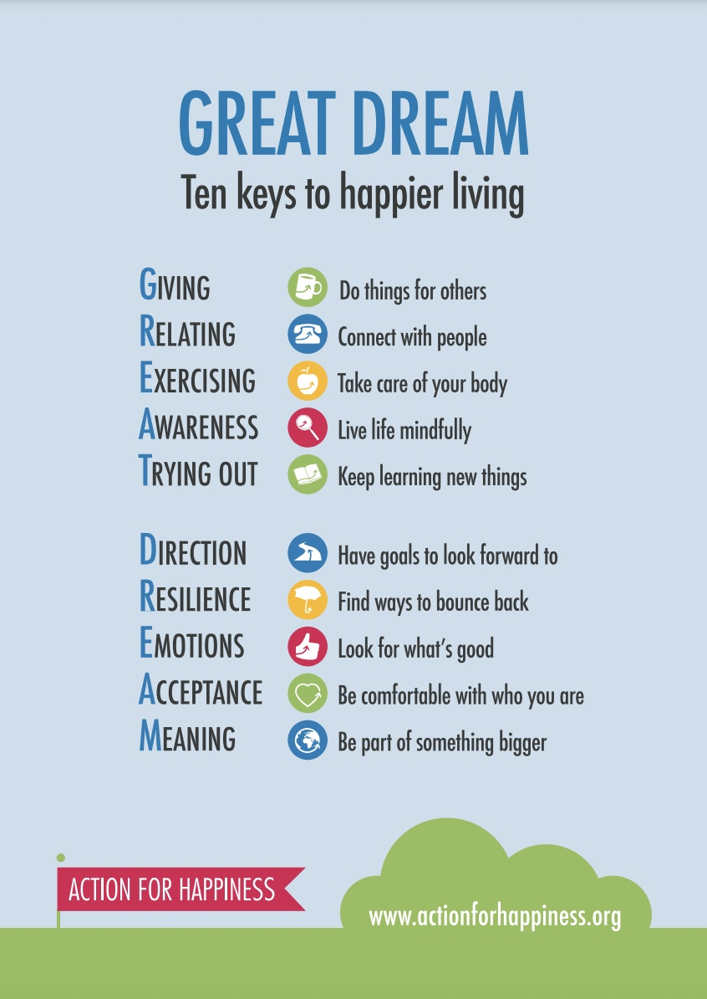

Mindful Moment: Relating to Others

Slide 11
Let us pray:
Dear Lord,
Through your baptism you showed us that we are all loved equally.
Inspire us to start our live afresh each day.
Remind us to be grateful for the gifts you have given us and help us to be generous to those around us and to put the needs of others first.
Amen.

Slide 12
In the name of the Father
And of the Son
And of the Holy Spirit
Amen

Slide 13
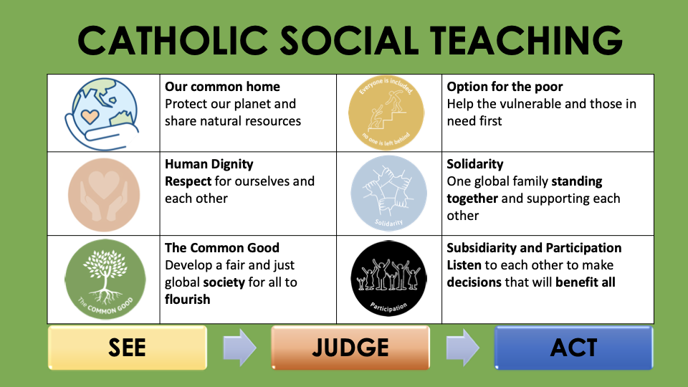

Slide 14










GREAT DREAM: 10 Keys to Happier Living
 | GIVING Do things for others |  | DIRECTION Have goals to look forward to
 | RELATING Connect with people |  | RESILIENCE Find ways to bounce back
 | EXERCISING Take care of your body |  | EMOTION Look for what’s good
 | AWARENESS Live life mindfully |  | ACCEPTANCE Be comfortable with who you are
 | TRYING OUT Keep learning new things |  | MEANING Be part of something bigger
BE KIND TO YOUR MIND

