Slide 1
M
PER MARIAM
Sacred Spaces PRAYER
Week commencing:
19th January

Slide 2


This half term at St Mary’s we are are growing to be curious about everything; and active in our engagement with the world, changing what we can for the better.
Curious and Active
PRACTICE your skills, REVISE your KNOWLEDGE and APPLY your learning to problems and in daily life

Slide 3
‘Look there is the lamb of God’
2nd Sunday in Ordinary Time

Slide 4

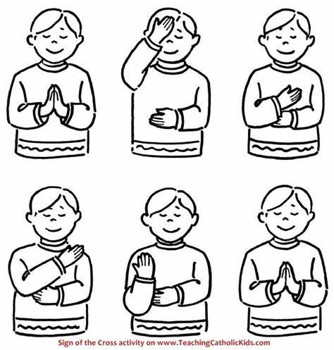
Let us remember that we are in the Holy Presence of God...
In the name of the Father
And of the Son
And of the Holy Spirit
Amen

Slide 5
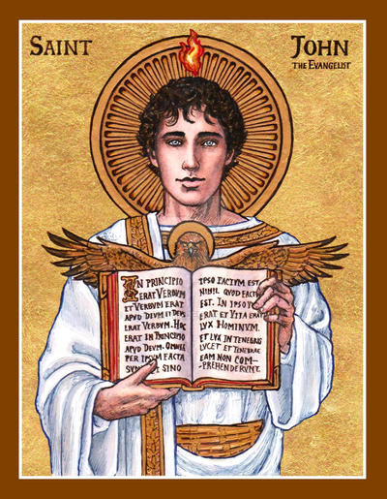
A reading
from
THE GOSPEL
According to
JOHN

Slide 6

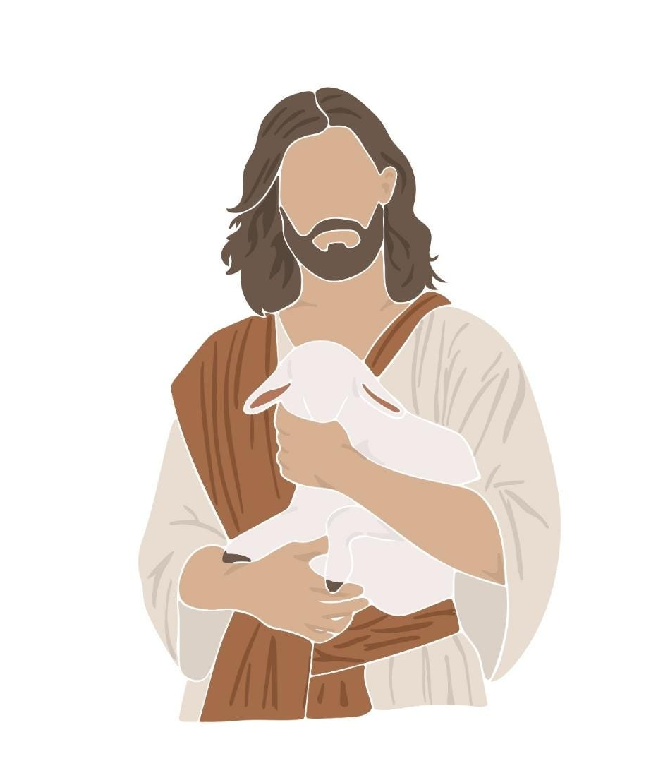
The next day John saw Jesus coming to him, and said, “There is the Lamb of God, who takes away the sin of the world! This is the one I was talking about when I said, ‘A man is coming after me, but he is greater than I am, because he existed before I was born.’ I did not know who he would be, but I came baptising with water in order to make him known to the people of Israel.”

Slide 7
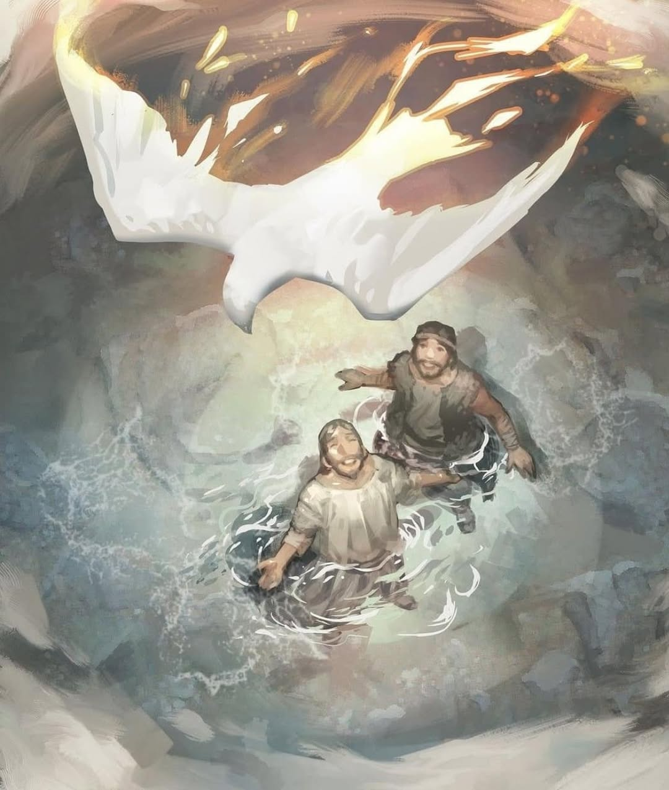
And John gave this testimony: “I saw the Spirit come down like a dove from heaven and stay on him. I still did not know that he was the one, but God, who sent me to baptise with water, had said to me, ‘You will see the Spirit come down and stay on a man; he is the one who baptises with the Holy Spirit.’ I have seen it,” said John, “and I tell you that he is the Son of God.”
John 1: 29-34

Slide 8

Scripture Sound Bite
“There is the Lamb of God.” John 1: 29-34
John the Baptist was sent to prepare people for the Messiah. When he sees Jesus, he wants everyone to know that Jesus is the one sent by God to save them.
John calls Jesus the Lamb of God to show that he is the sacrifice who takes away sin. Just as lambs were offered in the temple, Jesus gives his life to bring people back to God.
Jesus did not just come to teach or heal—he came to offer himself for others. Like a mechanic fixing a broken car, he enters into human sin and suffering to repair what is damaged.

Slide 9

Silent prayer
Because Jesus is the Lamb of God, every human life has dignity. If Jesus gave his life for all people, then every life is important. The sick, the poor, the unborn, the elderly—every person matters to God.
We take a moment to reflect in silence.
How can remembering Jesus’ sacrifice change the way you treat others?
We offer our intentions through Christ our Lord,
Amen

Slide 10
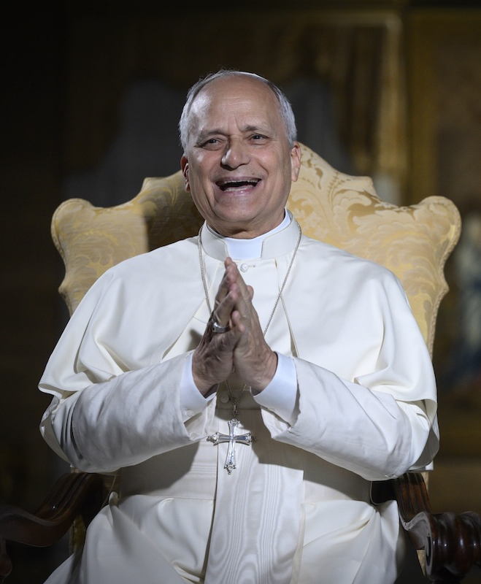
“
Be open to what the Lord has in store for you
“
BRIGHT IDEA
Notes:
Gospel
John 14:15-21

Slide 11
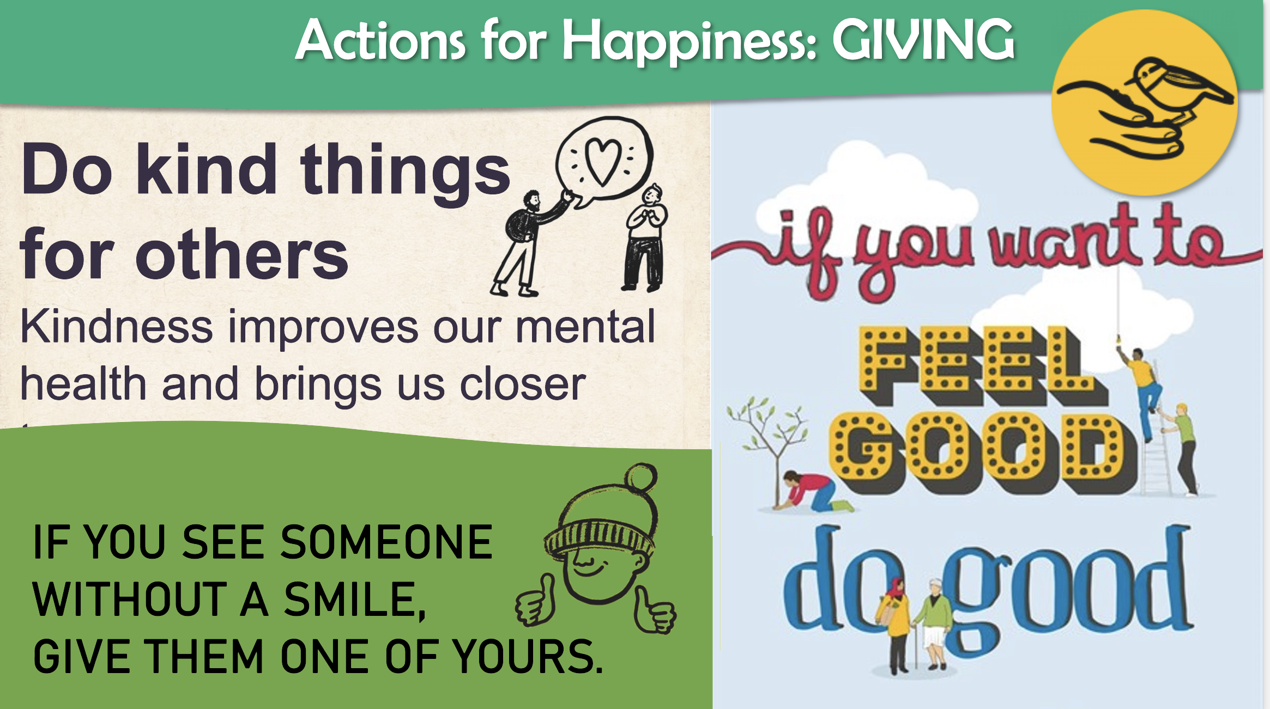

Slide 12
Let us pray:
Dear Lord,
you sent Jesus as the Lamb of God to take away the sins of the world.
Fill our hearts with your Spirit so we may follow him. Help us to listen to your call and trust in your plan. May we bring your light to others each day.
Amen.

Slide 13
In the name of the Father
And of the Son
And of the Holy Spirit
Amen

Slide 14
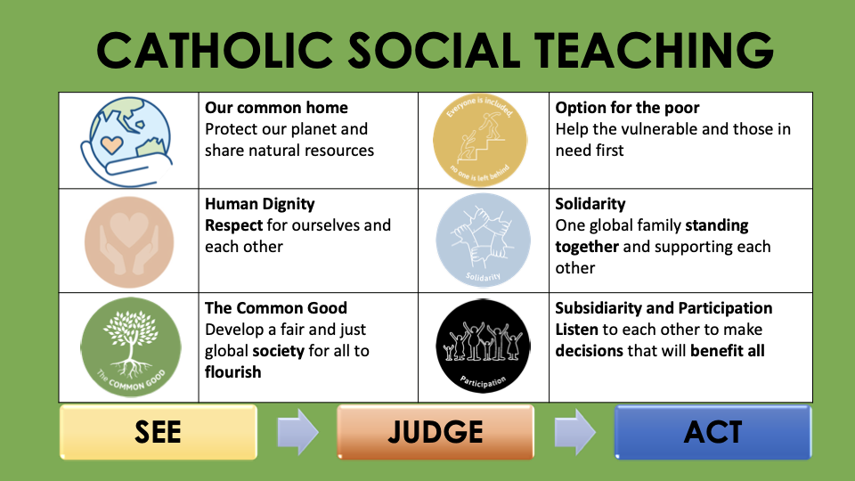

Slide 15










GREAT DREAM: 10 Keys to Happier Living
 | GIVING Do things for others |  | DIRECTION Have goals to look forward to
 | RELATING Connect with people |  | RESILIENCE Find ways to bounce back
 | EXERCISING Take care of your body |  | EMOTION Look for what’s good
 | AWARENESS Live life mindfully |  | ACCEPTANCE Be comfortable with who you are
 | TRYING OUT Keep learning new things |  | MEANING Be part of something bigger
BE KIND TO YOUR MIND

