Slide 1
M
PER MARIAM
Sacred Spaces PRAYER
Week commencing:
26th January

Slide 2


This half term at St Mary’s we are are growing to be curious about everything; and active in our engagement with the world, changing what we can for the better.
Curious and Active
PRACTICE your skills, REVISE your KNOWLEDGE and APPLY your learning to problems and in daily life

Slide 3
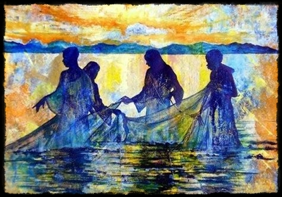
‘Follow me’
3rd Sunday in Ordinary Time

Slide 4

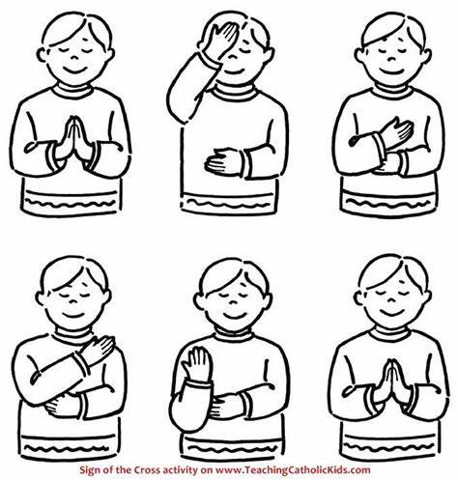
Let us remember that we are in the Holy Presence of God...
In the name of the Father
And of the Son
And of the Holy Spirit
Amen

Slide 5
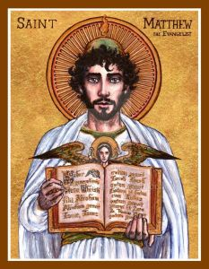
A reading
from
THE GOSPEL
According to
MATTHEW

Slide 6

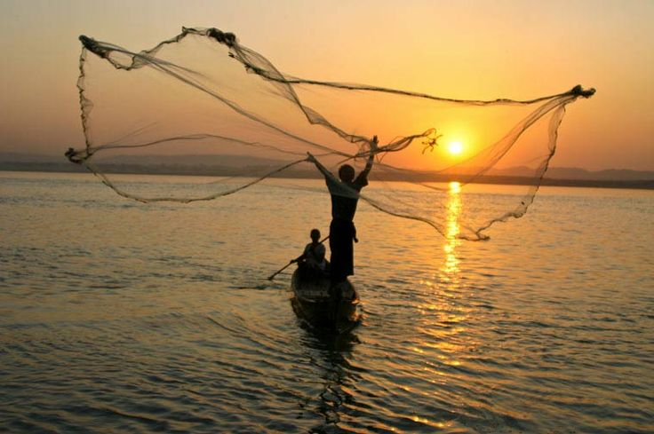
When Jesus heard that John had been put in prison, he went away to Galilee.
From that time Jesus began to preach his message: “Turn away from your sins, because the Kingdom of heaven is near!”
As Jesus walked along the shore of Lake Galilee, he saw two brothers who were fishermen, Simon (called Peter) and his brother Andrew, catching fish in the lake with a net. Jesus said to them, “Come with me, and I will teach you to catch people.” At once they left their nets and went with him.

Slide 7

He went on and saw two other brothers, James and John, the sons of Zebedee. They were in their boat with their father Zebedee, getting their nets ready. Jesus called them, and at once they left the boat and their father, and went with him.
Jesus went all over Galilee, teaching in the synagogues, preaching the Good News about the Kingdom, and healing people who had all kinds of disease and sickness. Matthew 4, 12-23

Slide 8

Scripture Sound Bite
“Come with me, and I will teach you to catch people.”
In this Gospel passage, Jesus begins preaching and calling his first followers. He brings light to Galilee, a place people often forgot. He tells them to turn their lives around and follow him. His message is simple but clear: the kingdom of heaven is close. Jesus invites ordinary fishermen to follow Him men who were not considered good enough by normal standards. They leave everything to follow Him because they see this as an incredible opportunity. This shows us that God does not choose people based on their skills or knowledge but calls them us just as we are.

Slide 9

Silent prayer
We take a moment to reflect in silence.
Following Jesus means trusting Him and being willing to change. The first disciples leave everything to be with Him.
How can you share the message of Jesus with the people around you?
We offer our intentions through Christ our Lord,
Amen

Slide 10

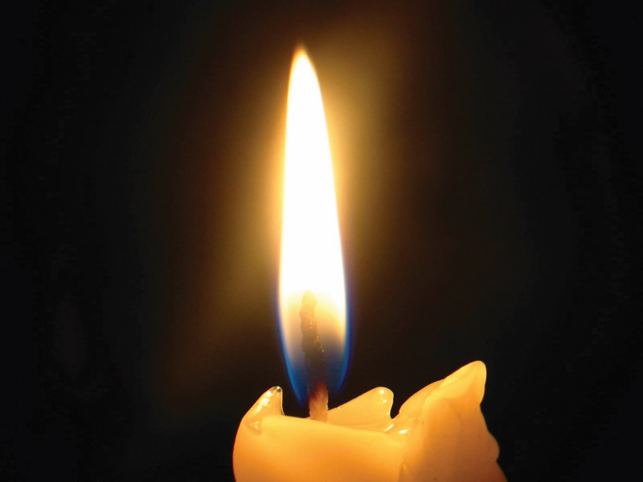

Holocaust Memorial Day 27th January 2026
Darfur in Sudan
Learn about what happened
How does it make you feel?
Take action
Your voice is amazing use it.

Slide 11
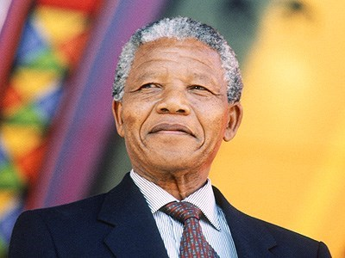
“
It is in your hands to make our world a better one for all
BRIGHT IDEA
“
Notes:
Gospel
John 14:15-21

Slide 12
Let us pray:
Dear Lord,
You are the light that leads us out of darkness. Help us to trust You when life is difficult.
Give us the courage to follow You, even when we feel unworthy.
Teach us to work together and build unity in our communities.
Guide us each day as we walk in faith.
Amen.

Slide 13
In the name of the Father
And of the Son
And of the Holy Spirit
Amen

Slide 14
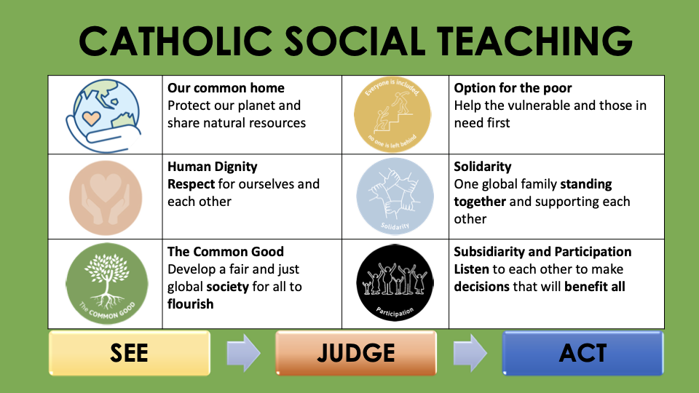

Slide 15










GREAT DREAM: 10 Keys to Happier Living
 | GIVING Do things for others |  | DIRECTION Have goals to look forward to
 | RELATING Connect with people |  | RESILIENCE Find ways to bounce back
 | EXERCISING Take care of your body |  | EMOTION Look for what’s good
 | AWARENESS Live life mindfully |  | ACCEPTANCE Be comfortable with who you are
 | TRYING OUT Keep learning new things |  | MEANING Be part of something bigger
BE KIND TO YOUR MIND

