Slide 1
M
PER MARIAM
Sacred Spaces PRAYER
Week commencing:
2nd February

Slide 2
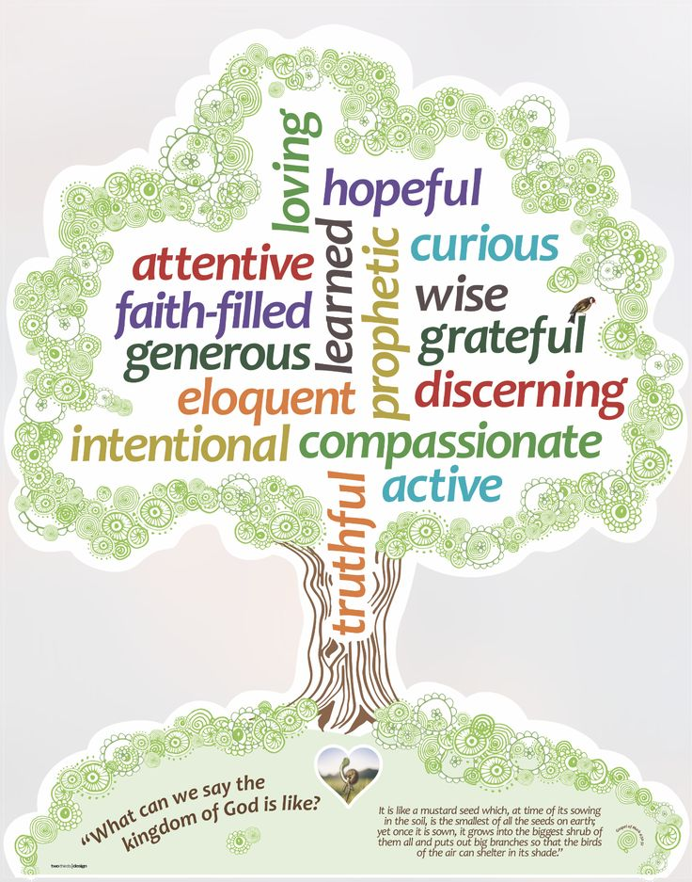

This half term at St Mary’s we are are growing to be curious about everything; and active in our engagement with the world, changing what we can for the better.
Curious and Active
PRACTICE your skills, REVISE your KNOWLEDGE and APPLY your learning to problems and in daily life

Slide 3
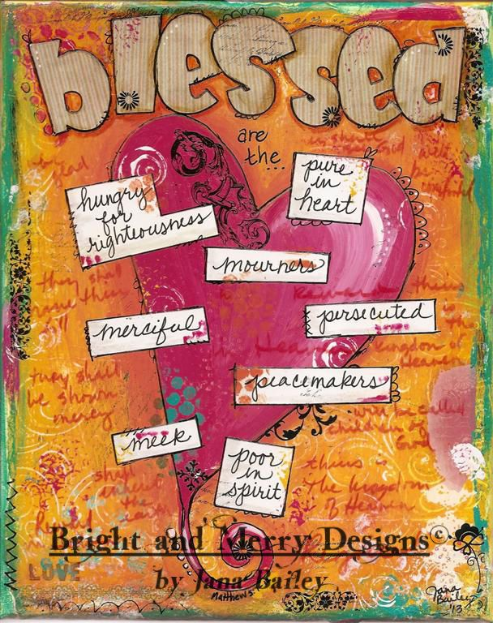
‘Blessed are the pure of heart, for they will see God.’
4th Sunday in Ordinary Time

Slide 4

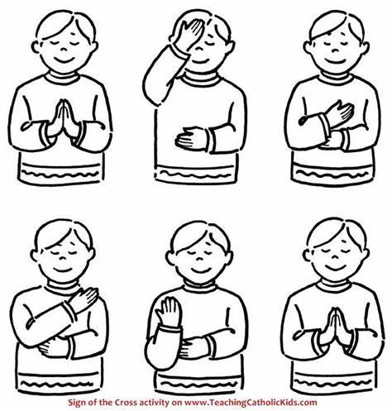
Let us remember that we are in the Holy Presence of God...
In the name of the Father
And of the Son
And of the Holy Spirit
Amen

Slide 5
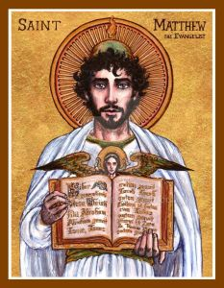
A reading
from
THE GOSPEL
According to
MATTHEW

Slide 6

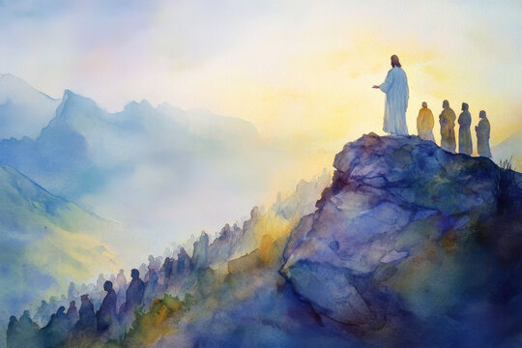
When Jesus saw the crowds, he went up the mountain, and after he had sat down, his disciples came to him.
He began to teach them, saying:
“Blessed are the poor in spirit, for theirs is the kingdom of heaven.
Blessed are they who mourn, for they will be comforted.
Blessed are the meek, for they will inherit the land.
Blessed are they who hunger and thirst for righteousness, for they will be satisfied.

Slide 7
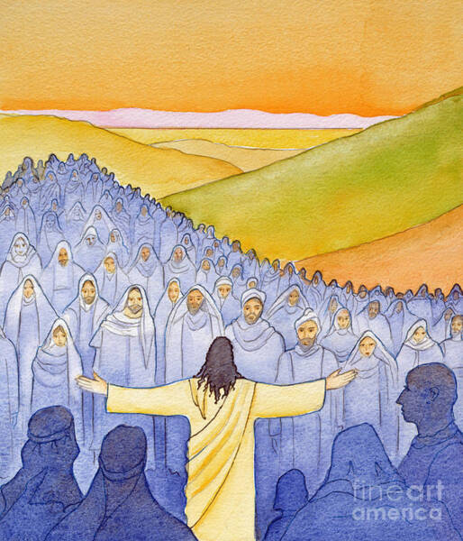
Blessed are the merciful, for they will be shown mercy.
Blessed are the pure of heart, for they will see God.
Blessed are the peacemakers, for they will be called children of God.
Blessed are they who are persecuted for the sake of righteousness, for theirs is the kingdom of heaven.
Blessed are you when they insult you and persecute you and utter every kind of evil against you falsely because of me.
Rejoice and be glad, for your reward will be great in heaven.”
Matthew 5:1-12

Slide 8

Scripture Sound Bite
‘Blessed are the pure of heart, for they will see God.’
The Beatitudes teach that real happiness comes from humility, mercy, and seeking holiness. Being poor in spirit means letting go of pride and trusting in God. Those who feel sorrow for their sins open themselves to God’s forgiveness. Jesus says the Kingdom of God is not in the future but already here for those who live with openness and surrender.
True strength comes from humility, not power.
Instead of chasing approval or power, Jesus invites people to live simply and trust in God’s ways. This is the path to real peace and joy.

Slide 9
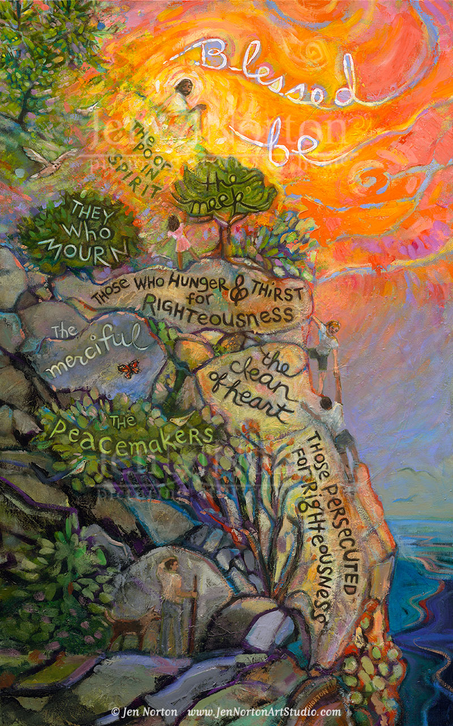
Silent prayer
We take a moment to reflect in silence.
God blesses those who live humbly, seek justice, and trust in Him. Success in the world is not what matters most.
How can you be more merciful to others?
How can you practice humility in a world that values self-promotion?
We offer our intentions through Christ our Lord,
Amen

Slide 10
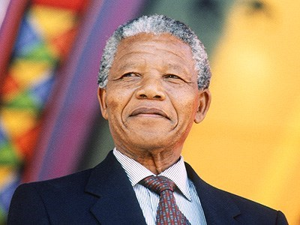
“
It is in your hands to make our world a better one for all
BRIGHT IDEA
“
Notes:
Gospel
John 14:15-21

Slide 11
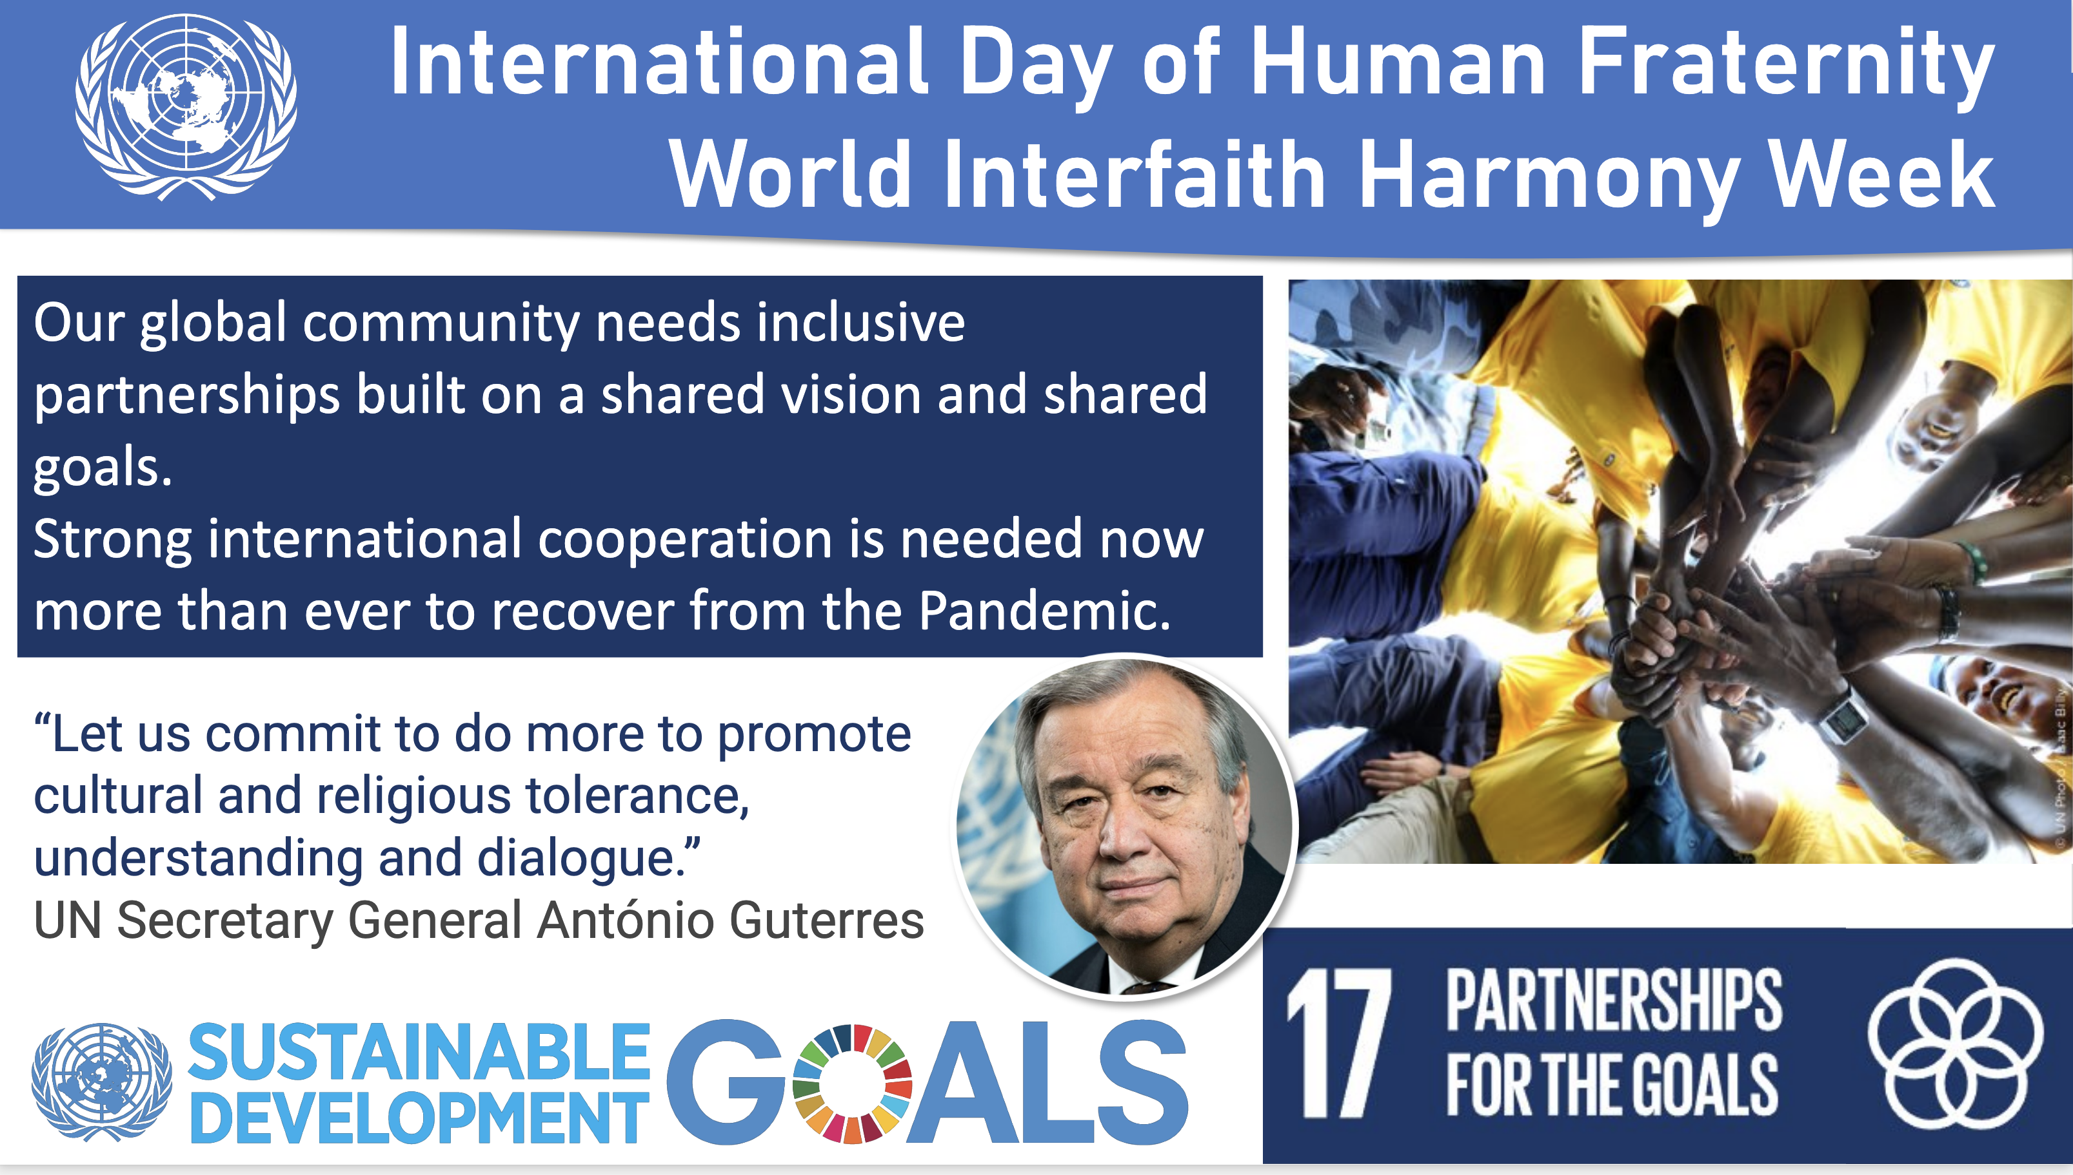

Slide 12

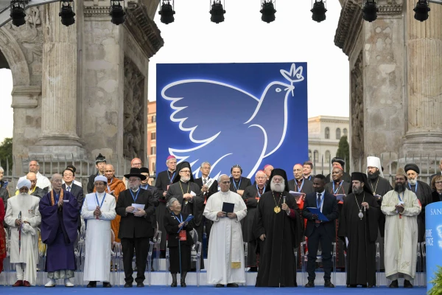
“the growing commitment to dialogue and fraternity, mutual respect and freedom of conscience is a solid basis for building bridges between our communities.”
Pope Leo

Slide 13
Let us pray:
Dear Lord,
Help us to follow the path You have set before us.
Teach us to trust in You, seek justice, and live humbly.
Give us the strength to show mercy and work for peace. May we always remember that true happiness comes from walking in Your ways.
Amen.

Slide 14
In the name of the Father
And of the Son
And of the Holy Spirit
Amen

Slide 15
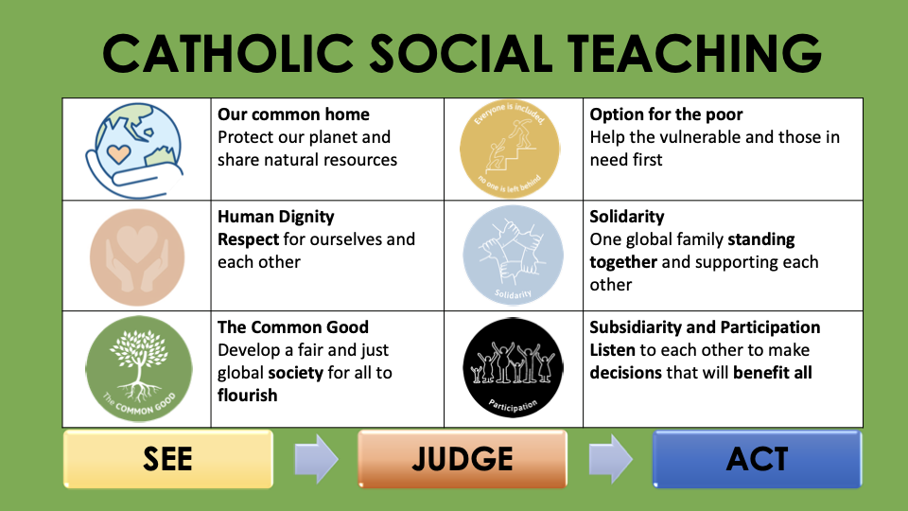

Slide 16










GREAT DREAM: 10 Keys to Happier Living
 | GIVING Do things for others |  | DIRECTION Have goals to look forward to
 | RELATING Connect with people |  | RESILIENCE Find ways to bounce back
 | EXERCISING Take care of your body |  | EMOTION Look for what’s good
 | AWARENESS Live life mindfully |  | ACCEPTANCE Be comfortable with who you are
 | TRYING OUT Keep learning new things |  | MEANING Be part of something bigger
BE KIND TO YOUR MIND

