Slide 1
M
PER MARIAM
Sacred Spaces PRAYER
Week commencing:
9th February

Slide 2
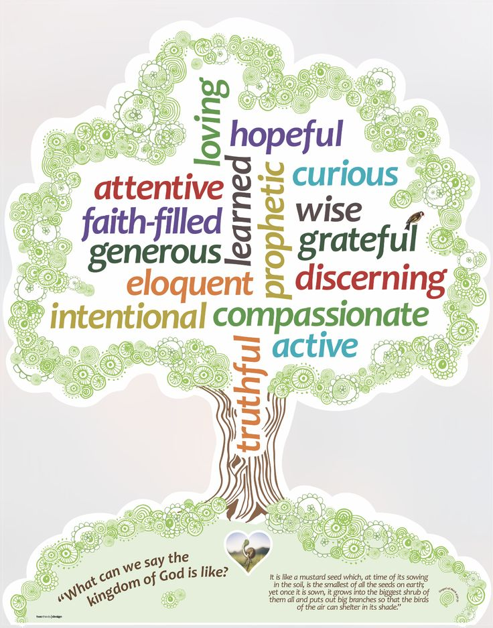

This half term at St Mary’s we are are growing to be curious about everything; and active in our engagement with the world, changing what we can for the better.
Curious and Active
PRACTICE your skills, REVISE your KNOWLEDGE and APPLY your learning to problems and in daily life

Slide 3

‘You are the salt of the earth.’
5th Sunday in Ordinary Time

Slide 4

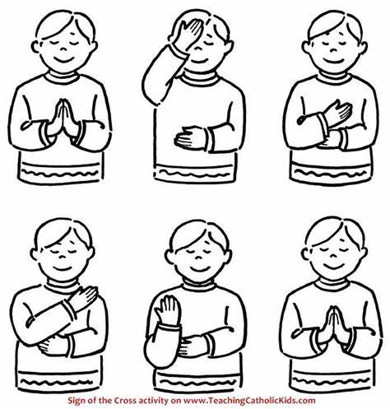
Let us remember that we are in the Holy Presence of God...
In the name of the Father
And of the Son
And of the Holy Spirit
Amen

Slide 5

A reading
from
THE GOSPEL
According to
MATTHEW

Slide 6

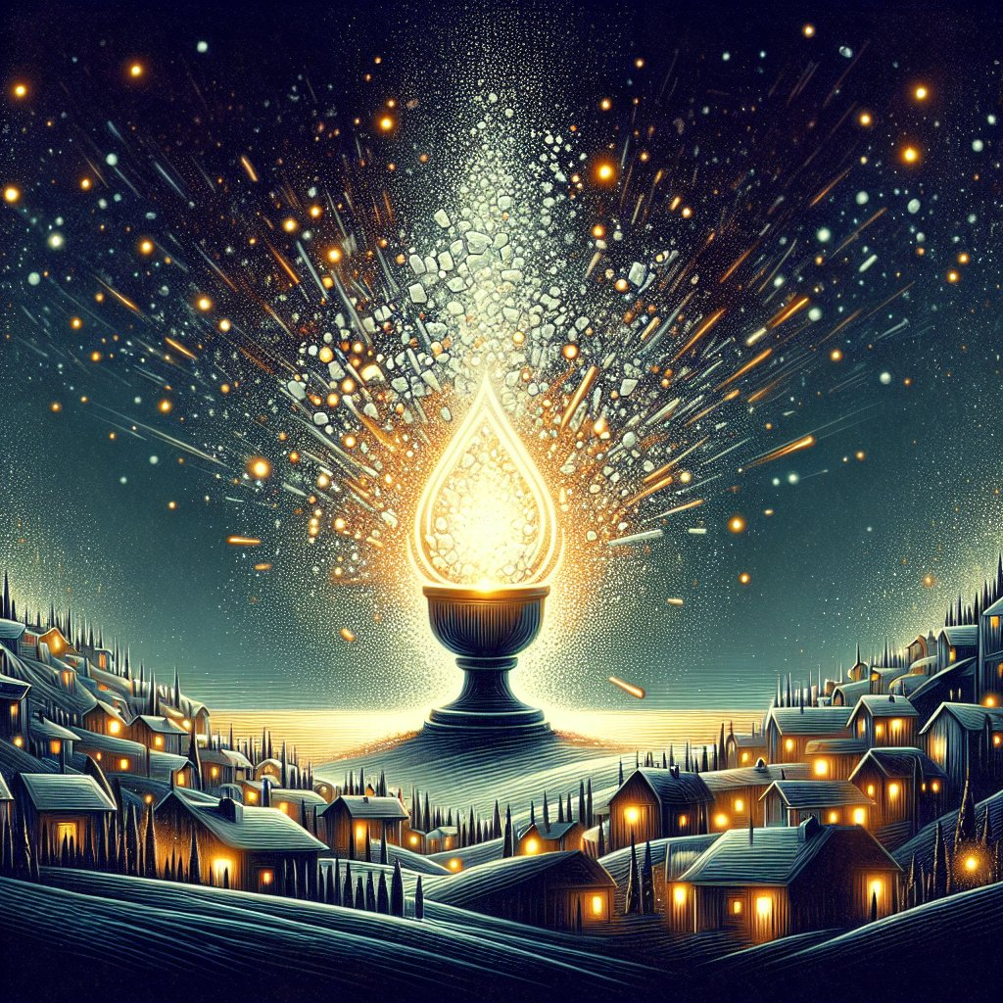
Jesus said to his disciples: “You are the salt of the earth. But if salt loses its taste, with what can it be seasoned? It is no longer good for anything but to be thrown out and trampled underfoot.
You are the light of the world. A city set on a mountain cannot be hidden. Nor do they light a lamp and then put it under a bushel basket; it is set on a lampstand, where it gives light to all in the house.
Just so, your light must shine before others, that they may see your good deeds and glorify your heavenly Father.”

Slide 7

Scripture Sound Bite
‘You are the salt of the earth’
Jesus compares his followers to salt, light, and a city on a hill. These things do not exist for themselves but for the good of others. Salt preserves and enhances, light reveals and guides, and a city on a hill helps people find their way. In the same way, faith should not be just personal. It should influence and improve the world. Faith is not just about believing the right things. It is about putting those beliefs into action through good works and love.

Slide 8
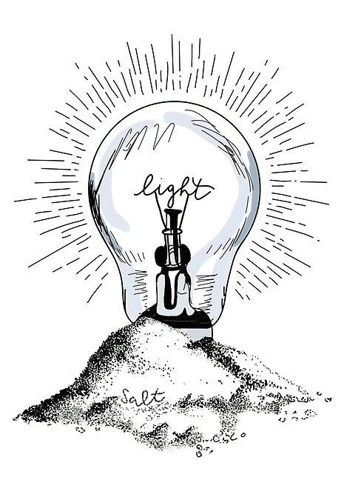
Silent prayer
We take a moment to reflect in silence.
Living as salt and light is not always easy, but we are reminded that our actions can make a difference. Even small acts of kindness can bring hope to others. When people trust in God and live with love, they help spread His message. Faith is not just about words, it is about how people live every day.
How can you bring light to someone who is struggling?
We offer our intentions through Christ our Lord,
Amen

Slide 9

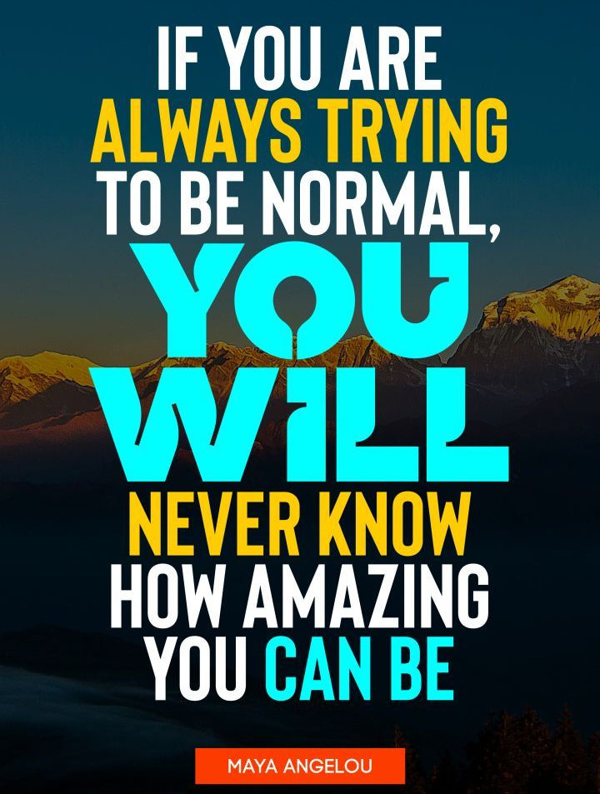


We often need others to help us to believe in ourselves, to keep going, and to try doing things a bit differently. Even when we have experienced really difficult challenges in our lives, with the right support, we can continue to grow and even flourish.

Slide 10





A FEW IDEAS FROM PLACE2BE:
Be authentic.
Rather than trying to "fit in", focus on being your true self. Belonging comes from being accepted for who you are.
Practice self-compassion.
When you make a mistake or feel like you've failed, be kind to yourself. This helps build resilience and reminds you that your worth isn't about being perfect.
Follow your interests.
Join clubs or groups you enjoy. Whether it's sport, video games, music, or art, shared interests is a great way to connect with others.
Embrace your uniqueness.
Think about your strengths and qualities. Don't be afraid to be different. Feeling comfortable with what makes you unique is key to building self-confidence.
Listen to yourself.
Pay attention to your feelings and try to understand what you need. For example, if you're feeling lonely, listen to this and think about what might help you feel more connected.
Talk with and be with trusted people, to support you.
This can help you feel a greater sense of belonging and support you when you don’t feel this way.

Slide 11
Let us pray:
Dear Lord,
Help us to be salt and light in the world. Give us the courage to act with love and kindness. Help us to trust in You, even when we feel weak. May our actions bring hope to others and lead them closer to You.
Amen.

Slide 12
In the name of the Father
And of the Son
And of the Holy Spirit
Amen

Slide 13
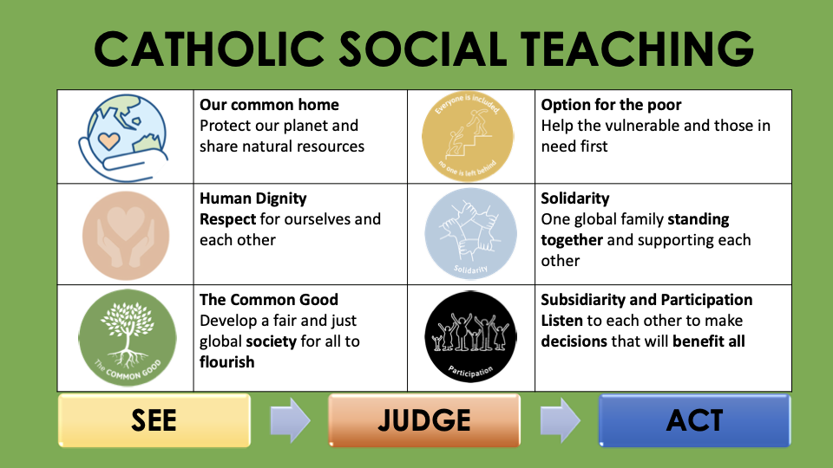

Slide 14










GREAT DREAM: 10 Keys to Happier Living
 | GIVING Do things for others |  | DIRECTION Have goals to look forward to
 | RELATING Connect with people |  | RESILIENCE Find ways to bounce back
 | EXERCISING Take care of your body |  | EMOTION Look for what’s good
 | AWARENESS Live life mindfully |  | ACCEPTANCE Be comfortable with who you are
 | TRYING OUT Keep learning new things |  | MEANING Be part of something bigger
BE KIND TO YOUR MIND

