Slide 1
M
PER MARIAM
Sacred Spaces PRAYER
Week commencing: 23rd February
1st Sunday of Lent

Slide 2
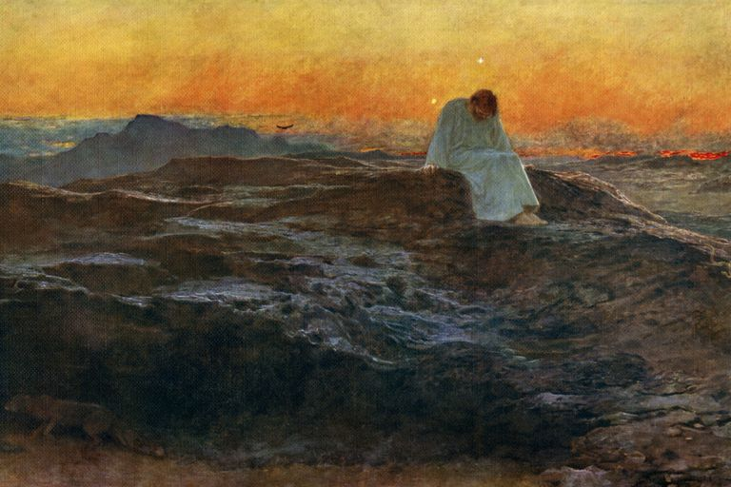
Avoiding Temptation
1st Sunday of Lent

Slide 3


This half term at St Mary’s we are growing to be Intentional in the way we live and use the resources of the earth, guided by conscience; and prophetic in the example we set to others.
Intentional and Prophetic
PRACTICE your skills, REVISE your KNOWLEDGE and APPLY your learning to problems and in daily life

Slide 4

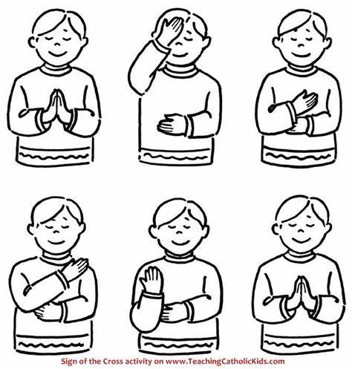
Let us remember that we are in the Holy Presence of God...
In the name of the Father
And of the Son
And of the Holy Spirit
Amen

Slide 5
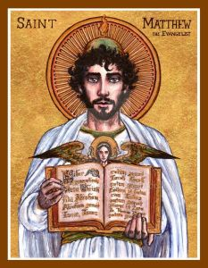
A reading
from
THE GOSPEL
According to
MATTHEW

Slide 6
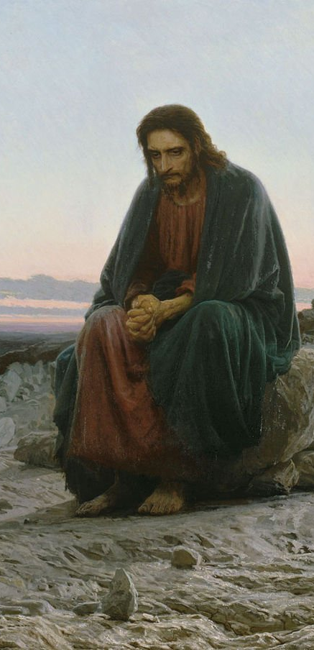
Then the Spirit led Jesus into the desert to be tempted by the Devil. After spending forty days and nights without food, Jesus was hungry. Then the Devil came to him and said, “If you are God's Son, order these stones to turn into bread.”
But Jesus answered, “The scripture says, ‘Human beings cannot live on bread alone, but need every word that God speaks.’”
Then the Devil took Jesus to Jerusalem, the Holy City, set him on the highest point of the Temple, and said to him, “If you are God's Son, throw yourself down, for the scripture says,
‘God will give orders to his angels about you; they will hold you up with their hands, so that not even your feet will be hurt on the stones.’”

Slide 7
Jesus answered, “But the scripture also says, ‘Do not put the Lord your God to the test.’”
Then the Devil took Jesus to a very high mountain and showed him all the kingdoms of the world in all their greatness. “All this I will give you,” the Devil said, “if you kneel down and worship me.”
Then Jesus answered, “Go away, Satan! The scripture says, ‘Worship the Lord your God and serve only him!’”
Then the Devil left Jesus; and angels came and helped him.

Slide 8

The Gospel of the Lord
ALL: Praise to you Lord Jesus Christ.

Slide 9

Scripture Sound Bite
Man does not live on bread alone
Matthew 4; 1-11
The forty days of Lent represent Jesus’ forty days in the desert.
He went there to be away from distractions. This helped him to find the right direction for his life ahead.
During Lent we take time to reflect on where we on the journey of our life.
What do you need to sustain you on the road ahead?
Notes:
Everyone is tempted. It is as much part of being a human as eating and sleeping. Resisting temptation can make us stronger and better people.
Just as PE develops our physical wellbeing, resisting temptation develops the spiritual side of our personality.
Lent prepares us for Easter, as Advent prepares us for Christmas.
Lent is a time for a change of heart – a time for a fresh and closer look at ourselves and the way we live our lives.
What needs to be done? We can change for the better.

Slide 10
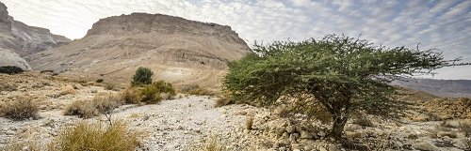

This is what the Judean Desert looks like today.
Jesus knew that he had some life changing decisions to make. By retreating into the Judean Desert he was able to clear his mind, identify his priorities and find the inspiration to face the challenges ahead.

Slide 11
Reflection
Do you ever feel the need to unplug yourself from the rest of the world?
We are naturally social beings and like to feel connected to our family, friendship and work groups.
However, there are times when we need to have some time and space to ourselves.
Jesus knew that he had some life changing decisions to make. By retreating into the desert he was able to clear his mind, identify his priorities and find the inspiration to face the challenges ahead.
He returns to his community with a renewed sense of what he has to do next.
Notes:
Prayer is something that can be really hard to understand, let alone do. Sometimes it comes naturally but usually it's something we forget about and don't find time for. Prayer is simply a chat with God and you don't need to use the right words, you don't even need to use any words, you just need to put aside some time to be in God's presence. It's amazing what a difference a few minutes a day can make - try it for yourself this week!

Slide 12
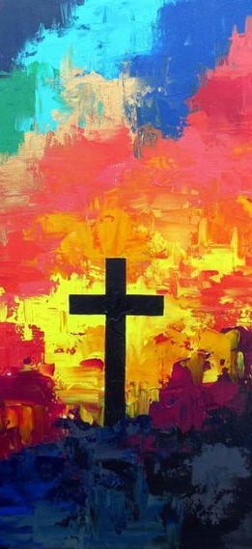
Our Journey through Lent
The number 40 is often used in the Bible as a sign of completeness, leading up to a great change. Noah and his family survived a flood that lasted 40 days and nights. Jesus spent 40 days and nights in the desert.
Lent lasts for 40 days and 40 nights (excluding Sundays).
The colour that we use in Lent is purple as it is a sign of repentance and anticipation.
During Lent we are invited to take the time to review our lives and identify the changes that we need to make.
Prayer helps us to put aside some time to be in God’s presence and gain what we need for the next stage of our lives.

Slide 13

Silent prayer
As we think about Jesus’ words, we take a moment to reflect in silence.
What aspect of your life do you need to reduce?
How can you be kinder to yourself?
We offer our intentions through Christ our Lord,
Amen

Slide 14


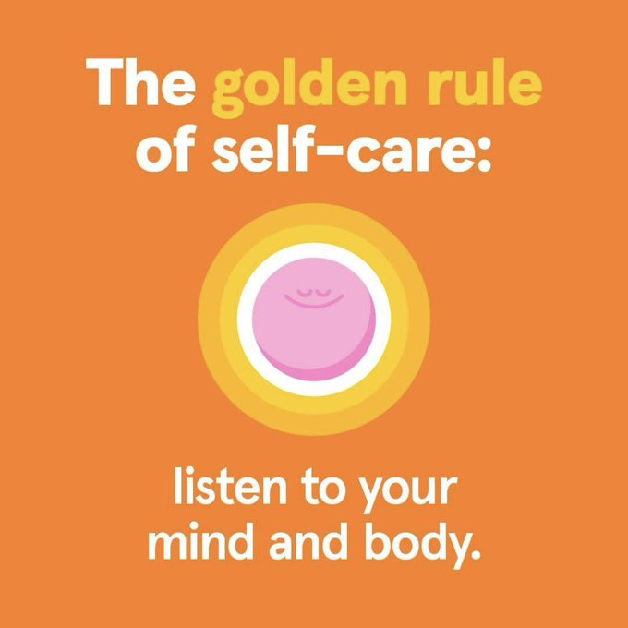


Actions for Happiness: Exercise
Invest in Rest
Take time each day to stop unplug your life.
Find an activity or a
space that enables you
to calm your thoughts and feelings.
Take 5 mins to sit still and breathe.

Slide 15
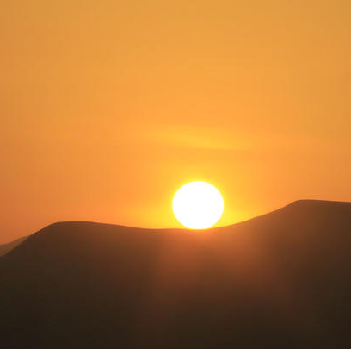
Prayer
Lord, help us to follow Jesus’ example of faith and obedience. Give us strength to resist temptation and trust in your love. Guide us through our struggles and remind us that we are never alone. May we grow closer to you through prayer, fasting, and almsgiving.
Amen

Slide 16
In the name of the Father
And of the Son
And of the Holy Spirit
Amen

Slide 17
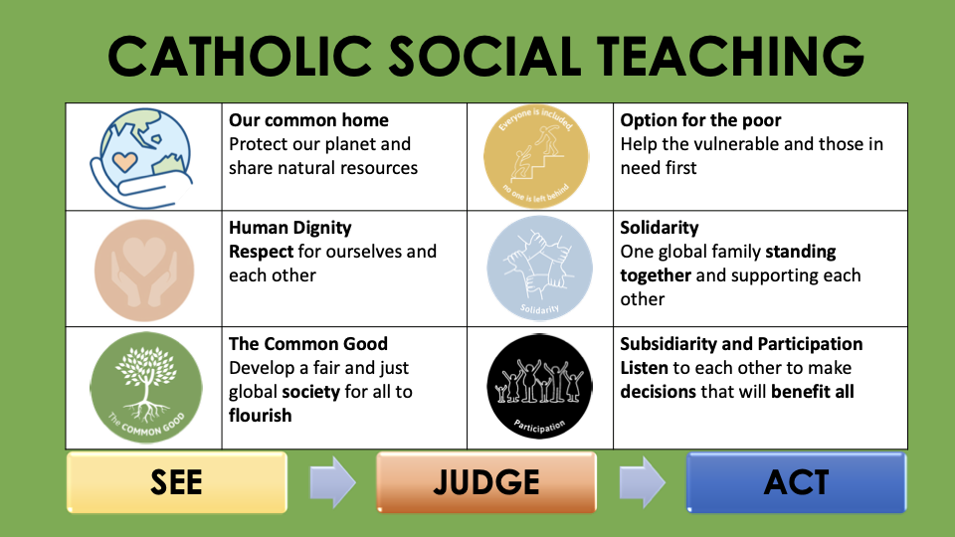

Slide 18









GREAT DREAM: 10 Keys to Happier Living
 | GIVING Do things for others |  | DIRECTION Have goals to look forward to
 | RELATING Connect with people |  | RESILIENCE Find ways to bounce back
 | EXERCISING Take care of your body |  | EMOTION Look for what’s good
 | AWARENESS Live life mindfully |  | ACCEPTANCE Be comfortable with who you are
 | TRYING OUT Keep learning new things |  | MEANING Be part of something bigger
BE KIND TO YOUR MIND

