Slide 1
M
PER MARIAM
Sacred Spaces PRAYER
Week commencing: 2nd March
2nd Sunday of Lent

Slide 2
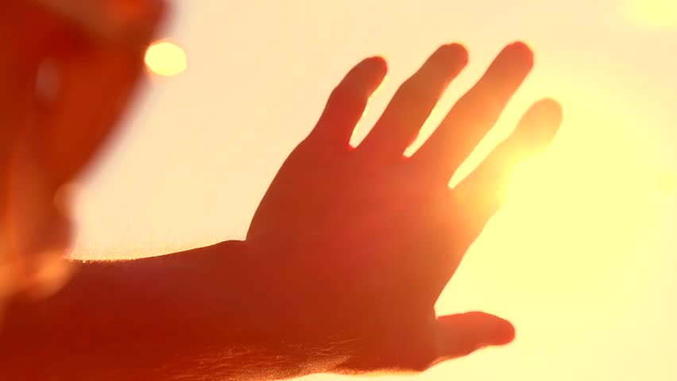
Shine
like
the sun

Slide 3


This half term at St Mary’s we are growing to be Intentional in the way we live and use the resources of the earth, guided by conscience; and prophetic in the example we set to others.
Intentional and Prophetic
PRACTICE your skills, REVISE your KNOWLEDGE and APPLY your learning to problems and in daily life

Slide 4

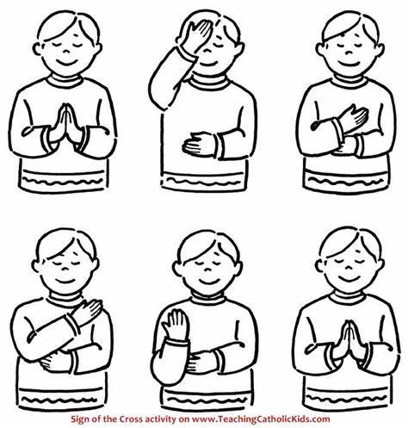
Let us remember that we are in the Holy Presence of God...
In the name of the Father
And of the Son
And of the Holy Spirit
Amen

Slide 5
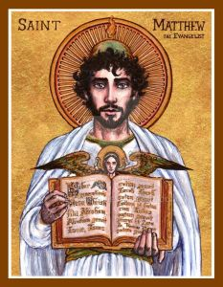
A reading
from
THE GOSPEL
According to
MATTHEW

Slide 6
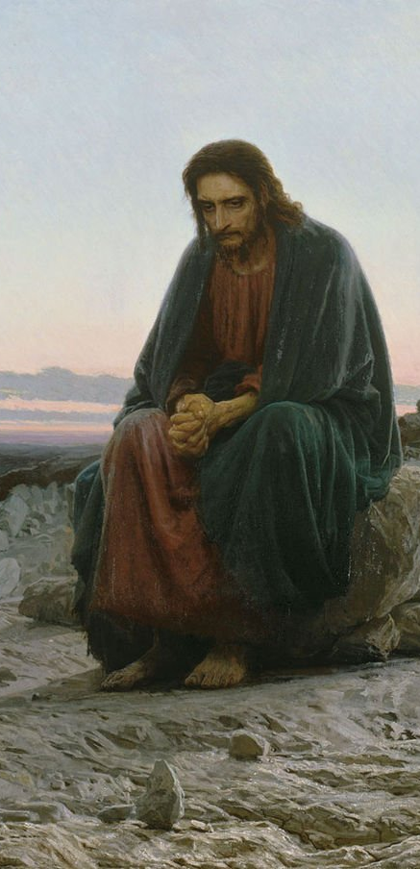

Jesus took with him Peter and James and his brother John and led them up a high mountain where they could be alone. There in their presence he was transfigured: his face shone like the sun and his clothes became as white as the light. Suddenly Moses and Elijah appeared to them; they were talking with him.
Then Peter spoke to Jesus. ‘Lord,’ he said ‘it is wonderful for us to be here; if you wish, I will make three tents here, one for you, one for Moses and one for Elijah.’

Slide 7
He was still speaking when suddenly a bright cloud covered them with shadow, and from the cloud there came a voice which said, ‘This is my Son, the Beloved; he enjoys my favour. Listen to him.’ When they heard this the disciples fell on their faces overcome with fear. But Jesus came up and touched them. ‘Stand up,’ he said ‘do not be afraid.’ And when they raised their eyes they saw no one but only Jesus.
As they came down from the mountain Jesus gave them this order, ‘Tell no one about the vision until the Son of Man has risen from the dead.’
Matthew 17:1-9

Slide 8

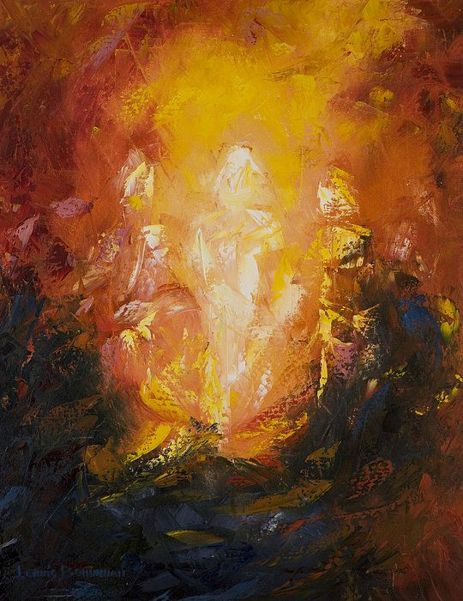
Scripture Sound Bite
‘His face shone like the sun’ Matthew 17: 1-9
This reading reveals the deeply profound affect that Jesus had on other lives.
What is truly remarkable is that Jesus’ example shines on 2,000 years later.
During Lent, we reflect on key people that have a positive influence in our lives. Who is it for you?

Slide 9

Wise Words
_{“You change}
_{Your life}
_{By changing}
_{Your heart.”}
_{Max Lucado}

Slide 10

Silent prayer
As we think about Jesus’ words, we take a moment to reflect in silence.
Lent is a time to reflect on how we trust God in our lives. Are you holding on to fears or doubts that keep you from following God?
Are you willing to step forward even though the path is not clear?
We offer our intentions through Christ our Lord,
Amen

Slide 11

Happiness Hack
Identify a change you can make
in your life for the better.
Be aware of how the
change makes you feel.
Reflect on how you can
motivate yourself
to keep the change going.

Slide 12
Prayer
We thank Jesus for giving his life as a shining example to show us the way.
Give us the confidence to make positive changes in our own lives. May this Lenten journey bring us closer to you.
Amen

Slide 13
In the name of the Father
And of the Son
And of the Holy Spirit
Amen

Slide 14
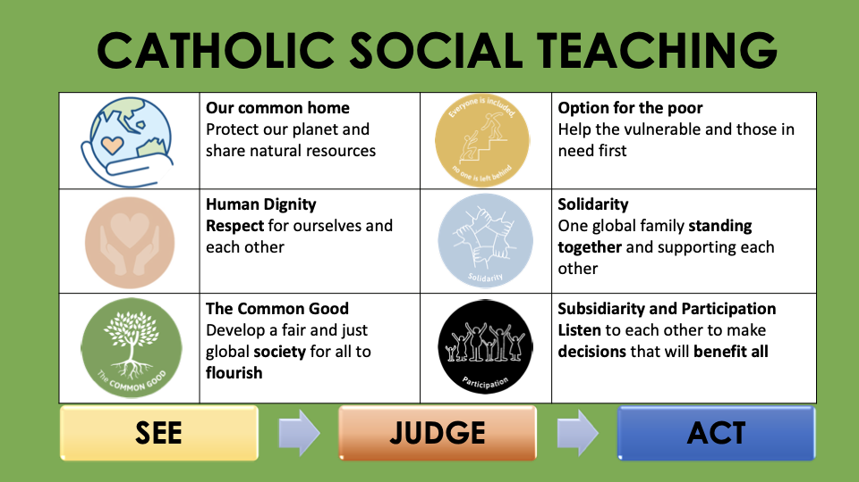

Slide 15










GREAT DREAM: 10 Keys to Happier Living
 | GIVING Do things for others |  | DIRECTION Have goals to look forward to
 | RELATING Connect with people |  | RESILIENCE Find ways to bounce back
 | EXERCISING Take care of your body |  | EMOTION Look for what’s good
 | AWARENESS Live life mindfully |  | ACCEPTANCE Be comfortable with who you are
 | TRYING OUT Keep learning new things |  | MEANING Be part of something bigger
BE KIND TO YOUR MIND

